Slide 1


Counting Defiers: A Design-Based Model of an Experiment Can Reveal
Evidence Beyond the Average Effect
Neil Christy and Amanda Kowalski
University of Michigan
Thanks to Jann Spiess for extensive regular feedback and to Charles Manski, Toru Kitagawa, Aleksey Tetenov, and Donald Rubin for encouraging us to use statistical decision theory and teaching us about it. Thanks also to Guido Imbens. April 2026
Paper on arXiv: https://arxiv.org/abs/2412.16352

Slide 2

You are a doctor at a rural health clinic, and you have six patients who are smokers.
Notes:
Photo by Atlantic Ambience: https://www.pexels.com/photo/brown-wooden-house-surrounded-by-green-trees-1172064/

Slide 3

You hope that payments contingent on quitting could induce some patients to quit.
Notes:
Photo by Hanna Pad: https://www.pexels.com/photo/money-bills-cash-currency-6801644/

Slide 4

You design an experiment that assigns exactly three of your six patients to intervention and run it.
Notes:
Photo by Zhuo Cheng on Unsplash: https://unsplash.com/photos/white-dice-on-brown-wooden-table-2WE_V_dh0B0

Slide 5

Two take up quitting in intervention and one takes up quitting in control.
Notes:
Photo by Mike Jones: https://www.pexels.com/photo/photo-of-a-person-s-hand-holding-a-red-strawberry-8804982/

Slide 6

It appears the payments work on average!
Notes:
Photo by Aslı Yaren Peker on Unsplash: https://unsplash.com/photos/a-large-field-of-red-and-white-tulips-KWR7tJqvFgU

Slide 7

But psychologists have shown that payments may crowd out intrinsic motivations.
Notes:
Photo by Milad Fakurian on Unsplash: https://unsplash.com/photos/blue-and-green-peacock-feather-58Z17lnVS4U

Slide 8

It seems plausible that some patients would have quit but did not because of the payments.
Notes:
Photo by Jim Wilson on Unsplash: https://unsplash.com/photos/curve-road-signage-5QvsD0AaXPk

Slide 9

Have you broken your oath to “do no harm”? If so, for how many patients?
Notes:
Photo by Etactics Inc on Unsplash: https://unsplash.com/photos/a-pair-of-black-headphones-g3PsF4_y7ZY

Slide 10

How many patients would have quit regardless? (You would rather not waste payments on them.)
Notes:
Photo by Towfiqu barbhuiya: https://www.pexels.com/photo/a-crumpled-papers-inside-the-trash-bin-13156208/

Slide 11

How many patients would smoke regardless? (You would not waste payments on them, but you would feel bad that your intervention could not reach them.)
Notes:
Photo by MART PRODUCTION: https://www.pexels.com/photo/fingers-holding-lighted-cigarette-stick-7277895/

Slide 12

Can you estimate how many patients of each type are in your sample?*
*You know you can obtain Fréchet bounds on the share of each type in the population, but you want to estimate the number of each type in your fixed sample of six patients.
Notes:
Photo by cottonbro studio: https://www.pexels.com/photo/pink-doughnut-on-white-textile-4686960/

Slide 13
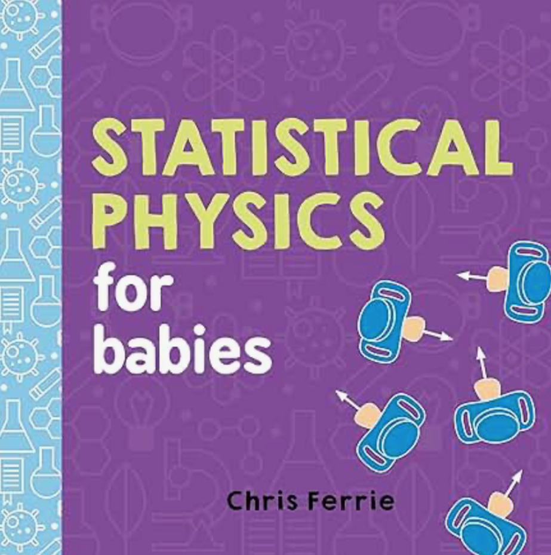
Yes! We will show that
A Design-Based Model of an Experiment Can Reveal Evidence Beyond the Average Effect
Pictured book and style inspiration for visualizations: Ferrie 2016

Slide 14
This is your randomized experiment.

Slide 15

It has an intervention on the left,
Intervention

Slide 16
It has an intervention on the left, and a control on the right.
Intervention
Control

Slide 17
There are six people,
Intervention
Control

Slide 18
You observe takeup and no takeup in intervention.
There are six people, and three are randomly assigned intervention.
Data
Intervention
Control
Notes:
The left of the rectangle reveals the left of the circle. (The experiment reveals the potential outcome in intervention for the people assigned intervention.) Orange is Amanda's favorite color, which is why it represents the good outcome – takeup of the desired health behavior.
In your experiment, two patients take up quitting in intervention.

Slide 19
But the potential outcome in control remains unobserved (Rubin 1974).
Data
Intervention
Control

Slide 20
For the people in control, you observe takeup and no takeup in control.
Data
Intervention
Control
Notes:
The right of the rectangle reveals the right of the circle. (The experiment reveals the potential outcome in control for the people assigned control.)
In your experiment, one patient takes up quitting in control.

Slide 21
But the potential outcome in intervention remains unobserved.
Data
Intervention
Control

Slide 22
What is your best guess of the unobserved potential outcomes that generated the data?
What is the joint distribution of potential outcomes?
?
Data
Intervention
Control
?
?
?
?
?
Notes:
For each of the grey areas, you can choose orange or white.

Slide 23
Here is one possible answer.
Always Taker
Data
Intervention
Control
Always Taker
Complier
Complier
Never Taker
Never Taker
Notes:
You get this answer by filling in the grey areas with orange and white.

Slide 24
This answer satisfies monotonicity (Imbens and Angrist 1994).
Always Taker
?
Data
Intervention
Control
Always Taker
?
Complier
?
Complier
?
Never Taker
?
Never Taker
?
Notes:
To apply monotonicity to the finite sample of people in our experiment, we assume away defiers.
One of the three people in intervention did not take up, so that person must be a never taker. Assuming balance between intervention and control since the full experiment has six people, there must be two never takers in the experiment.
Similarly, one of the three people in control did take up, so that person must be an always taker. Assuming balance between intervention and control, since the full experiment has six people, there must be two always takers in the experiment.
The remaining two people must be compliers.

Slide 25
Here is another answer with a defier (Angrist, Imbens, and Rubin 1996).
Always Taker
Data
Intervention
Control
Complier
Complier
Complier
Defier
Never Taker
Notes:
It has one defier--the midpoint number of defiers within the estimated Fréchet bounds.
The experiment gives the estimated marginal distributions of potential outcomes: two out of three people take up in intervention and one out of three people take up in control.
Therefore, answers that are within the Fréchet bounds have two of three people take up in intervention (the left half of four of the six circles are orange), and one of three people take up in control (the right half of two of the six circles are white.)

Slide 26
Here is another answer with two defiers.
Complier
Data
Intervention
Control
Complier
Complier
Complier
Defier
Defier
Notes:
This one has two defiers, the maximum number of defiers within the Fréchet bounds.

Slide 27
This is the optimal answer!
Complier
?
Data
Intervention
Control
Complier
?
Complier
?
Complier
?
Defier
?
Defier
?

Slide 28
Really? Why?
Complier
?
Data
Intervention
Control
Complier
?
Complier
?
Complier
?
Defier
?
Defier
?

Slide 29
We answer with our proposed design-based maximum likelihood decision rule.
Complier
?
Data
Intervention
Control
Complier
?
Complier
?
Complier
?
Defier
?
Defier
?

Slide 30

Here are the data again.
Data
Intervention
Control

Slide 31
We can randomize three of the six people into intervention with 20 possible assignments.
Data
Intervention
Control
Joint Distribution of Potential Outcomes
20 Possible Randomized Assignments in Sample of 6 with 3 in Intervention
Always Taker
Always Taker
Complier
Complier
Never Taker
Never Taker
Notes:
Let's start with the joint distribution of potential outcomes that satisfies monotonicity.
There are 20 ways to randomize 6 people into an experiment with 3 in intervention and 3 in control. We enumerate each of the 20. (We start with the first three in intervention and the last three in control, and we end with the last three in intervention and the first three in control.)
Note that with a candidate joint distribution of potential outcomes, our model tells us exactly what we will see in the data. In some sense, we have built a structural model of a randomized experiment, and we can draw simulations from it to generate the data. Instead of drawing simulations randomly as you would do in a Monte Carlo, we do an exact simulation as in Fisher's exact test. The randomization process guarantees that each randomized assignment has the same probability.
Look at the possible realizations of the data. Not all of them are the same as the data we observe at the top.

Slide 32
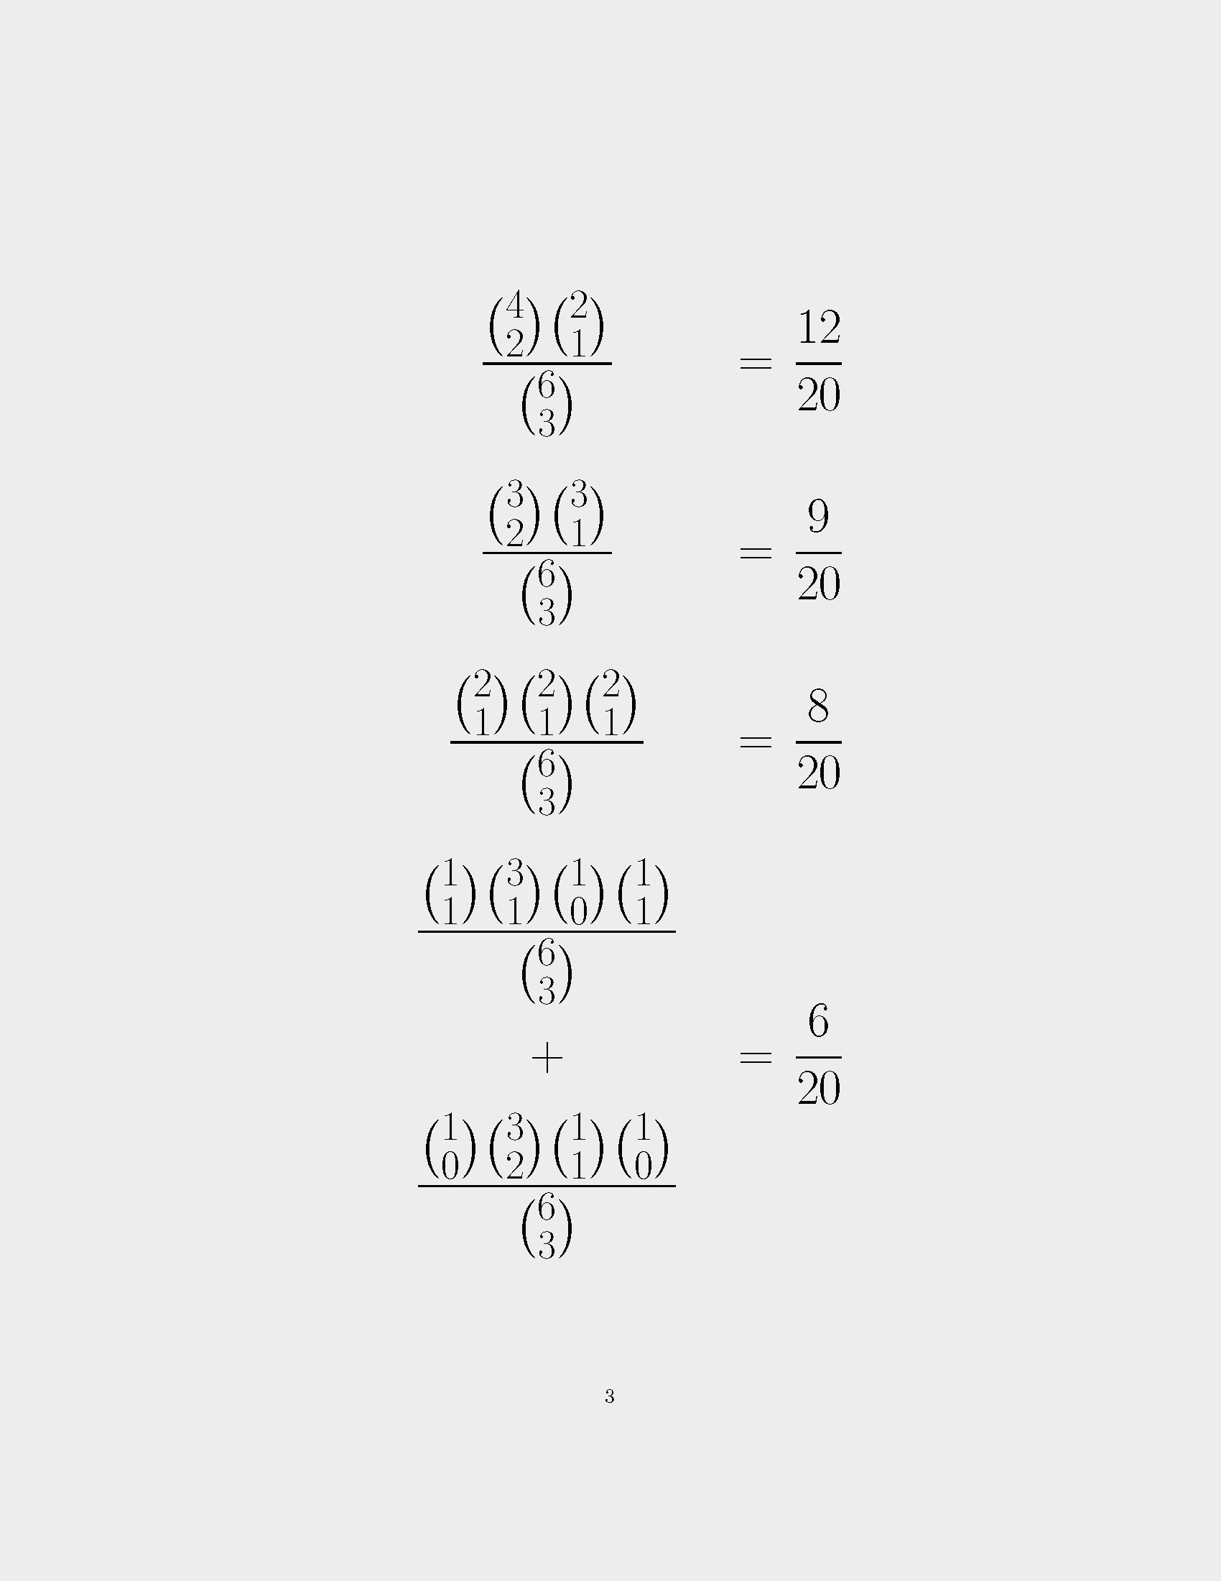
We can randomize three of the six people into intervention with 20 possible assignments. The eight assignments that generate the data are in lighter shading.
Data
Intervention
Control
Joint Distribution of Potential Outcomes
20 Possible Randomized Assignments in Sample of 6 with 3 in Intervention
Assignments That Generate Data in Lighter Shading
Likelihood
Always Taker
Always Taker
Complier
Complier
Never Taker
Never Taker
Notes:
Here, we grey out the randomizations that do not generate the data. The remaining 8 of the 20 randomizations generate the data.
By the definition of likelihood--the probability of the observed data given the truth--the likelihood is 8/20. In other words, if your truth is the configuration consistent with monotonicity, given the known randomization process (which is under your control when you design the experiment), you know that you will see the observed data 8 times out of 20.
Can we develop any formula and accompanying intuition for why the likelihood is 8/20?

Slide 33
Assignments that generate the data have one always taker, one complier, and one never taker in intervention.
Data
Intervention
Control
Joint Distribution of Potential Outcomes
20 Possible Randomized Assignments in Sample of 6 with 3 in Intervention
Assignments That Generate Data in Lighter Shading
Likelihood
Always Taker
Always Taker
Complier
Complier
Never Taker
Never Taker
2 Always Takers, 2 Compliers, 2 Never Takers
1 Always Taker
1 Always Taker
1 Complier
1 Complier
0 Defiers
0 Defiers
1 Never Taker
1 Never Taker
Notes:
Here, we just consider the randomizations that yield the data, and we group people of the same type into the same row. We see that all the randomizations that yield the data have one always taker, one complier, and one never taker in intervention.
Numerically, in the right column, we show the formula for the likelihood. There are two always takers, one in intervention, so there are 2 choose 1 ways to randomize one of two always takers into intervention. There are also 2 choose 1 ways to randomize one of two compliers into intervention and 2 choose 1 ways to randomize one of two never takers into intervention. 2 choose 1 equals 2, so the numerator of the likelihood is 8. The denominator is the total possible number of randomizations: 6 choose 3 equals 20.
Notice that all the randomizations that produce the data have balance between intervention and control within each type. (Within each type, there is 1 in intervention and 1 in control). Let's hold onto this for later – I will move it up now.

Slide 34
Assignments that generate the data have one always taker, one complier, and one never taker in intervention.
Data
Intervention
Control
Joint Distribution of Potential Outcomes
20 Possible Randomized Assignments in Sample of 6 with 3 in Intervention
Assignments That Generate Data in Lighter Shading
Likelihood
Always Taker
2 Always Takers, 2 Compliers, 2 Never Takers
Always Taker
Complier
1 Always Taker
1 Always Taker
Complier
1 Complier
1 Complier
Never Taker
0 Defiers
0 Defiers
1 Never Taker
1 Never Taker
Never Taker
Notes:
Okay, now let's consider the second answer we discussed, the one with one defier.

Slide 35
Here are the 20 possible randomized assignments for the answer with one defier.
Data
Intervention
Control
Joint Distribution of Potential Outcomes
20 Possible Randomized Assignments in Sample of 6 with 3 in Intervention
Assignments That Generate Data in Lighter Shading
Likelihood
Always Taker
2 Always Takers, 2 Compliers, 2 Never Takers
Always Taker
Complier
1 Always Taker
1 Always Taker
Complier
1 Complier
1 Complier
Never Taker
0 Defiers
0 Defiers
1 Never Taker
1 Never Taker
Never Taker
Always Taker
Complier
Complier
Complier
Defier
Never Taker
Notes:
Here it is, and here are all the possible randomizations.

Slide 36
Only six assignments generate the data.
Data
Intervention
Control
Joint Distribution of Potential Outcomes
20 Possible Randomized Assignments in Sample of 6 with 3 in Intervention
Assignments That Generate Data in Lighter Shading
Likelihood
Always Taker
2 Always Takers, 2 Compliers, 2 Never Takers
Always Taker
Complier
1 Always Taker
1 Always Taker
Complier
1 Complier
1 Complier
Never Taker
0 Defiers
0 Defiers
1 Never Taker
1 Never Taker
Never Taker
Always Taker
Complier
Complier
+
Complier
Defier
Never Taker
Notes:
Here, only 6 of the 20 possible randomizations generate the data.

Slide 37
Only six assignments generate the data.
Data
Intervention
Control
Joint Distribution of Potential Outcomes
20 Possible Randomized Assignments in Sample of 6 with 3 in Intervention
Assignments That Generate Data in Lighter Shading
Likelihood
Likelihood
Always Taker
2 Always Takers, 2 Compliers, 2 Never Takers
Always Taker
Complier
1 Always Taker
1 Always Taker
Complier
1 Complier
1 Complier
Never Taker
0 Defiers
0 Defiers
1 Never Taker
1 Never Taker
Never Taker
Always Taker
1 Always Taker, 3 Compliers, 1 Defier, 1 Never Taker
Complier
1 Always Taker
0 Always Takers
1 Always Taker
Complier
0 Always Takers
+
1 Complier
2 Compliers
1 Complier
Complier
2 Compliers
0 Defiers
1 Defier
0 Defiers
Defier
1 Defier
1 Never Taker
0 Never Takers
1 Never Taker
Never Taker
0 Never Taker
Notes:
If we just look at the randomizations that produce the data, we see that they all have an imbalance between intervention and control within each type.

Slide 38
Now consider the solution with two defiers. How many assignments generate the data?
Data
Intervention
Control
Joint Distribution of Potential Outcomes
20 Possible Randomized Assignments in Sample of 6 with 3 in Intervention
Assignments That Generate Data in Lighter Shading
Likelihood
Likelihood
Always Taker
2 Always Takers, 2 Compliers, 2 Never Takers
Always Taker
Complier
1 Always Taker
1 Always Taker
Complier
1 Complier
1 Complier
Never Taker
0 Defiers
0 Defiers
1 Never Taker
1 Never Taker
Never Taker
Always Taker
1 Always Taker, 3 Compliers, 1 Defier, 1 Never Taker
Complier
1 Always Taker
0 Always Takers
1 Always Taker
Complier
0 Always Takers
+
1 Complier
2 Compliers
1 Complier
Complier
2 Compliers
0 Defiers
1 Defier
0 Defiers
Defier
1 Defier
1 Never Taker
0 Never Takers
1 Never Taker
Never Taker
0 Never Taker
Complier
Complier
Complier
Complier
Defier
Defier

Slide 39
12 of the 20 possible assignments generate the data!
Data
Intervention
Control
Joint Distribution of Potential Outcomes
20 Possible Randomized Assignments in Sample of 6 with 3 in Intervention
Assignments That Generate Data in Lighter Shading
Likelihood
Likelihood
Always Taker
2 Always Takers, 2 Compliers, 2 Never Takers
Always Taker
Complier
1 Always Taker
1 Always Taker
Complier
1 Complier
1 Complier
Never Taker
0 Defiers
0 Defiers
1 Never Taker
1 Never Taker
Never Taker
Always Taker
1 Always Taker, 3 Compliers, 1 Defier, 1 Never Taker
Complier
1 Always Taker
0 Always Takers
1 Always Taker
Complier
0 Always Takers
+
1 Complier
2 Compliers
1 Complier
Complier
2 Compliers
0 Defiers
1 Defier
0 Defiers
Defier
1 Defier
1 Never Taker
0 Never Takers
1 Never Taker
Never Taker
0 Never Taker
Complier
Complier
Complier
Complier
Defier
Defier

Slide 40
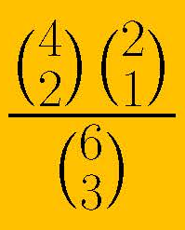

The answer with two defiers has the maximum likelihood!
We decide that the intervention backfires for two people in the sample.
Data
Intervention
Control
Joint Distribution of Potential Outcomes
20 Possible Randomized Assignments in Sample of 6 with 3 in Intervention
Assignments That Generate Data in Lighter Shading
Likelihood
Always Taker
2 Always Takers, 2 Compliers, 2 Never Takers
Always Taker
Complier
1 Always Taker
1 Always Taker
Complier
1 Complier
1 Complier
Never Taker
0 Defiers
0 Defiers
1 Never Taker
1 Never Taker
Never Taker
Always Taker
1 Always Taker, 3 Compliers, 1 Defier, 1 Never Taker
Complier
1 Always Taker
0 Always Takers
1 Always Taker
Complier
0 Always Takers
+
1 Complier
2 Compliers
1 Complier
Complier
2 Compliers
0 Defiers
1 Defier
0 Defiers
Defier
1 Defier
1 Never Taker
0 Never Takers
1 Never Taker
Never Taker
0 Never Taker
Complier
4 Compliers, 2 Defiers
Complier
Complier
0 Always Takers
0 Always Takers
Complier
2 Compliers
2 Compliers
Defier
1 Defier
1 Defier
Defier
0 Never Taker
0 Never Takers
Notes:
All the assignments that generate that data have two of four compliers in intervention and one of two defiers in control.
Look over at the likelihood expression and compare it to the likelihood expression under monotonicity in the top row. Having more people of one type increases the likelihood. 4 choose 2 equals 6, but (2 choose 1) times (2 choose 1) equals 4. If you have more people of the same type, there are more ways that they could be randomized that would still yield the observed data.
This is where the book "Statistical Physics for Babies" comes in. Physicists call the number of ways that you could have seen what you saw as the "entropy." The entropy is the numerator of the likelihood. Because there are more ways to yield the observed data, the likelihood is higher.
By the principle of maximum entropy (Jaynes), this answer is the optimal answer.
Compare the optimal answer to the other answers. The optimal answer is the one in which the people as similar as possible to each other in two senses: they take on the smallest number of types, and there is balance between intervention and control within each type.
Don't worry, though, not all answers will just have compliers and defiers! Things get even more interesting as we increase the sample.

Slide 41

What can we say beyond the average effect in all possible results with 50 people, 25 in intervention?
Notes:
Never Taker
Photo by Alex Souza: https://www.pexels.com/photo/vibrant-colored-ball-pit-with-dramatic-lighting-33944174/

Slide 42
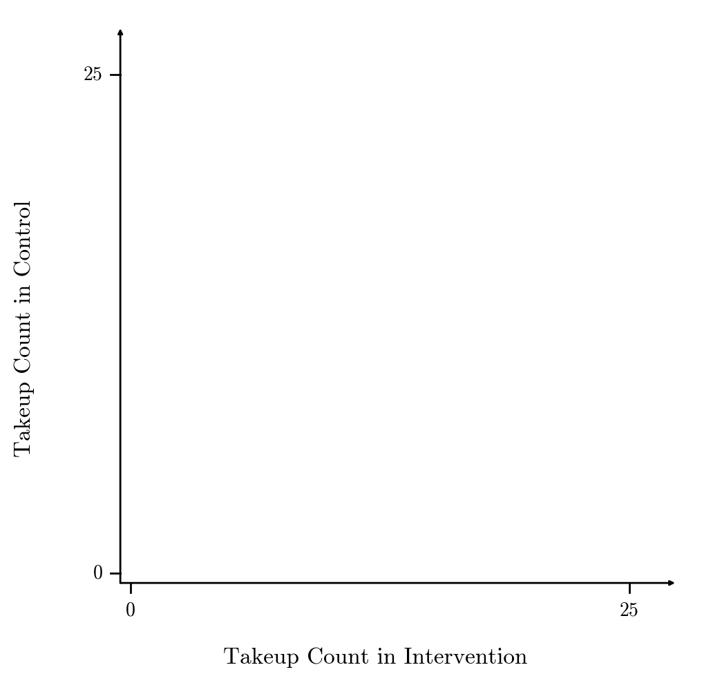
These axes show the takeup count in intervention and the takeup count in control.

Slide 43
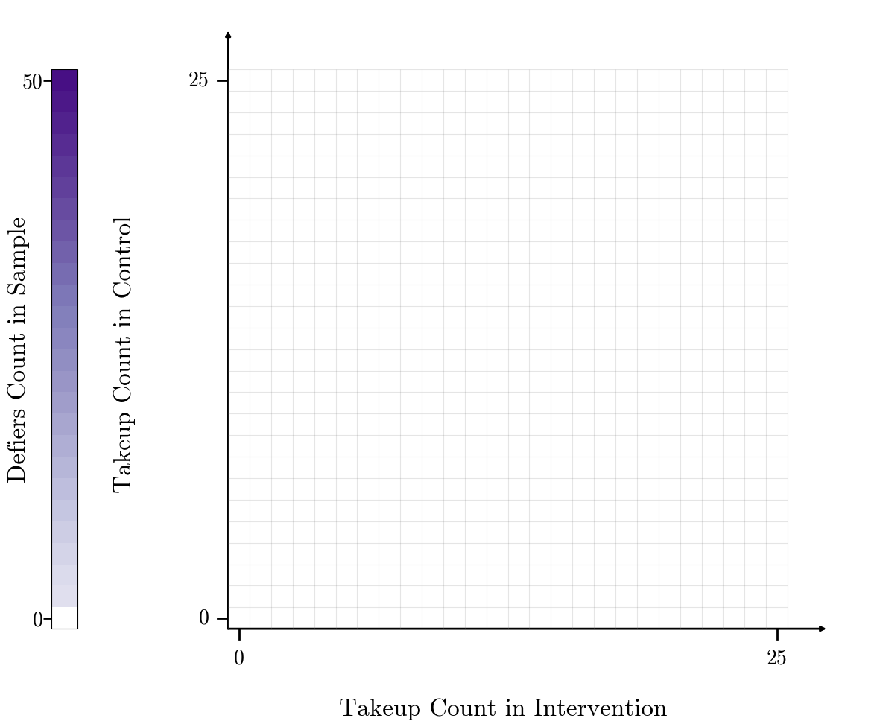
There are the 676 (=26x26) possible realizations of the data in a sample of 50 people.
Notes:
We are considering all the possible data that you could observe in an experiment with 50 people. This experiment assigns 25 people to intervention and 25 people to control.
Each realization of the data gets its own cell. There are 26 cells of 25 in each arm because takeup of zero is possible.
Okay, now we fire up the supercomputer. For each possible realization of the data, we calculate the maximum likelihood estimate for the counts of always takers, compliers, defiers and never takers. The result is a four-dimensional object for each cell. Therefore, instead of showing you the maximum likelihood estimate for each cell, we are going to show you some summary statistics on those maximum likelihood estimates.
Here is the result.

Slide 44
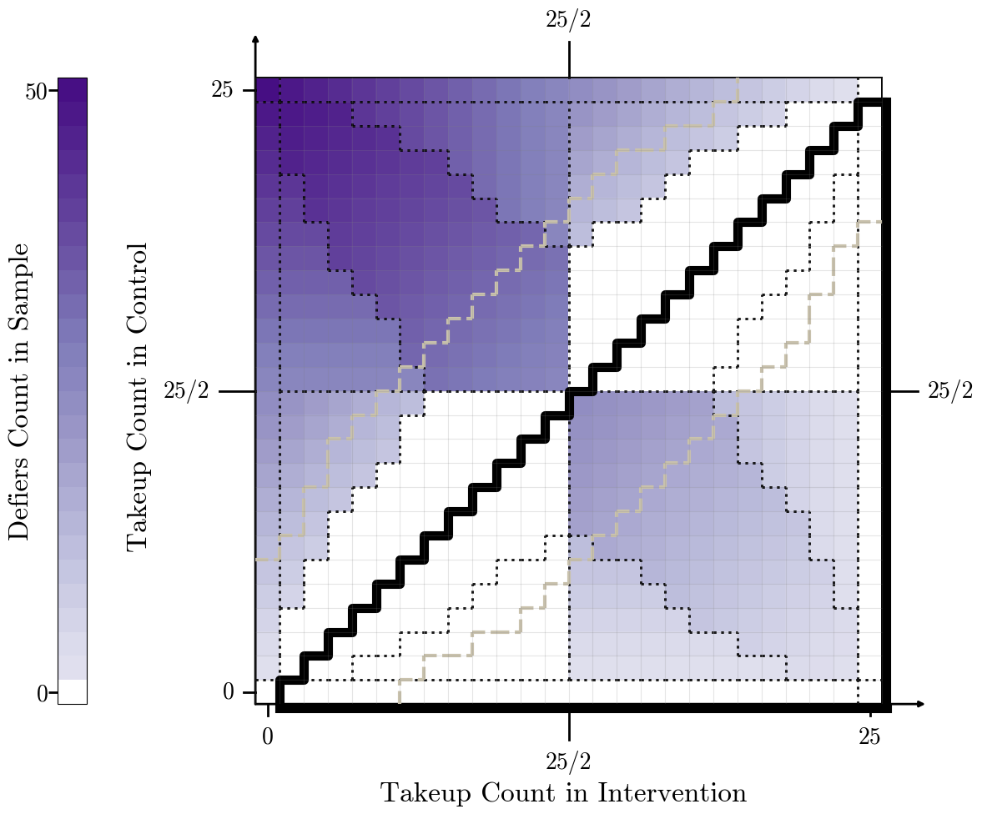
We can reveal evidence beyond the average effect!
Region with Positive Average Effect
Regions with Same Types Present in MLE
Region where Fisher’s Exact Test Fails to Reject Null at 5% Level
D
AD
A
ACD
ADN
Average Effect
Takeup in Sample
More Negative
DN
AC
AN
CDN
CD
AN
ACN
ADN
AN
CD
ACD
AN
Average Effect
More Positive
ACN
CDN
N
CN
C
Types:
A: Always Takers
C: Compliers
D: Defiers
N: Never Takers
Notes:
There is a lot going on here, but I will walk you through it.
First, let's orient ourselves on the figure more. Along the 45 degree line, the takeup count in intervention is equal to the takeup count in control, so the estimated average effect is zero.
If the takeup count in intervention is higher than the takeup count in control, the estimated average effect is positive, as shown in the region outlined in bold.
Darker colors of purple (more "heat" on this heatmap) indicate that the MLE has more defiers. Even when the average effect is positive, the MLE can include defiers, just as we saw in our simple experiment with six people.
What's more interesting is that there is a systematic pattern in the data that gives us a quick heuristic to determine if the MLE includes defiers: the MLE includes defiers if takeup is below half in control and above half in intervention, unless takeup is zero in control or full in intervention.
This figure shows us that the estimated average effect is not sufficient to determine if there are defiers in the MLE. The average effect is constant across upward sloping lines, but it can include defiers or not.
Good empirical researchers do not just report the estimated average effect. They also report the takeup rate in control, which you can observe from the vertical axis. This figure shows that both pieces of information are important to the MLE. But does the MLE itself make sense?
Now consider the regions that we enclose in dots–regions with same types present in the MLE. If a type is zero, we don't include it. First consider the upper-right corner. Everyone in control takes up and so does everyone in intervention. Even without any math, you'd probably conclude that everyone is an always taker. The other corners also make sense. If no one takes up in intervention or control, the MLE indicates that everyone is a never taker. If everyone takes up in intervention but no one takes up in control, the MLE indicates that everyone is a complier. Finally, if no one takes up in intervention and everyone takes up in control, the MLE indicates that everyone is a defier. Along the edges of the figure, the MLE is a combination of the types at the corners. That's also true along the diagonals.
The interior is where things get exciting. The two regions labeled ACN (always takers, compliers, and never takers) are what we assume under monotonicity. The MLE can include three types when the imbalance between intervention and control gets so large for configurations with only two types that the entropy increases by adding another type.
Let's also look at the region around the 45 degree line. Remember, the 45 degree line is where the estimated average effect equals zero. When the estimated average effect is zero or close to zero, Fishers' exact test fails to reject the null hypothesis that there are only always and never takers. As Alex Tetenov discusses, Fisher's exact test and all other hypothesis tests are conservative in that they prioritize not rejecting the null. That's why the dashed region in which Fisher's exact test does not reject is larger than the region in which the MLE includes just always and never takers. Fisher's exact test reduces that the results that you would get from an experiment to just two regions – but there is a lot more interesting variation in the MLE that Fisher's exact test obscures.
For example, have you ever estimated an average effect of zero but wondered if that was the case not because no one was affected but because everyone was affected in opposite directions? As shown toward the center of the figure, the estimated average effect is not statistically significant at traditional levels, but the MLE can include just compliers and defiers (CD).
Is there something specific here to small samples? Does this information somehow go away in larger samples, which would be really weird?

Slide 45
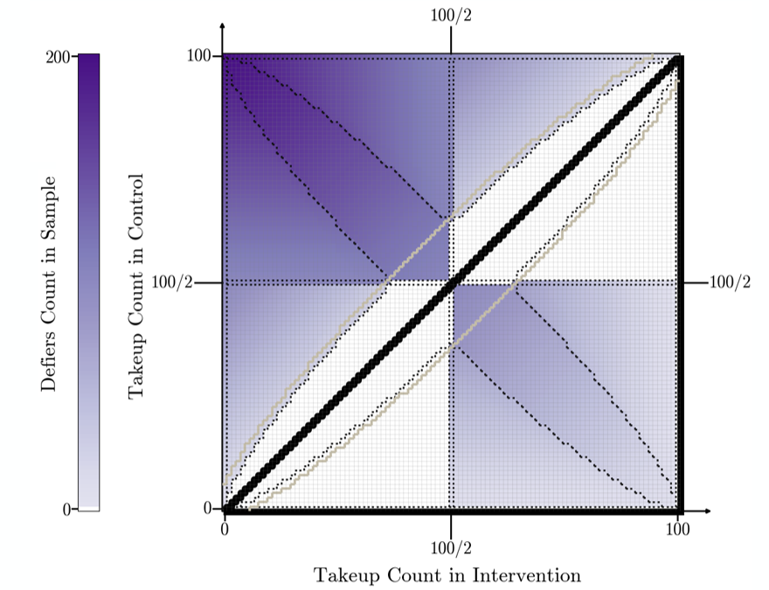
What happens to the patterns if the sample size quadruples to 200?
Region with Positive Average Effect
Regions with Same Types Present in MLE
Region where Fisher’s Exact Test Fails to Reject Null at 5% Level
D
AD
A
D
AD
A
ACD
ADN
ACD
ADN
Average Effect
Takeup in Sample
Average Effect
Takeup in Sample
More Negative
More Negative
DN
AC
DN
AC
AN
AN
CDN
CD
AN
ACN
CDN
CD
AN
ACN
ADN
AN
CD
ACD
ADN
AN
CD
ACD
AN
AN
Average Effect
Average Effect
More Positive
More Positive
ACN
CDN
ACN
CDN
N
CN
C
N
CN
C
* Two-way ties in the MLE occur in cells bisected by indicated lines, between MLEs in the cells on either side of the line, only when takeup count in intervention or control is not zero or full.
Types:
A: Always Takers
C: Compliers
D: Defiers
N: Never Takers
Notes:
No. The right figure how shows all possible data from experiments with 200 people, 100 in intervention and 100 in control. The broad patterns still appear.
Also note that here, as in all samples in which an even number are randomized into intervention, there are ties along the midlines.
Let's move to some empirical examples. In some sense, I have already shown you the results from all possible empirical examples, so the point of showing you two particular ones will be to discuss what we learn in terms of substance and to demonstrate how we recommend that applied researchers report results.
We have developed a command (https://pypi.org/project/dbmle/) that you can use to report the results. It took a lot of computational power to produce these figures, but in any empirical example, you will only need to evaluate one specific point.
Let's return to our motivating example: you want pregnant women to quit smoking.

Slide 46
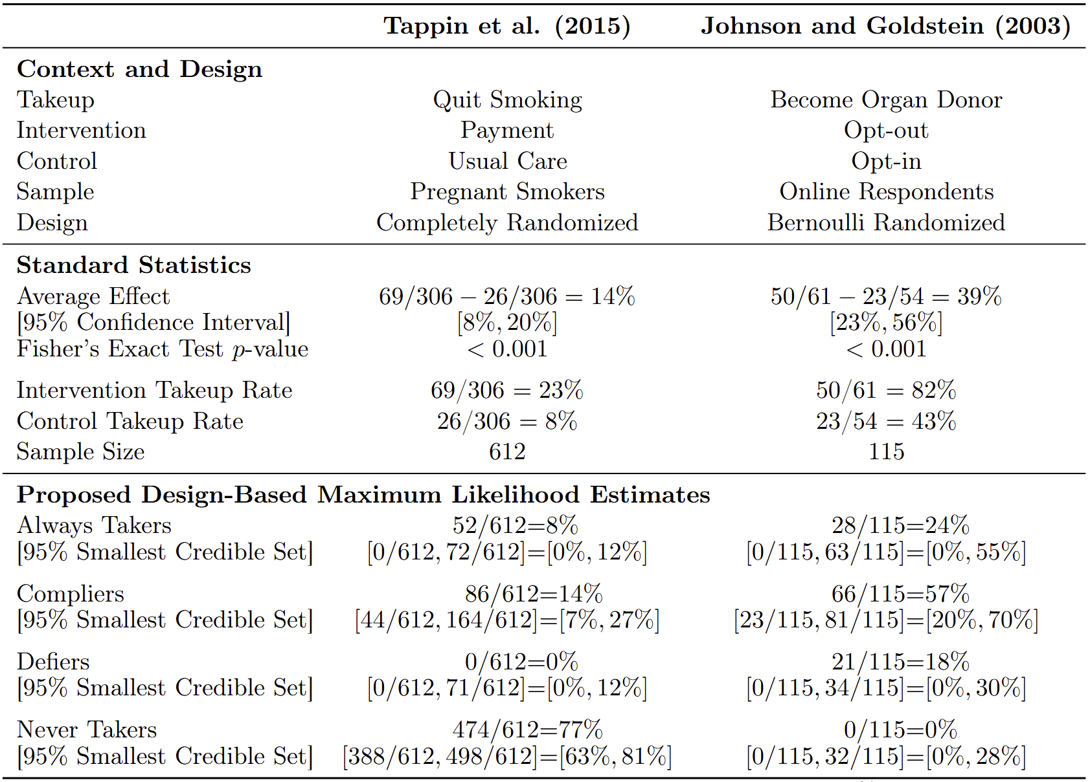
In this published experiment that offered a payment to pregnant smokers, we decide that the intervention does not backfire for anyone in the sample.
0/612=0%
[0/612, 71/612]=[0%, 12%]
Percentages are rounded to whole numbers. We report the range of the numbers of each type present in the 95% smallest credible set on the joint distribution of potential outcomes. The ranges of the numbers for each type are not independent.
Notes:
Experiments that try to get pregnant women to quit smoking have a long history in the monotonicity literature. The original Permutt and Hebel (1989) paper cited by Imbens and Angrist (1994) proposed that all women who quit smoking in intervention also would have quit in control. That is indeed what we find. Our MLE estimate includes no defiers, as shown in yellow.
Based on this estimate, instead of just assuming monotonicity, you could use the MLE to decide on monotonicity and then assume it. It's still a strong assumption, but now there is some evidence for it. Under monotonicity, you could proceed as you normally would.
Things get interesting in the next application.

Slide 47
But in this well-known experiment that offered an opt-out nudge to become an organ donor, we decide that the intervention does backfire for 18% of the sample.
0/612=0%
[0/612, 71/612]=[0%, 12%]
21/115 = 18%
[0/115, 34/115]=[0%, 30%]
Percentages are rounded to whole numbers. We report the range of the numbers of each type present in the 95% smallest credible set on the joint distribution of potential outcomes. The ranges of the numbers for each type are not independent.
Notes:
This application was a very high-profile experiment published in Science in 2003. You have probably heard of it. It showed that a simple re-framing – making the default to be an organ donor unless you opt-out – increased rates of hypothetical organ donor status in an online experiment by a whopping 39 percentage points. States have changed their defaults in response to these results. However, there is some concern that people in the online experiment knew that they were in an experiment, so some of them would have gone with the default to please the experimenters, and others would have gone against the default because they are wary of defaults. Recent research by Al Roth and Judd Kessler replicated the experiment, but allowed participants to change their actual organ donor status and didn't find anything, so perhaps there were defiers.
We find that there were defiers. Among the 115 people in the sample, our MLE is that 21 are defiers. This is the maximum number of defiers within the Fréchet bounds. As shown the standard statistics, the intervention take up rate is 82%. The remaining 18% of people who do not take up in intervention could be never takers or defiers. Our MLE indicates that all of them were defiers, and there were no never takers.
Note that this evidence is by no means a "slam dunk," and it never is. We construct the 95% smallest credible set for the number of defiers under the uniform prior for which our MLE is Bayes optimal, and it is even larger than the Fréchet bounds because the Fréchet bounds are estimated.
However, this weak evidence can motivate a new strong assumption in this context - an assumption of no never takers. Under an assumption of no never takers, we can label some specific people as compliers and other as defiers. If there are no never takers, everyone who does not take up in control must be a complier, and everyone who does not take up in intervention must be a defier. Under this assumption, with additional data, you could learn the average characteristics of compliers and defiers and ultimately try to achieve the goal of targeting a future intervention toward compliers and away from defiers.
Even if you only care about the average effect, you would still like to know if there are defiers and figure out who they are because you could achieve a larger average effect with the same intervention but better targeted. Even though this experiment increased hypothetical organ donation rates by an impressive 39%, our MLE says that 57% of the sample are compliers who increase their organ donation rate in response to the intervention.

Slide 48


Fisher 1935:
The design of Charles Darwin's experiments was "greatly superior" to "statistical methods available at the time."

Slide 49

Athey and Imbens 2017:
"We recommend using statistical methods that are directly justified by randomization, in contrast to the more traditional sampling-based approach that is commonly used in econometrics."

Slide 50
Counting Defiers: A Design-Based Model of an Experiment Can Reveal
Evidence Beyond the Average Effect
Neil Christy and Amanda Kowalski
University of Michigan
Thanks to Jann Spiess for extensive regular feedback and to Charles Manski, Toru Kitagawa, Aleksey Tetenov, and Donald Rubin for encouraging us to use statistical decision theory and teaching us about it. Thanks also to Guido Imbens.
Paper on arXiv: https://arxiv.org/abs/2412.16352

Slide 51
Counting Defiers: A Design-Based Model of an Experiment Can Reveal
Evidence Beyond the Average Effect
We estimate the numbers of always takers, compliers, defiers, and never takers in the sample
  The sampling-based literature considers the shares of these types in a superpopulation.
  It is well-known that the sampling-based likelihood does not vary with the share of defiers within the Boole 1854, Hoeffding 1940, and Fréchet 1957 bounds.
  Sampling-based literature considers bounds on shares of defiers in the population.
    Balke and Pearl 1997, Heckman, Smith and Clements 1997, Manski 1997, Tian and Pearl 2000, Zhang and Rubin 2003, Imbens and Manski 2004, Fan and Park 2010, Mullahy 2018, Ding and Miratrix 2019, Li and Pearl 2019, Bai, Huang, Shaikh, and Vytlacil 2024, Semenova 2024.

Slide 52
Counting Defiers: A Design-Based Model of an Experiment Can Reveal
Evidence Beyond the Average Effect
We consider a primitive estimand: always takers, compliers, defiers, and never takers in the sample
Using a causal model with parametric structure from the randomization design
  Neyman 1923, Welch 1937, Kempthorne 1952, Copas 1973, Rubin 1974, 1977, Greenland and Robins 1986, Holland 1986, and others develop the causal model.
  Copas 1973 uses the design-based likelihood to compare hypothesis tests.
  Li and Ding 2016 use parametric structure to construct exact confidence intervals on the average effect.
  Ding and Miratrix (2019) use the design-based likelihood to examine the sensitivity of inference on aggregate parameters to assumptions about the joint distribution of potential outcomes.

Slide 53
Counting Defiers: A Design-Based Model of an Experiment Can Reveal
Evidence Beyond the Average Effect
We consider a primitive estimand: always takers, compliers, defiers, and never takers in the sample
Using a causal model with parametric structure from the randomization design
And a maximum likelihood decision rule that can harness weak evidence
  Fisher 1935 exact test discards this weak evidence.
    Tetenov 2012 discusses how implied rules from all tests treat Type I and II errors asymmetrically.
  Our rule varies with the data.
    Ferguson 1967: our rule is “reasonable” because it is “better than just guessing.”
    Minimax and minimax regret rules do not necessarily vary with data.
      Schalg 2003, Manski 2004, Hirano and Porter 2009, and Stoye 2009.
  Our rule is Bayes optimal.
    Our rule is admissible (Ferguson 1967).
    Our rule cannot be bested in a betting framework (Freedman and Purves 1969).
    We can quantify the gains of our rule over a Fréchet rule and a monotonicity rule.
    We can construct credible sets as an alternative to sampling-based inference on Fréchet bounds (Manski, Sandefur, McLanahan, and Powers 1992, Horowitz and Manski 2000, Tamer, Chernozhukov, and Hong 2004) and defiers within the Fréchet bounds (Imbens and Manski 2004)
  Our rule is optimal by the principle of maximum entropy (Jaynes 1957a,b).
    Golan 2002 uses entropy to abstract away from parametric structure, which we embrace.

Slide 54
Counting Defiers: A Design-Based Model of an Experiment Can Reveal
Evidence Beyond the Average Effect
We consider a primitive estimand: always takers, compliers, defiers, and never takers in the sample
Using a causal model with parametric structure from the randomization design
And a maximum likelihood decision rule that can harness weak evidence
  Our rule contributes to the integration of statistical decision theory into econometrics,
    Manski 2004, Dehejia 2005, Manski 2007, Hirano 2008, Hirano and Porter 2009, Stoye 2012, Kitagawa and Tetenov 2018, Manski 2018, 2019, Manski and Tetenov 2021, Fernandez, Montiel Olea, Qiu, Stoye, and Tinda 2024
  Particularly in finite sample settings.
    Canner 1970, Manski and Tetenov 2007, Schlag 2007, Stoye 2007, 2009, Tetenov 2012.

Slide 55
Counting Defiers: A Design-Based Model of an Experiment Can Reveal
Evidence Beyond the Average Effect
We consider a primitive estimand: always takers, compliers, defiers, and never takers in the sample
Using a causal model with parametric structure from the randomization design
And a maximum likelihood decision rule that can harness weak evidence
To support a monotonicity assumption or a specific alternative.
  Previous evidence against monotonicity requires more data than a binary intervention and outcome.
    Machine learning requires covariates.
      For example: Wager and Athey 2018, Semenova 2024.
    Analysis of side effects in medicine requires secondary outcomes.
      For example, Barnard et al. 2001.
    Other approaches require data on a second stage outcome and a two-stage model.
      Specification tests reveal evidence against model and/or monotonicity in the first stage.
        Imbens and Rubin 1997, Richardson and Robins 2010, Huber and Mellace 2012, 2015, Kitagawa 2015, Mourifié and Wan 2017, Machado, Shaikh, and Vytlacil 2019.
      Marginal treatment effect models can reveal evidence against monotonicity in the second stage under instrumental variable assumptions plus ancillary assumptions.
        Bjorklund and Moffit 1987, Heckman and Vytlacil 1999, Kowalski 2023a,b.
      Chan, Gentzkow, and Yu (2022) require a multi-valued instrument and a second stage outcome for at least one value of the first stage outcome.

Slide 56
Counting Defiers: A Design-Based Model of an Experiment Can Reveal
Evidence Beyond the Average Effect
We consider a primitive estimand: always takers, compliers, defiers, and never takers in the sample
Using a causal model with parametric structure from the randomization design
And a maximum likelihood decision rule that can harness weak evidence
To support a monotonicity assumption or a specific alternative.
Our goal is to improve the average effect of future interventions by targeting away from defiers.
Our work has implications for methodological and applied work.
  Derive design-based likelihoods for other designs: two stage models, matched pairs, stratified, and permuted block to obtain exact test statistics and confidence intervals
  Improve computation.
  Consider other utility functions and estimands
    Outcome quantiles (Guggenberger, Mehta, and Pavlov 2024)
    Welfare (Cui and Han 2023)
    Asymmetric counterfactual utilities (Ben-Michael, Imai, Jiang 2024, Christy and Kowalski 2024, Gelman and Mikhaeil 2025)
  Leverage our visualizations, which we see as a secondary contribution.
  Revisit results on optimal experimental design that focus on the average effect (Bai 2022).
  Report randomization design and sample counts in applied work.

Slide 57
Counting Defiers: A Design-Based Model of an Experiment Can Reveal
Evidence Beyond the Average Effect
Neil Christy and Amanda Kowalski
University of Michigan
Thanks to Jann Spiess for extensive regular feedback and to Charles Manski, Toru Kitagawa, Aleksey Tetenov, and Donald Rubin for encouraging us to use statistical decision theory and teaching us about it. Thanks also to Guido Imbens.
Paper on arXiv: https://arxiv.org/abs/2412.16352

Slide 58
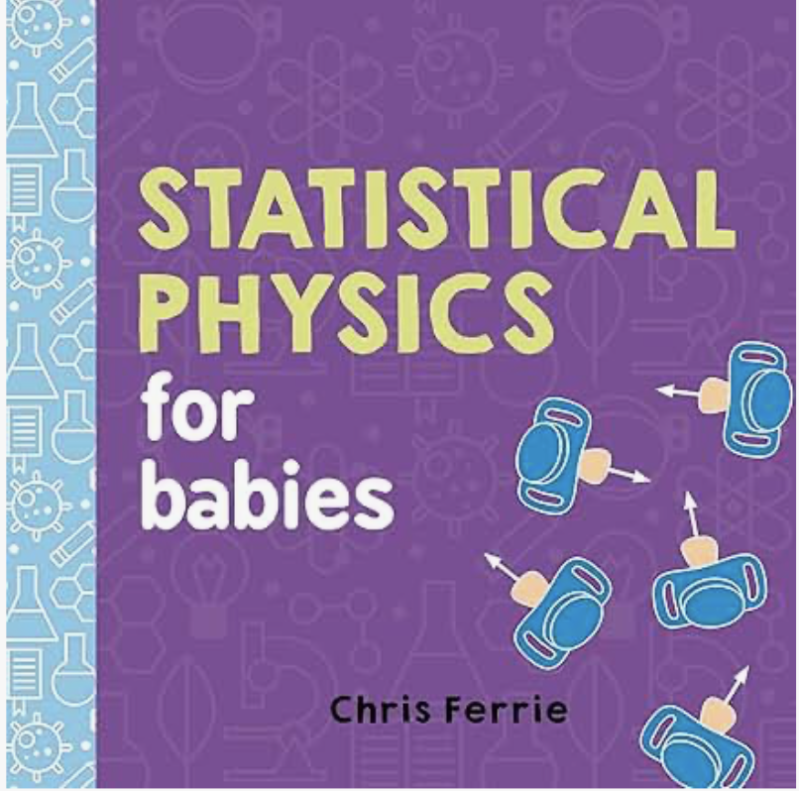
Yes!
A Design-Based Model of an Experiment Can Reveal Evidence Beyond the Average Effect
Pictured book and style inspiration for visualizations: Ferrie 2016

