Slide 1
An introduction to International Banking Data (US) Presentation by Linda Goldberg
July 2014 NBER Summer Institute, Workshop on Data Sources in International Finance. Views expressed are those of the author and do not necessarily reflect the position of the Federal Reserve Bank of New York, the Federal Reserve Board, or the Federal Reserve System. Special thanks to Arun Gupta and Rose Wang for compiling much of the information contained within. Potential errors are my own.

Slide 2
What is a “Bank”?
Bank Holding Company (FRB)
Nonbanks
(SEC, OCC, etc)
i.e. Securities Broker-Dealers, Investment Banks
Commercial Bank / Subsidiary (FRB)
Branch/Agency (FRB)
Bank Holding Company (FRB)
Nonbanks
(FRB)
i.e. finance companies, specialized mortgage lenders, VC
Notes:
Who files to the FRB? And who doesn’t?

Slide 3
What is a “Bank”?
Bank Holding Company (FRB)
Nonbanks
(SEC, OCC, etc)
i.e. Securities Broker-Dealers, Investment Banks
Commercial Bank / Subsidiary (FRB)
Branch/Agency (FRB)
Bank Holding Company (FRB)
Nonbanks
(FRB)
i.e. finance companies, specialized mortgage lenders, VC
Reports to the FRB
Notes:
Who files to the FRB? And who doesn’t?
- Entities inside the large square file to the FRB

Slide 4
Commonly Used Terms in US Regulatory Reporting
BHC – Bank holding company
Bank – FDIC-insured depository institutions
Nonbank – non-depository financial institutions
e.g. Broker dealers, finance companies, investment banks, etc.
USBO – United States Banking Organizations (BHCs headquartered in the US)
e.g.. Bank of America, JP Morgan Chase, Citigroup, etc.
FBO – Foreign Banking Organizations (BHCs headquartered abroad)
e.g. Deutsche Bank AG, Credit Suisse AG, BNP Paribas AG
FFIEC – Reporting forms administered by the Federal Financial Institutions Examination Council i.e. FFIEC 031 (Call Report)
FR – Reporting forms administered by the Federal Reserve i.e. FR Y-9C
Notes:
(To Linda) Feel free to substitute any of the official definitions below as deemed appropriate:
Official definitions from NIC:
Bank Holding Company A company that owns and/or controls one or more U.S. banks or one that owns, or has controlling interest in, one or more banks. A bank holding company may also own another bank holding company, which in turn owns or controls a bank; the company at the top of the ownership chain is called the top holder. The Board of Governors is responsible for regulating and supervising bank holding companies, even if the bank owned by the holding company is under the primary supervision of a different federal agency (OCC or FDIC) Commercial Bank A financial institution that is owned by stockholders, operates for a profit, and engages in various lending activities.
Foreign Banking Organization (FBO) Foreign banking organizations can acquire or establish freestanding banks or bank holding companies in the United States. These entities are regulated and supervised as domestic institutions.
FFIEC is a formal interagency body empowered to prescribe uniform principles, standards, and report forms for the federal examination of financial institutions by the Board of Governors of the Federal Reserve System (FRB), the Federal Deposit Insurance Corporation (FDIC), the National Credit Union Administration (NCUA), the Office of the Comptroller of the Currency (OCC), and the Consumer Financial Protection Bureau (CFPB), and to make recommendations to promote uniformity in the supervision of financial institutions.

Slide 5
FBOs with operations in the US – Key Definitions
FBO
i.e. Deutsche Bank AG
US BHC of FBO
i.e. Taunus Corporation (owned by Deutsche Bank AG)
US Subsidiary of FBO – Legally separate entity from its foreign parent; holds its own equity in the US
US Commercial Bank Subsidiary of FBO
US Edge Agree Corp Subsidiary of FBO
US Nonbank Subsidiary of FBO
US Branches/Agencies of FBO – Legally the same entity as its foreign parent; does not have its own equity in the US
Notes:
Notes:
Taunus Corporation was founded in 1999 as the North American subsidiary of Germany’s Deutsche Bank AG. The company is headquartered in New York City.
Edge/Agreement Corporation An organization chartered by the Federal Reserve to engage in international banking and financial operations. They file information about foreign country exposures (FFIEC 009)

Slide 6
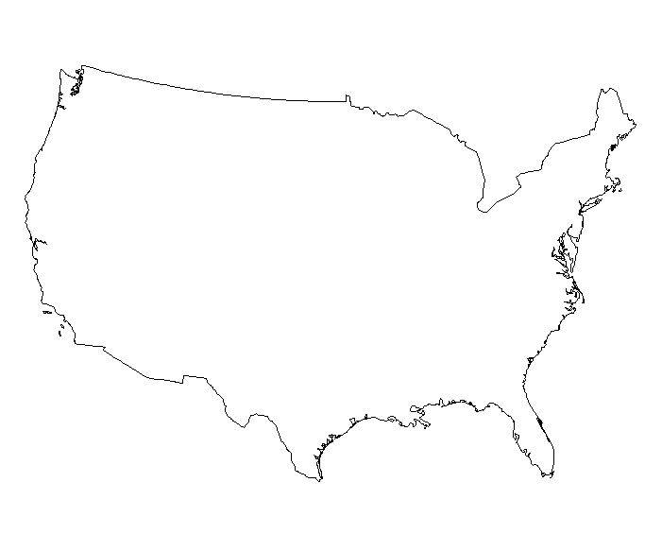
Balance Sheet, Income Statement, and other key data for FBOs with operations in the US
Parent FBO
FR Y-7, 1995-2001, A B I O
FR Y-7Q, 2002Q4, Q A B
US BHC
FR Y-9C, 1981Q2, Q B I
FFIEC 009 (A), 1986Q1, Q FCE
Key Variables
B | Balance Sheet
I | Income Statement
FCE | Foreign Country Exposures
O | Organizational Structure
Frequency
A | Annually
Q | Quarterly
W | Weekly
Availability
FORM | Public
FORM | Public, some variables Confidential
FORM | Confidential
FORM (A) | Aggregated data is public
US Branches / Agencies
FFIEC 002, 1980Q2, Q B
FR 2644, 1960W1, W B
FFIEC 019, 1986Q2, Q FCE
US Commercial Bank Subsidiaries
FFIEC 031, 1984Q1, Q B I
FFIEC 041, 1984Q1, Q B I
FR 2644, 1960W1, W B
FFIEC 009 (A), 1986Q1, Q FCE
US Nonbank Subsidiaries
FR Y-7N/7NS, 2002Q4, Q A B I
FR Y-7, 1995-2001, A B I O
* Dates reflect when data collection began, however actual starting date may vary by form
Notes:
TBD: FR Y-6 info, FR Y-7Q key variables, FFIEC 019 frequency
Ask Linda if she still wants FR Y6 included?
Ask Linda if she wants domestic information for domestic high holders (i.e. FR 2644 for US Comm banks under USBOs)?
Ask Linda if she wants us to show data dates from time of downloadability or actual start of the series?
Find out if FBOs own US EdgeAgree Corps (FR 2886b)?
FR 2886b, 1978Q4, Q B I

Slide 7
USBOs with operations abroad – Key Definitions
US BHC
Bank of America Corporation
USBO – Top BHC
Foreign Subsidiary of USBO- Legally separate entity from its US parent; holds its own equity abroad
Foreign Commercial Bank Subsidiary of USBO
Foreign Non-Bank Subsidiaries of USBO
US EdgeAgree Corp Subsidiary of USBO
Foreign Branches/Agencies of USBO - Legally the same entity as its US parent; does not have its own equity abroad
Notes:
EdgeAgree Corps are physically located in the US, and have historically housed the majority of a USBOs international banking activity and exposure.

Slide 8
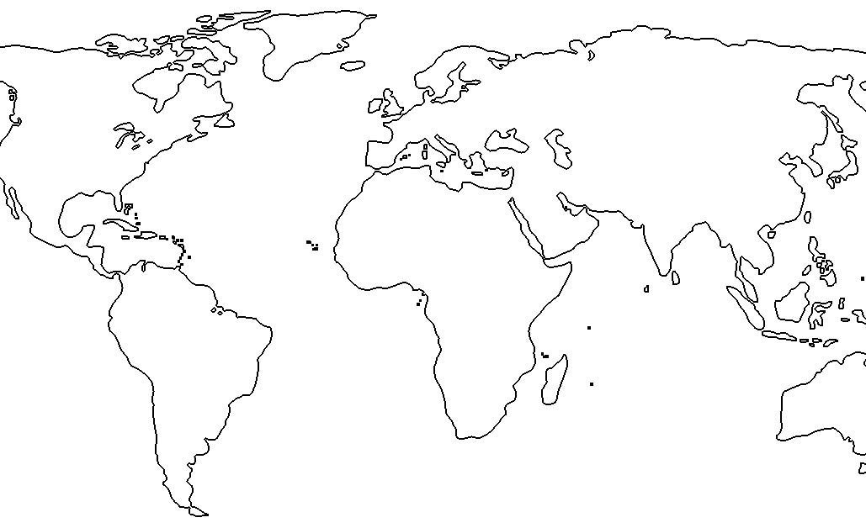
Balance Sheet, Income Statement, and Foreign Country Exposures data for the Foreign parts of USBO’s
US Commercial Bank Subsidiaries
US EdgeAgree Corp Subsidiaries
FFIEC 009 (A), 1986Q1, Q FCE
FR 2886b, 1972Q1, Q B I
US BHC / Commercial Bank Subsidiaries
Foreign Branches / Agencies
FFIEC 030/030S (A), 1984Q1, Q A B
FFIEC 031, 1984Q1, Q B I
Key Variables
B | Balance Sheet
I | Income Statement
FCE | Foreign Country Exposures
Frequency
A | Annually
Q | Quarterly
Availability
FORM | Public
FORM | Public, some variables Confidential
FORM | Confidential
FORM (A) | Aggregated data is public
Foreign Bank Subsidiaries
Foreign Non-Bank Subsidiaries
FFIEC 2314/2314S, 1973Q4, Q A B I
Notes:
TBD: What are foreign offices of US Commercial banks?
Ask Linda if she wants Fr Y 10 (USBO structure changes) and FR Y 11 (FBO structure changes included)? Note that they are not given in a consistent dataset

Slide 9
Accessing Regulatory Forms and Instructions
1) Go to http://www.federalreserve.gov/apps/reportforms/default.aspx
2) Select Form of Interest from drop down selection
Notes:
Arun

Slide 10
Accessing Data (1)
Chicago FRB Public Website
http://www.chicagofed.org/webpages/banking/financial_institution_reports/index.cfm
Download datasets for FFIEC 031, FFIEC 041, FFIEC 002, FR 2886b, FR Y9C, FR Y-9LP, and FR Y-9SP.
Notes:
Arun

Slide 11
Accessing Data (2)
Freedom of Information Office at the Board of Governors
Access to FR2314, FR Y-11, FR Y-7N
Making a FOIA Request: http://www.federalreserve.gov/foia/request.htm
Electronic Request Form: http://www.federalreserve.gov/forms/efoiaform.aspx
Tips for FOIA Requesters: http://www.federalreserve.gov/foia/tips.htm
FOIA Contacts: http://www.federalreserve.gov/foia/servicecenter.htm
Fees and Waivers: http://www.federalreserve.gov/foia/fees.htm
Notes:
Arun

Slide 12
Useful Links (1)
National Information Center (NIC) http://www.ffiec.gov/nicpubweb/nicweb/nichome.aspx
You can use the Institution Search to view individual information on Organizational trees, Institution Histories, Institution Acquisitions, and on a case-by-case basis, the individual pdf reporting forms (such as the FFIEC 031, FFIEC 041, Y-9C, Y-9LP, etc.).

Slide 13
Useful Links (2)
Micro Data Reference Manual (MDRM) Data Dictionary: http://www.federalreserve.gov/apps/mdrm/data-dictionary
This website can be used to search the definitions of specific variables found in the various FRB banking datasets. To search the meaning of any given variable, type the last 4 digits of the variable name into the Search For: box.

Slide 14
Useful Links (3)
Forming Consistent Time Series: http://www.chicagofed.org/digital_assets/others/banking/financial_institution_reports/notes_on_forming_consistent_time_series.pdf
The Chicago Fed provides some examples of how to recreate consistent time series of dataset variables (since reporting forms incur changes through time).

Slide 15
Useful Links (4)
List of Structural and Geographical Variables associated with datasets: http://www.chicagofed.org/webpages/banking/financial_institution_reports/structure_and_geographical_variables.cfm
The Chicago Fed provides a convenient list of important structural variables found in many of the FRB banking datasets. All of these definitions can be also searched and found in MDRM.

Slide 16
Appendix – Detailed Information on Selected Forms Filed to the FRB

Slide 17
Titles of Reporting Forms filed by USBOs with operations abroad
FFIEC 031 Consolidated Reports of Condition and Income for a Bank with Domestic and Foreign Offices
FR 2314/2314S Financial Statements of Foreign Subsidiaries of U.S. Banking Organizations
FFIEC 009/009a Country Exposure Report/Country Exposure Information Report
FFIEC 030/030S Foreign Branch Report of Condition/Abbreviated Foreign Branch Report of Condition
FR 2886b Consolidated Report of Condition for Edge and Agreement Corporations

Slide 18
Titles of Reporting Forms filed by FBOs with operations in the US
FR Y-9C Consolidated Financial Statements for Bank Holding Companies
FFIEC 031 Consolidated Reports of Condition and Income for a Bank with Domestic and Foreign Offices
FFIEC 041 Consolidated Reports of Condition and Income for a Bank with Domestic Offices Only
FR 2644 Weekly Report of Selected Assets and Liabilities of Domestically Chartered Commercial Banks and U.S. Branches and Agencies of Foreign Banks
FFIEC 009/009a Country Exposure Report/Country Exposure Information Report
FFIEC 002 Report of Assets and Liabilities of U.S. Branches and Agencies of Foreign Banks
FFIEC 019 Country Exposure Report for U.S. Branches and Agencies of Foreign Banks
FR Y-7N/Y-7NS Financial Statements of U.S. Nonbank Subsidiaries Held by Foreign Banking Organizations
FR Y-7 Annual Report of Parent Foreign Banking Organizations

Slide 19
FR Y-9C
Name: Consolidated Financial Statements for Bank Holding Companies
Key variables: Balance Sheet, Income Statement
Frequency: Quarterly
Respondents: BHCs/SLHCs with $500 million asset minimum threshold
Series Dates: 1981Q2 - present
Availability: Reports available to public upon request on individual basis. Certain sections are confidential.
Accessibility: Chicago Fed website

Slide 20
FFIEC 031
Name: Consolidated Reports of Condition and Income for a Bank with Domestic and Foreign Offices
Key variables: Balance Sheet, Income Statement
Frequency: Quarterly
Respondents: All state member US (commercial) banks with only domestic offices
Series Dates: 1984Q1 to present
Availability: Data is public. Certain sections are confidential.
Accessibility: Chicago Fed website

Slide 21
FFIEC 041
Name: Consolidated Reports of Condition and Income for a Bank with Domestic Offices Only
Key variables: Balance Sheet, Income Statement
Frequency: Quarterly
Respondents: All state member US (commercial) banks with only domestic offices
Series Dates: 2001Q1 to present (exists on FFIEC 032, FFIEC 033, and FFIEC 034 1984Q1 – 2000Q4)
Availability: Data is public. Certain sections are confidential.
Accessibility: Chicago Fed website

Slide 22
FFIEC 009/FFIEC 009a
Name: Country Exposure Report/Country Exposure Information Report
Key variables: Foreign Country Exposures
Frequency: Quarterly
Respondents: All US commercial banks, edge and agreement corporations, and bank holding companies holding $30 million or more in claims on residents of foreign countries
Series Dates: 1986Q1 to present
Availability: Individual Reports are confidential. Aggregate data are published in the Country Exposure Lending Survey (E.16) statistical release http://www.federalreserve.gov/releases/
Accessibility: Confidential

Slide 23
FR 2644
Name: Weekly Report of Selected Assets and Liabilities of Domestically Chartered Commercial Banks and U.S. Branches and Agencies of Foreign Banks
Key variables: Balance Sheet
Frequency: Weekly
Respondents: US commercial banks, US branches and agencies of foreign banks
Series Dates: 1960W1 to present
Availability: Confidential
Accessibility: Confidential

Slide 24
FFIEC 002
Name: Report of Assets and Liabilities of U.S. Branches and Agencies of Foreign Banks
Key variables: Balance Sheet
Frequency: Quarterly
Respondents: US branches and agencies of FBOs
Series Dates: 1980Q2 to present
Availability: Individual reports available upon request for a fee payable to the NTIS. The following sections are confidential: Various contact information, Schedule M - Due from/Due to Related Institutions in the U.S. and in Foreign Countries
Accessibility: Chicago Fed website

Slide 25
FFIEC 019
Name: Country Exposure Report for U.S. Branches and Agencies of Foreign Banks
Key variables: Foreign Country Exposures
Frequency: Quarterly
Respondents: US branches and agencies of FBOs with total direct claims on foreign residents in excess of $30 million
Series Dates: 1986Q2 to present
Availability: All data are confidential
Accessibility: Confidential

Slide 26
FR Y-7N/FR Y-7NS
Name: Financial Statements of U.S. Nonbank Subsidiaries Held by Foreign Banking Organizations
Key variables: Balance Sheet, Income Statement
Frequency: Quarterly/Annually based on asset thresholds
Respondents: FBO files report for each nonbank subsidiary
Series Dates: 2002Q4 to present (this information is available on the FR Y-7 from 1995 – 2001)
Availability: All data are public unless FBO requests confidentiality for certain items.
Accessibility: Freedom of Information Office

Slide 27
FR Y-7
Name: Annual Report of Parent Foreign Banking Organizations
Key variables: Balance Sheet, Income Statement, Organizational Structure
Frequency: Annually
Respondents: All FBOs that have a US banking presence through US commercial bank subsidiaries, US EdgeAgree subsidiaries, or US branches & agencies
Series Dates: 1995 to 2001
Availability: All data are public (upon request), unless FBO requests confidentiality for certain items. Data from the FR Y-7 are not published.
Accessibility: ?

Slide 28
FR 2886B
Name: Consolidated Report of Condition and Income for Edge and Agreement Corporations
Key variables: Balance Sheet, Income Statement
Frequency: Quarterly
Respondents: The panel consists of Edge and agreement corporations organized under section 25 or 25A of the Federal Reserve Act.
Series Dates: 1972Q1 to present
Availability: All data are public.
Accessibility: Chicago Fed website

Slide 29
FR Y-7Q
Name: The Capital and Asset Report for Foreign Banking Organizations
Key variables: Balance Sheet
Frequency: Quarterly/Annually based on FHC status
Respondents: All FBOs that have a US banking presence through US commercial bank subsidiaries, US EdgeAgree subsidiaries, or US branches & agencies
Series Dates: 2002Q4 to present (this information is available on the FR Y-7 from 1995 – 2001)
Availability: All data are public.
Accessibility: TBD

Slide 30
FFIEC 030/030S
Name: Foreign Branch Report of Condition/Abbreviated Foreign Branch Report of Condition
Key variables: Balance Sheet
Frequency: Quarterly/Annually based on asset thresholds
Respondents: Foreign branches of insured U.S.-chartered commercial banks
Series Dates: 1984Q4 to present
Availability: Microdata data are confidential and are not published. However, aggregate data are available upon request.
Accessibility: Confidential

Slide 31
FFIEC 2314/2314S
Name: Financial Statements of Foreign Subsidiaries of U.S. Banking Organizations
Key variables: Balance Sheet, Income Statement
Frequency: Quarterly/Annually based on asset thresholds
Respondents: US BHCs files a report for each foreign subsidiary
Series Dates: 2002Q4 to present
Availability: Individual reports may be requested, unless reporting entity has requested confidentiality
Accessibility: Freedom of Information Office

