Slide 1
Structural change, labor productivity and economic growth
Margaret McMillan
IFPRI, Tufts, NBER
June 2012
Based on a paper with the title “Globalization, Structural Change, and Productivity Growth,” authored jointly with Dani Rodrik (Harvard) and on work with Ann Harrison and Avi Ebenstein (2011). McMillan thanks IFPRI for financial support.
Notes:
Motivation for this work – came from some work I was doing with avi ebenstein and ann harrison on the impact of trade and offshoring on labor markets in the US. AND realization that most of the recent work on growth ignored dual economy models and most of the work on the impacts of trade on productivity and wages focused exclusively on the manufacturing sector.

Slide 2
Outline
Defining, measuring, documenting structural transformation
Extensions and Robustness tests
Explaining the results
  Macro framework
  Micro framework (example from Botswana)
Research Agenda
  country studies
  More than 200 household surveys
  Data collection Africa

Slide 3
What do economists usually mean by structural transformation?

Slide 4
structural transformation →
dual economy models
a la Arthur Lewis →
agriculture to manufacturing →
economic growth

Slide 5
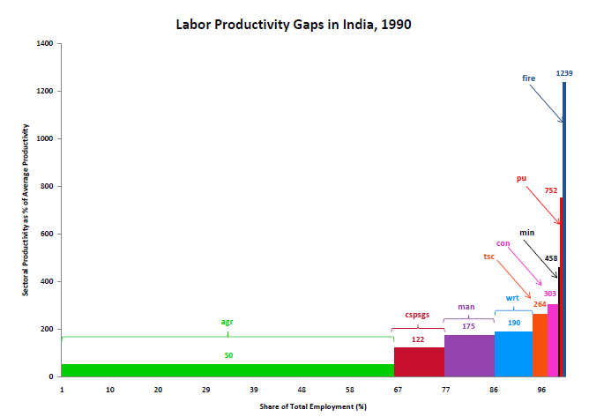
Consider India in 1990

Slide 6
India fits the Lewis Model

Slide 7
So does PRC

Slide 8
So, what does the rest of the world look like?

Slide 9
Venezuela

Slide 10
Nigeria

Slide 11
United States

Slide 12
How important has structural change been as a determinant of labor productivity and to what extent does it explain regional patterns of growth?

Slide 13
Labor productivity growth decomposition
within
structural change
Y refers to aggregate labor productivity, y is sectoral labor productivity, θ is employment share, Δ is the first-difference operator, i indexes sectors, t -k and t stand for initial and final years.

Slide 14
Data
Start from Groningen Growth and Development Center (GGDC) data base, which provides employment and real valued added statistics for 27 countries disaggregated into 10 sectors (Timmer and de Vries, 2007; 2009)
  We converted local currency value added at 2000 prices to dollars using 2000 PPP exchange rates.
Complement with data from national sources for 11 additional countries (China, Turkey, and several African countries)
For the most part, VA comes from national income accounts, while level and structure of employment come from population censuses (and other household surveys)
  Since employment data are not based on labor force or industrial surveys (save for extrapolation purposes), coverage of informal sector should be less problematic than otherwise

Slide 15
Decomposition of productivity growth, by region: 1990 - 2005
Productivity growth within sectors
Productivity growth due to structural change
Decomposition of productivity growth by country group, 1990-2005

Slide 16
What’s going on? Some possibilities:
Some countries have more “surplus labor” in agriculture than others
Role of comparative advantage: primary products versus manufactures
Labor market rigidity: large hiring/firing costs may prevent employment growth in dynamic sectors
Trade/industrial/currency policies have:
  Not encouraged new tradable activities sufficiently
  Exposed tradables to import competition too early and excessively

Slide 17
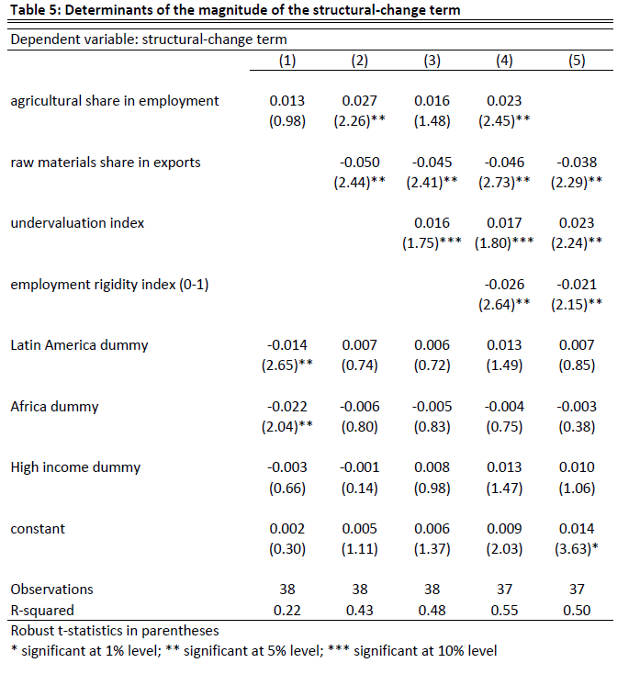

Slide 18
Large reservoir of “excess labor” helps, but only conditionally
unconditional
conditional
Association between the initial labor share in agriculture and the contribution of structural change to growth

Slide 19
Comparative advantage in primary products is bad news
Partial association between the share of primary products in exports and the contribution of structural change to growth

Slide 20
But policy can clearly help: currency undervaluation
Partial association between an index of currency “undervaluation” and the contribution of structural change to growth

Slide 21
But policy can clearly help: labor market rigidity
Partial association between an index of labor market rigidity and the contribution of structural change to growth

Slide 22
What’s going on? Some possibilities:
Some countries have more “surplus labor” in agriculture than others
Role of comparative advantage: primary products versus manufactures
Labor market rigidity: large hiring/firing costs may prevent employment growth in dynamic sectors
Trade/industrial/currency policies have:
  Not encouraged new tradable activities sufficiently
  Exposed tradables to import competition too early and excessively

Slide 24
Large reservoir of “excess labor” helps, but only conditionally
unconditional
conditional
Association between the initial labor share in agriculture and the contribution of structural change to growth

Slide 25
Comparative advantage in primary products is bad news
Partial association between the share of primary products in exports and the contribution of structural change to growth

Slide 26
But policy can clearly help: currency undervaluation
Partial association between an index of currency “undervaluation” and the contribution of structural change to growth

Slide 27
But policy can clearly help: labor market rigidity
Partial association between an index of labor market rigidity and the contribution of structural change to growth

Slide 28
Extensions and Robustness Tests
Including unemployment
Marginal vs. average productivity of labor
Country studies: 9 commissioned already
Extending the timeframe 1960-2010
Data collection for Africa underway

Slide 29
Conclusions
Large gaps in productivity within countries ensures significant potential for rapid economic growth in developing world, regardless of what happens in the rich countries
Fulfilling this potential requires ongoing process of diversification and structural change
This process is not automatic, especially in countries with an initial comparative advantage in primary products
It necessitates pragmatic, experimental policies that support new industries
  China’s OEZ in Africa and elsewhere
  Land governance assessment frameworks

