Slide 1

Covid-19 Supplemental Slides
PRINCIPLES OF ECONOMICS
Betsey Stevenson – Justin Wolfers | First Edition
Notes:
These slides are meant as a resource for the economics teaching community, providing you ways to add covid-related material to your existing teaching materials. They are written to pair with Betsey Stevenson and Justin Wolfers new textbook “Principles of Economics”, but in reality will work for just about any economics instructor. If you find errors in these slides, or have new examples you want to add, simply email: jwolfers@umich.edu. We hope that you find them useful!

Slide 2
The Core Principles of Economics
PRINCIPLES OF ECONOMICS
Betsey Stevenson – Justin Wolfers | First Edition

Slide 3

Everyday Economics: People Weighed the Costs and Benefits Before Government Shutdowns
Businesses and households began to shutdown or social distance 10-20 days before government orders.
Across early or late closing states, including states that did not close, most of the decline in economic activity occurred before official closures
10 days before Florida issued a stay-at-home order cellphone location data showed an 80% decrease in travel, with half of all phones not traveling more than a mile.
Notes:
Lecture Tips:
Use this slide to connect people’s implicit decision-making process during the pandemic to the cost-benefit principle
Possible Discussion Question: What do you think are some of the costs and benefits people weighed when deciding to go working or shopping?
Sources:
New York Times “Government Orders Alone Didn’t Close the Economy. They Probably Can’t Reopen It.” https://www.nytimes.com/2020/05/07/upshot/pandemic-economy-government-orders.html
CNN ““Floridians stopped traveling well before official shutdowns, data shows” https://www.cnn.com/2020/05/11/us/florida-coronavirus-travel/index.html

Slide 4

You Should Ignore Sunk Costs.
Ignoring sunk costs, especially during a pandemic, can be difficult.
“Mr. Nguyen knew the risk of attending, but said he did not want to lose the money he had spent on tickets. He did not blame organizers for holding the festival, and pointed to mix messages from local officials.”
The Costly Toll of Not Shutting Down Spring Break Earlier: people got sick – and some died – after attending parties in Florida as the coronavirus spread
- The New York Times (April 11, 2020)
Notes:
Lecture tips:
This concept is often hard for students. This example can help show how subtle sunk costs can be and therefore difficult to ignore with an extreme real-world example. This may also be an opportunity to introduce the link between the economic principles and policy
Sources:
The New York Times “The Costly Toll of Not Shutting Down Spring Break Earlier” https://www.nytimes.com/2020/04/11/us/florida-spring-break-coronavirus.html

Slide 5


Everyday Economics: Covid-19 Could Change the Opportunity Cost of Going to College
What was the opportunity cost of attending college this fall?
Did you ask: “or what?”
Attend college OR travel?
But travel is severely limited
Attend college OR work?
But work is severely limited for young workers and those without a bachelor’s degree
searches for “gap year” increased 180% in the last week of April 2020
Source: The Wall Street Journal (May 5, 2020)
17.6%
Unemployment rate for high school graduates, no college
(April 2020)
Source: U.S. Bureau of Labor Statistics
Notes:
Lecture Tips:
This slide builds off the Nerida example, to ask students to consider what opportunity costs did they consider before deciding to attend classes in the fall. It may be helpful to note that the BLS reports unemployment rates by education level for people 25 years and older. Therefore, depending on student’s age, unemployment could be higher.
Sources:
The Wall Street Journal “Incoming College Students Could Take Gap Year Over Covid-19 Uncertainty” https://www.wsj.com/articles/incoming-college-students-could-take-gap-year-over-covid-19-uncertainty-11588687598
McKinsey Global Institute “COVID-19 and jobs: Monitoring the US impact on people and places” https://www.mckinsey.com/industries/public-sector/our-insights/covid-19-and-jobs-monitoring-the-us-impact-on-people-and-places

Slide 6
Demand: Thinking Like a Buyer
PRINCIPLES OF ECONOMICS
Betsey Stevenson – Justin Wolfers | First Edition

Slide 7

Discussion Questions
How do you think market demand will change in the post-Covid ‘new normal’?
What are examples where demand will increase and examples where demand will decrease?
Price
Price
Decreased demand
Increased demand
Quantity
Quantity
Notes:
Lecture Tips: This slide allows students to discuss how Covid-19 changed their ‘buyer decisions’ and postulate how the pandemic will influence broader market demand. The below quote from a McKinsey report on consumer intent post-Covid could be helpful:
“Consumers intend to continue some of the digital and low-touch activities they have adopted during the pandemic (outdoor/fitness, remote learning, and digital entertainment). While there is lower intent to continue digital replacements for critical in-person activities like in-store shopping, eating at restaurants, and schooling for children.”
Source:
McKinsey “Consumer sentiment evolves as the next ‘normal’ approaches”

Slide 8

Practice Question
While in quarantine, many people started to bake which increased the demand for flour. How did this change in preferences effect demand for flour?
it caused the demand curve to shift left
it caused a movement up along the demand curve
it caused the demand curve to shift right
It caused a movement down along the demand curve
“The Coronavirus Baking Boom Has Made It Hard to Find Flour.”
- TIME (May 13, 2020)
- Correct Answer
Notes:
Answer: C
A change in preferences that increases demand causes the demand curve to shift to the right.

Slide 9
Supply: Thinking Like a Seller
PRINCIPLES OF ECONOMICS
Betsey Stevenson – Justin Wolfers | First Edition

Slide 10
Practice Question
Covid-19 lockdowns caused demand for gas to decrease and therefore oil prices plummeted. In response, Russia and Saudi Arabia cut production by 9.7M barrels per day. How did the global oil supply curve change?
it caused the supply curve to shift left
it caused a movement up along the supply curve
it caused the supply curve to shift right
It caused a movement down along the supply curve
“Oil Nations, Prodded by Trump, Reach Deal to Slash Production.”
- The New York Times (April 12, 2020)
- Correct Answer
Notes:
Answer: D
Covid-19 caused demand to decrease (demand curve shifted left), this caused a price change which leads to a movement along the supply curve.

Slide 11
Equilibrium: Where Supply Meets Demand
PRINCIPLES OF ECONOMICS
Betsey Stevenson – Justin Wolfers | First Edition

Slide 12
Everyday Economics: Pandemics Cause Both Supply and Demand to Shift
Covid-19 caused unemployment to skyrocket.
On March 26, the Department of Labor reported 3,283,000 people filed for unemployment last week.
The week before only 282,000 people filed for unemployment.
“More Than 3 Million Americans Lost Their Jobs Last Week.”
- Justin Wolfers, The New York Times (March 26, 2020)
“More Than 3 Million Americans Lost Their Jobs Last Week.”
- The New York Times (March 26, 2020)
Notes:
Lecture Tips:
This example aims to illustrate how pandemics cause both supply and demand to shift. Lockdowns or social distancing cause entire economies and markets to come to a halt leading to supply and demand-side shocks
Provide students with a brief roadmap: First, we will cover how a pandemic affects demand for restaurant meals. Second, how a pandemic affects the supply of restaurant meals. Both illustrated by real world examples. And third, we will see if our economic intuition was correct using publicly available app data.

Slide 13
Everyday Economics: Pandemics Cause Both Supply and Demand to Shift
Covid-19 caused unemployment to skyrocket.
What happened to Demand for restaurant meals?
Market for Restaurant Meals
Price
Old demand
New demand
Quantity
Notes:
Lecture Tips:
This example aims to illustrate how pandemics cause both supply and demand to shift. Lockdowns or social distancing cause entire economies and markets to come to a halt leading to supply and demand-side shocks
Provide students with a brief roadmap: First, we will cover how a pandemic affects demand for restaurant meals. Second, how a pandemic affects the supply of restaurant meals. Both illustrated by real world examples. And third, we will see if our economic intuition was correct using publicly available app data.

Slide 14

Everyday Economics: Pandemics Cause Both Supply and Demand to Shift
Covid-19 caused unemployment to skyrocket.
Many restaurants could not survive social distance shutdowns.
Celebrity Chef David Chang isn’t sure the restaurant industry will survive Covid-19.
-The New York Times (March 27, 2020)
“A Running List of Permanent Austin Restaurant Closures Due to Covid-19”
- Eater Austin (May 18, 2020)
“Sweet Tomatoes Shutters, Archive Bar & Kitchen Calls It Quits, and More Bay Area Restaurant Closures”
- Eater San Francisco (May 19, 2020)
“Coronavirus pandemic cripples Seattle restaurant industry, with more than 50 closures in 2 weeks”
- The Seattle Times (March 13, 2020)
Notes:
Lecture Tips:
This example aims to illustrate how pandemics cause both supply and demand to shift. Lockdowns or social distancing cause entire economies and markets to come to a halt leading to supply and demand-side shocks
Provide students with a brief roadmap: First, we will cover how a pandemic affects demand for restaurant meals. Second, how a pandemic affects the supply of restaurant meals. Both illustrated by real world examples. And third, we will see if our economic intuition was correct using publicly available app data.

Slide 15

Everyday Economics: Pandemics Cause Both Supply and Demand to Shift
Covid-19 caused unemployment to skyrocket.
Many restaurants could not survive social distance shutdowns.
What happened to Supply of restaurant meals?
Market for Restaurant Meals
Price
New supply
Old supply
Quantity
Notes:
Lecture Tips:
This example aims to illustrate how pandemics cause both supply and demand to shift. Lockdowns or social distancing cause entire economies and markets to come to a halt leading to supply and demand-side shocks
Provide students with a brief roadmap: First, we will cover how a pandemic affects demand for restaurant meals. Second, how a pandemic affects the supply of restaurant meals. Both illustrated by real world examples. And third, we will see if our economic intuition was correct using publicly available app data.

Slide 16


Everyday Economics: Pandemics Cause Both Supply and Demand to Shift
Covid-19 caused unemployment to skyrocket.
Many restaurants could not survive social distance shutdowns.
Now let’s put both shifts together. How do you think Price and Quantity changed?
Market for PPE
Price
New supply
Old supply
Old demand
New demand
Quantity
Notes:
Lecture Tips:
This example aims to illustrate how pandemics cause both supply and demand to shift. Lockdowns or social distancing cause entire economies and markets to come to a halt leading to supply and demand-side shocks
Provide students with a brief roadmap: First, we will cover how a pandemic affects demand for restaurant meals. Second, how a pandemic affects the supply of restaurant meals. Both illustrated by real world examples. And third, we will see if our economic intuition was correct using publicly available app data.

Slide 17
Everyday Economics: Pandemics Cause Both Supply and Demand to Shift
Source: OpenTable
Notes:
Lecture Tips:
This example aims to illustrate how pandemics cause both supply and demand to shift. Lockdowns or social distancing cause entire economies and markets to come to a halt leading to supply and demand-side shocks
Provide students with a brief roadmap: First, we will cover how a pandemic affects demand for restaurant meals. Second, how a pandemic affects the supply of restaurant meals. Both illustrated by real world examples. And third, we will see if our economic intuition was correct using publicly available app data.

Slide 18
Discussion Question
What should businesses and governments do when there is a shortage of personal protective equipment (PPE) and other essential items?
The Law of Supply and Demand Isn’t Fair.
“In a crisis, consumers think it is outrageous to jack up prices of essential items, yet that social norm predictably leads to shortages.”
-The New York Times (May 20, 2020)
“Higher prices discourage panic buying and increase the chance that the people who truly need particular goods and services have a greater chance of getting them”
“Supply and demand would tell us that the masks should go simply to the buyer who was willing and able to pay the most for them. But fairness tells us that this can’t be the only consideration.”
Tyler Cowen, professor of economics at George Mason University
Richard Thaler, Nobel Prize winning economist at the University of Chicago
Notes:
Lecture Tips: This slide connects supply and demand equilibrium and shortages to ideas of fairness within the context of coronavirus. One illustrative example (described in the article) is that of N95 masks. Since hospitals has long-term contracts with suppliers, when the need for masks skyrocketed suppliers were not allowed to raise the price on hospitals. But when hospitals ran out of regular stock, they were forced to pay overseas suppliers $6 per mask (normally $0.35). Would increased prices prevented people from panic buying PPE and allowed hospitals to buy masks for frontline workers, albeit at a higher price?
Sources:
The New York Times “The Law of Supply and Demand Isn’t Fair” (https://www.nytimes.com/2020/05/20/business/supply-and-demand-isnt-fair.html)

Slide 19
Elasticity:Measuring Responsiveness
PRINCIPLES OF ECONOMICS
Betsey Stevenson – Justin Wolfers | First Edition

Slide 20

Discussion Question
How has demand for streaming services changed during Covid-19?
Demand for streaming services increased while people quarantined
Demand for streaming services also become less elastic.
Why do you think this is?
Netflix’s ‘Tiger King’ documentary
Price
Less elastic demand
Increased demand
Quantity
Notes:
Lecture Tips: This asks students to build on their knowledge of demand to incorporate elasticity. First, demand for streaming services increased (shift right) because more people where social distancing at home needing entertainment. Additionally, because of government shutdowns substitutes for streaming (i.e. other leisure activities like going out to restaurants, sports events, live entertainment etc.) decreased. Less substitutes means more inelastic (less elastic). This emphasizes the theme that elasticity is about substitutability.

Slide 21
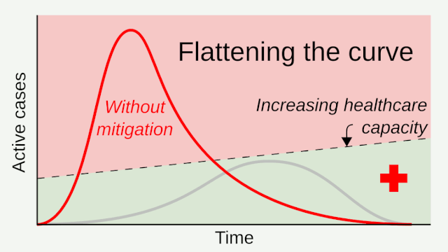
Everyday Economics: Supply Elasticity is an Important Factor in ‘Flattening the Curve’
However, short run supply of ventilators is inelastic, therefore it is crucial to flatten the curve
Market for Ventilators
Price
Short run supply curve
Source: Wikipedia (User RCraig09 own work)
Quantity
Notes:
Lecture Tips: These slides draw the connection between supply elasticity and public health strategy ‘flattening the curve’.
The animated gif on the right, shows how mitigation measures, like social distancing, help ‘flatten the curve’ of active cases by slowing the spread of infectious diseases. If the mitigation measures are adequate it is possible to disperse the active cases over time such that the caseload remains below healthcare capacity. Without mitigation measures, the active number of cases spikes quickly and dramatically overwhelming healthcare systems. This animation is also helpful because it shows an upward sloping healthcare capacity line, which can be analogous to our healthcare services supply curve.
In the long run, the supply curve for healthcare services or devices (like ventilators) is very elastic and horizontal. This means over time; the supply of healthcare services becomes more responsive to changes in price. However, in the short run the supply of ventilators and health services is extremely inelastic – or extremely unresponsive to changes in price. One reason for this is the limitation of health system capacity and highlights the importance of ‘flattening the curve’ to allow healthcare capacity to increase and therefore healthcare service supply to become more responsive
Sources:
Wikipedia: animation link (https://en.wikipedia.org/wiki/Flattening_the_curve#/media/File:20200403_Flatten_the_curve_animated_GIF.gif) and ‘Flattening the curve’ page link (https://en.wikipedia.org/wiki/Flattening_the_curve)

Slide 22
Everyday Economics: Policy Levers Are an Important Factor in Long Run Supply Elasticity
In the long run, supply of ventilators and healthcare services is very elastic.
GM to build 30,000 ventilators for national stockpile for $489.4 million
-CNBC(April 8, 2020)
Market for Ventilators
Price
Long run supply curve
Quantity
Notes:
Lecture Tips: This slide draws the connection between supply elasticity and the use of the Defense Production Act.
In the long run, the supply curve for healthcare services or devices (like ventilators) is very elastic and horizontal. This means over time; the supply of healthcare services becomes more responsive to changes in price. Policy responses like the Defense Production Act, allow government to influence the supply of crucial goods like ventilators. However, it is important to note that at the time of this article's publication, GM was slated to complete these ventilators in August. For a disease as infectious as Covid-19 the intervening 4 months is 'long term'. Highlighting the importance of 'flattening the curve' in the short run (see previous slide).
Sources:
CNBC "GM to build 30,000 ventilators for national stockpile for $489.4 million" (https://www.cnbc.com/2020/04/08/gm-to-build-30000-ventilators-for-us-for-489point4-million.html)

Slide 23
When Governments Intervene in Markets
PRINCIPLES OF ECONOMICS
Betsey Stevenson – Justin Wolfers | First Edition

Slide 24

Everyday Economics: $2 Trillion CARES Act Aid Package for Coronavirus Relief
The U.S. CARES Act included $377 billion in aid for small businesses in the form of grants, and forgivable loans contingent on maintaining payroll and keeping workers employed.
How do you think the government’s intervention changed the market for restaurant meals?
Market for Restaurant Meals
Sticker Price
Old supply curve
New supply curve
Price sellers receive
Price buyers pay
Quantity
Demand curve
Quantity
Notes:
Lecture Tips: This slide ask students to analyze the effect of the CARES act on the Market for Restaurant meals. In this simplified example, the CARES act can be thought of as a subsidy for restaurants, thereby lowering and shifting the marginal cost of restaurant meal and increasing the quantity of restaurant meals.
Sources:
NPR “What’s Inside The Senate’s $2 Trillion Coronavirus Aid Package” (https://www.npr.org/2020/03/26/821457551/whats-inside-the-senate-s-2-trillion-coronavirus-aid-package)
The New York Times “F.A.Q. on Stimulus Checks, Unemployment and the Coronavirus Plan” (https://www.nytimes.com/article/coronavirus-stimulus-package-questions-answers.html)
The New York Times “F.A.Q. on Coronavirus Relief for Small Businesses, Freelancers and More” (https://www.nytimes.com/article/small-business-loans-stimulus-grants-freelancers-coronavirus.html)

Slide 25
Welfare and Efficiency
PRINCIPLES OF ECONOMICS
Betsey Stevenson – Justin Wolfers | First Edition

Slide 26
Discussion Question
Notes:
Lecture Tips: This slide connects the introduction of equity with the CARES Act, providing an opportunity for students to comment as to whether they think the distribution of $2 Trillion dollars was equitable. It may be helpful to provide students with information regarding the following stipulations:
Individuals: in addition to cash payments, these funds added an additional $600 per week to unemployment and extends UI by 13 weeks. Additionally, gig workers and freelancers were eligible for temporary Pandemic Unemployment (usually these works are not eligible for normal UI)
Large Corporations: any company receiving government loans are barred from making stock buybacks for the term of the loan + one year
Small Businesses: any portion of loans used to maintain payroll and keep workers employed through the end of June could be forgiven
Other: included temporary student loan relief until the end of September
Sources:
NPR “What’s Inside The Senate’s $2 Trillion Coronavirus Aid Package” (https://www.npr.org/2020/03/26/821457551/whats-inside-the-senate-s-2-trillion-coronavirus-aid-package)
The New York Times “F.A.Q. on Stimulus Checks, Unemployment and the Coronavirus Plan” (https://www.nytimes.com/article/coronavirus-stimulus-package-questions-answers.html)
The New York Times “F.A.Q. on Coronavirus Relief for Small Businesses, Freelancers and More” (https://www.nytimes.com/article/small-business-loans-stimulus-grants-freelancers-coronavirus.html)

Slide 27
Gains from Trade
PRINCIPLES OF ECONOMICS
Betsey Stevenson – Justin Wolfers | First Edition

Slide 28
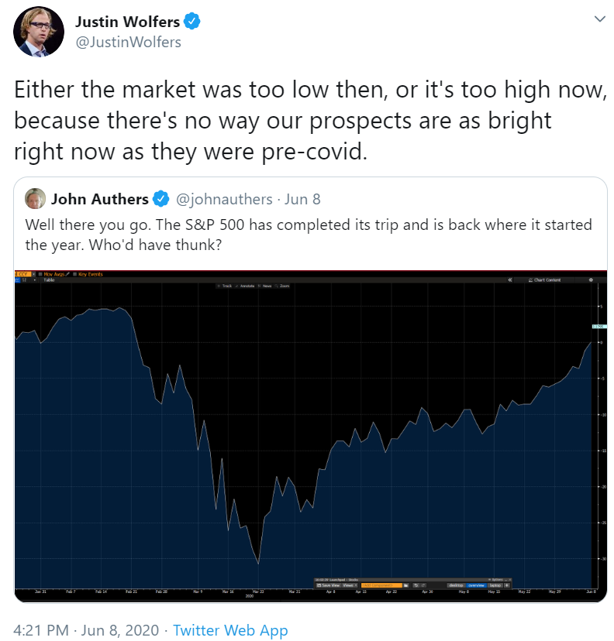
Everyday Economics: A Pandemic Can Make it Difficult to Interpret Prices
Despite the Covid-19 recession, the S&P 500 experienced the fastest drop followed by the fastest rebound in 90 years
During Covid-19 lockdowns Hertz stock dropped to $0.40 due to bankruptcy before growing 1,400% to $6
Due in part to thousands of amateur investors buying Hertz stock on Robinhood
Notes:
Lecture Notes: This slide builds off Price’s three roles (as a signal, incentive, and aggregate information) – by highlighting during times of extreme uncertainty (and volatility) it can be difficult to interpret what prices are trying to tell us. For example:
During the Covid-19 lockdowns, despite it being clear the U.S. (and the global economy) was heading into a recession, the S&P 500 had it’s fastest 50 day rebound in 90 years. Since stocks are a measure of a company’s future cash flows, and the S&P 500 a proxy for the market’s prospects, what does this fall and rise tell us? Per Justin’s tweet – what the market too low pre-covid? Or is the market to high in June 2020?
During Covid-19, Hertz (a car rental company) declared bankruptcy after which it’s shares dropped to 40 cents. However, in the weeks that followed many amateur investors bought shares of Hertz which increased the price 1,400% to a high of $6 (before falling to $2). Hertz even attempted to sell $500 million in additional shares, despite it warning ‘potential investors that it’s almost certain that the equity will become worthless’, before the SEC caused it to halt. What does Hertz’s stock price tell us about the prospects of this bankrupt company?
Sources:
CNBC “Hertz halts plan to sell $500 million in shares pending SEC review” (https://www.cnbc.com/2020/06/17/hertz-halts-plan-to-sell-500-million-in-shares-after-sec-review.html?utm_source=morning_brew)
Bloomberg “Hundreds of Thousands of Tiny Buyers Swarm to Insolvency Stocks” (https://www.bloomberg.com/news/articles/2020-06-09/hundreds-of-thousands-tiny-investors-swarm-to-insolvency-stocks?sref=KkPzpZvz&utm_source=morning_brew)

Slide 29
International Trade
PRINCIPLES OF ECONOMICS
Betsey Stevenson – Justin Wolfers | First Edition

Slide 30
Discussion Question: How Will Covid-19 Change Global Trade?
Before 2008, global trade was growing twice as fast as the world economic output
Post-Covid, global trade is projected to fall three times as much as world output
Anti-trade talk is growing around the world; including on-shoring of food supply and restricting PPE exports.
Is on-shoring the best way to build resilient supply chains?
Has Covid-19 Killed Globalization?
-The Economist (May 14, 2020)
“The pandemic will politicize travel and migration and entrench a bias towards self-reliance. This inward-looking lurch will enfeeble the recovery, leave the economy vulnerable and spread geopolitical instability.”
Notes:
Lecture Notes: This slide provides an opportunity for students to discuss the future of global trade post-covid. This discussion builds on the five arguments for limiting trade, especially 1) national security concerns. The slide provides data on global trade post-2008 financial crisis to inform students discussion. Additionally, the third bullet provides projects for 2020 post-Covid and ask an additional question – is nationalization better for resilient supply chains? This question aims to push students to balance national security with diversification of global supply chains – a call back to the counter argument for national security limiting trade.
Sources:
The Economist “Has Covid-19 Killed Globalization?” (https://www.economist.com/leaders/2020/05/14/has-covid-19-killed-globalization)
The New York Times “The Pandemic Isn’t Changing Everything” (https://www.nytimes.com/2020/05/03/opinion/coronavirus-economy-nationalism.html?searchResultPosition=31)

Slide 31
Externalities and Public Goods
PRINCIPLES OF ECONOMICS
Betsey Stevenson – Justin Wolfers | First Edition

Slide 32
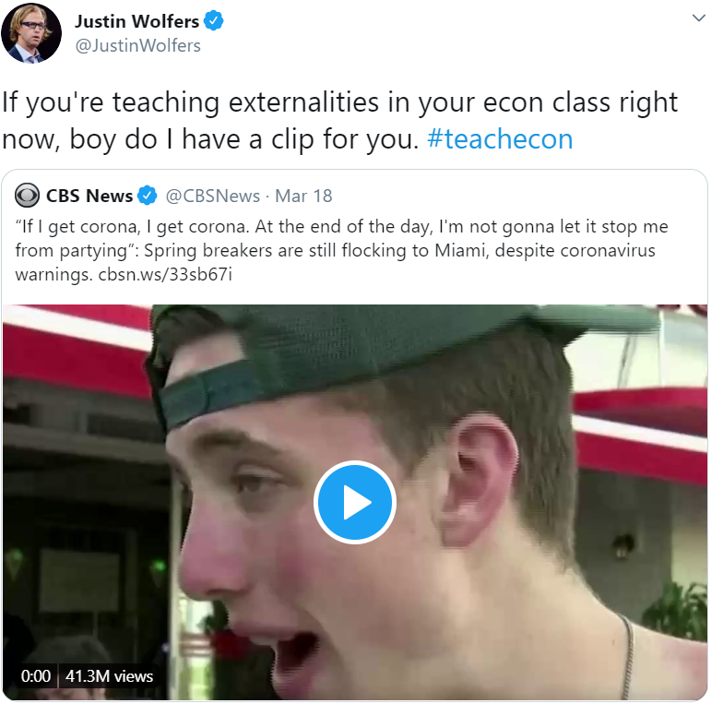

Everyday Economics: Covid-19 Presented Negative and Positive Externalities
Infectious diseases, like coronavirus Covid-19, force individuals to make decisions laden with externalities.
Negative externalities include attending crowded spring break parties
Positive externalities include appropriate social distancing
Source: CBS News (Twitter)
Notes:
Lecture Notes: These slides connect the discussion of externalities (and solutions) to the Covid-19 pandemic.
This slide provides background that students can see both negative and positive externalities at play within individual decision-making during the pandemic. The clip shows several undergraduate college students explaining their decision to continue spring break plans amidst growing state and local business closures. The quote “If I get corona, I get corona” exemplifies the attitude of someone failing to internalize the external social costs of spreading the disease. (There are also examples of individuals falling for the sunk cost fallacy in the clip)
Sources:
CBS News Twitter Feed (https://twitter.com/CBSNews/status/1240371160078000128)

Slide 33
Everyday Economics: Covid-19 Presented Examples of Negative Externalities
The marginal external cost associated with risky behavior during a pandemic are larger the more infectious and fatal the disease because you are likely to make more people sick
The infectiousness of a disease is estimated by R or its ‘reproduction rate’.
A higher R means, on average, someone with the disease infects more people
What solutions can be used to internalize this negative externality?
Marginal social cost
of contracting Covid-19
Market for Spring Break Trip
Price
Marginal external cost of infecting others with Covid-19
Marginal private cost
of contracting Covid-19
Demand
Overproduction of spring break trips
Quantity
Notes:
Lecture Notes: This next slide focuses on the negative externality. Specifically, how failing to internalize the external social cost of contracting Covid-19 leads to an overproduction of risky behaviors (such as attending spring break parties, going to bars and restaurants, not wearing a mask, etc.). This slide also draws a directional relationship between the R0 of a disease and the magnitude of the marginal external cost. For example, a disease with an R0 of 1.5 to 3.5 (ex. Covid-19) would have a larger marginal external cost compared to a disease with an R0 of 0.9 to 2.1 (seasonal influenza) all else held equal (case fatality rates, incubation periods, transmission vectors, etc.). Lastly, this slide ask students to brainstorm potential solutions to address the negative externality (ex. corrective taxes/fines for not wearing a mask, social norms that shame risky behavior etc.)
Sources:
University of Michigan School of Public Health “R0: How Scientists Quantify the Intensity of an Outbreak Like Coronavirus and Its Pandemic Potential” (https://sph.umich.edu/pursuit/2020posts/how-scientists-quantify-outbreaks.html)

Slide 34
Everyday Economics: Covid-19 Presented Examples of Positive Externalities
Similarly, the marginal external benefit associated with social distancing and mask-wearing during a pandemic are larger the more potential infections and fatalities averted since your actions can save more lives.
What solutions can be used to internalize this positive externality?
Market for Masks
Price
Supply
Marginal social benefit
of masks
Marginal external benefit of preventing spread of Covid-19
Marginal private benefit of mask wearing
Underproduction of masks
Quantity
Notes:
Lecture Notes: This last slide focuses on the positive externality of social distancing. Specifically, how failing to internalize the external social benefit of preventing Covid-19 infections and fatalities leads to an underproduction of public health behaviors (such as social distancing, and mask wearing, etc.). Lastly, this slide ask students to brainstorm potential solutions to address the positive externality. For example: providing free testing, paid sick leave, govt subsidizing remote work, etc.

Slide 35
The Labor Market
PRINCIPLES OF ECONOMICS
Betsey Stevenson – Justin Wolfers | First Edition

Slide 36

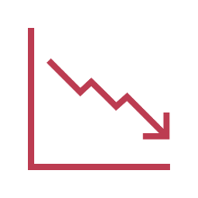

Everyday Economics: Recessions Cause Changes in Labor Market with Lasting Effects
“Those entering the job market during in a downturn may never catch up”
- The New York Times (May 19, 2020)
Rothstein, and Munnell et. al show 2008 college grads had lower employment rates, earned less, and were less financially secure 10 years later
Khan found college grads in the 80’s who experienced 2 recessions experienced low-quality, low-pay jobs and higher mortality rates over the next 2 decades
During a recession first jobs are a worse fit making competing in future labor market difficult and grads are more risk averse, so they don’t change jobs as often
Notes:
Lecture Tips:
This examples aims to illustrate one of the reasons why pandemics create uncertainty
During lockdowns or social distancing, entire economies and markets where experience supply and demand-side shocks
Sources:
The New York Times “Facing Adulthood With an Economic Disaster’s Lasting Scars” (https://www.nytimes.com/2020/05/19/business/economy/coronavirus-young-old.html?action=click&module=Spotlight&pgtype=Homepage)
Rothstein, Jesse “The Lost Generation? Scarring after the Great Recession” (https://eml.berkeley.edu/~jrothst/workingpapers/rothstein_scarring_052019.pdf)
Munnell, Alicia H., and Wenliang Hou “Will Millennials Be Ready for Retirement?” (https://crr.bc.edu/briefs/will-millennials-be-ready-for-retirement/)
Khan, Lisa B., “The Long-Term Labor Market Consequences of Graduating from College in a Bad Economy” (https://pdfs.semanticscholar.org/a16a/033a9b71bc7eeafe5419053ae608fd3368a3.pdf?_ga=2.129414732.1352823761.1588859993-1755115163.1588859993)

Slide 37
Wages, Workers, and Management
PRINCIPLES OF ECONOMICS
Betsey Stevenson – Justin Wolfers | First Edition

Slide 38

Discussion Question
What If Working From Home Goes on… Forever
-The New York Times (June 9, 2020)
How do you think work will change in the post-Covid-19 ‘new normal’?
Digital monitoring
VS
Efficiency wages
Will remote work lead to an increase in digital surveillance or higher efficiency wages since its more difficult to monitor remote employees?
Better work/life balance
VS
Longer work hours
During covid-19 workdays expanded an additional 3 hours in the US, will this continue post-covid or will companies offer more flexible remote work schedules to attract intrinsically motivated employees?
Notes:
Lecture Tips: This slide provides an opportunity for students to discuss their ‘hot takes’ regarding how the world of work will change post-covid. Students can practice applying new concepts such as efficiency wages, market for superstars, worker/union bargaining power, compensating differentials, and corporate culture. The following four pairs are meant to be illustrative examples:
Digital micromanaging vs Efficiency wages: will remote work lead to an increase in digital surveillance technologies or will employers use higher wages since it will be more difficult to monitor remote employees?
Lower wages due to recession vs Higher wages due to cost-savings: will the recession lead to lower wages due to the poor economy or will the cost-savings from reduced physical footprints be passed on to employees?
Better work/life balance vs longer work hours: During covid-19 workdays have expanded in Britain, France, and Spain – including an additional 3 hours in the US, will this continue post-covid? Or will companies looking to hire intrinsically motivated employees offer more flexible work schedules and better work/life balance?
Sources:
The Economist “Adam Grant on how jobs, bosses and firms may improve after the crisis” (https://www.economist.com/by-invitation/2020/06/01/adam-grant-on-how-jobs-bosses-and-firms-may-improve-after-the-crisis)
The New York Times “What If Working From Home Goes on… Forever?” (https://www.nytimes.com/interactive/2020/06/09/magazine/remote-work-covid.html)
The Economist “Working life has entered a new era” (https://www.economist.com/business/2020/05/30/working-life-has-entered-a-new-era)

Slide 39
Everyday Economics: Retailers Offered Hazard Pay During Covid-19
During the pandemic, many retailers offered temporary pay bumps to employees who continued to work.
Starbucks increased hourly wages by $3 and Target increased hourly wages by $2.
This ‘Hero Pay’ was used as a compensating differential for the increased risk of Covid-19 and increased altercations with customers not willing to follow public health guidelines.
“As ‘Hero’ Pay Ends, Essential Workers Wonder What They are Worth”
- NPR (May 30, 2020)
“In a normal world, high hazard pay might be the only way to stop employees from quitting en masse. But with tens of millions unemployed, workers quickly lost a lot of leverage
- NPR (May 30, 2020)
Notes:
Lecture Tips: This slide draws a connection between compensating differentials and Covid-19 hazard pay. The quote also provides a jumping off point for students to critically think about the role of employer power (especially monopsony power) in these situations. By mid-July, many retailers ended their ‘hero pay’ programs, despite increasing cases in the U.S., though there were some exceptions such as Target which decided to make the bumped up $15 an hour wage permanent.
Sources:
NPR ‘As 'Hero' Pay Ends, Essential Workers Wonder What They Are Worth’ (https://www.npr.org/2020/05/30/864477016/as-hero-pay-ends-essential-workers-wonder-what-they-are-worth)
NPR ‘Target Makes Extra Coronavirus Pay Permanent, Boosts Hourly Minimum To $15’ (https://www.npr.org/sections/coronavirus-live-updates/2020/06/17/879696142/target-makes-extra-coronavirus-pay-permanent-boosts-hourly-minimum-to-15)

Slide 40
Inequality, Social Insurance, and Redistribution
PRINCIPLES OF ECONOMICS
Betsey Stevenson – Justin Wolfers | First Edition

Slide 41
Interpreting the Data: Covid-19 Reinforced Income Inequality
Notes:
Data from The Economist “American inequality meets covid-19”, April 18, 2020 (link below)
Lecture Tips: These slides provide an opportunity to
Connect inequality to the coronavirus pandemic
Highlight the relationships between different forms of inequality (income, health, racial, housing, etc.)
These slides should be presented after “Who is in Poverty” slides
Additional Resources:
The Economist “American inequality meets covid-19” (https://www.economist.com/united-states/2020/04/18/american-inequality-meets-covid-19)
The New York Times “New York City Coronavirus Map and Case Count” (https://www.nytimes.com/interactive/2020/nyregion/new-york-city-coronavirus-cases.html)
The New York Times “Virus Is Twice as Deadly for Black and Latino People Than Whites in N.Y.C” (https://www.nytimes.com/2020/04/08/nyregion/coronavirus-race-deaths.html)
The New York Times “As Coronavirus Deepens Inequality, Inequality Worsens Its Spread” (https://www.nytimes.com/2020/03/15/world/europe/coronavirus-inequality.html)
Vox “Every aspect of the coronavirus pandemic exposes America’s devastating inequalities” (https://www.vox.com/2020/4/10/21207520/coronavirus-deaths-economy-layoffs-inequality-covid-pandemic)
Vox “How racism and poverty made Detroit a new coronavirus hot spot” (https://www.vox.com/identities/2020/4/10/21211920/detroit-coronavirus-racism-poverty-hot-spot)

Slide 42
Interpreting the Data: Covid-19 Reinforced Income Inequality
Less than a high school diploma
High school graduates, no college
Some college or associate degree
Bachelor’s degree and higher
Source: U.S. Bureau of Labor Statistics
Notes:
Data from the U.S. Bureau of Labor Statistics
Lecture Tips: These slides provide an opportunity to
Connect inequality to the coronavirus pandemic
Highlight the relationships between different forms of inequality (income, health, racial, housing, etc.)
These slides should be presented after “Who is in Poverty” slides
Additional Resources:
The Economist “American inequality meets covid-19” (https://www.economist.com/united-states/2020/04/18/american-inequality-meets-covid-19)
The New York Times “New York City Coronavirus Map and Case Count” (https://www.nytimes.com/interactive/2020/nyregion/new-york-city-coronavirus-cases.html)
The New York Times “Virus Is Twice as Deadly for Black and Latino People Than Whites in N.Y.C” (https://www.nytimes.com/2020/04/08/nyregion/coronavirus-race-deaths.html)
The New York Times “As Coronavirus Deepens Inequality, Inequality Worsens Its Spread” (https://www.nytimes.com/2020/03/15/world/europe/coronavirus-inequality.html)
Vox “Every aspect of the coronavirus pandemic exposes America’s devastating inequalities” (https://www.vox.com/2020/4/10/21207520/coronavirus-deaths-economy-layoffs-inequality-covid-pandemic)
Vox “How racism and poverty made Detroit a new coronavirus hot spot” (https://www.vox.com/identities/2020/4/10/21211920/detroit-coronavirus-racism-poverty-hot-spot)

Slide 43
Interpreting the Data: Covid-19 Reinforced Income and Racial Inequalities
The coronavirus pandemic was worse in New York City ZIP codes with lower median incomes
Coronavirus cases and deaths were also more prevalent in majority black or Hispanic ZIP codes
“The pandemic is widening social and economic divisions that also make the virus deadlier, a self-reinforcing cycle that experts warn could have consequences for years to come.”
The New York Times (March 15, 2020)
“Virus Is Twice as Deadly for Black and Latino People Than Whites in N.Y.C”
- The New York Times (March 26, 2020)
Notes:
Lecture Tips: These slides provide an opportunity to
Connect inequality to the coronavirus pandemic
Highlight the relationships between different forms of inequality (income, health, racial, housing, etc.)
These slides should be presented after “Who is in Poverty” slides
Additional Resources:
The Economist “American inequality meets covid-19” (https://www.economist.com/united-states/2020/04/18/american-inequality-meets-covid-19)
The New York Times “New York City Coronavirus Map and Case Count” (https://www.nytimes.com/interactive/2020/nyregion/new-york-city-coronavirus-cases.html)
The New York Times “Virus Is Twice as Deadly for Black and Latino People Than Whites in N.Y.C” (https://www.nytimes.com/2020/04/08/nyregion/coronavirus-race-deaths.html)
The New York Times “As Coronavirus Deepens Inequality, Inequality Worsens Its Spread” (https://www.nytimes.com/2020/03/15/world/europe/coronavirus-inequality.html)
Vox “Every aspect of the coronavirus pandemic exposes America’s devastating inequalities” (https://www.vox.com/2020/4/10/21207520/coronavirus-deaths-economy-layoffs-inequality-covid-pandemic)
Vox “How racism and poverty made Detroit a new coronavirus hot spot” (https://www.vox.com/identities/2020/4/10/21211920/detroit-coronavirus-racism-poverty-hot-spot)

Slide 44
Interpreting the Data: Income and Racial Inequalities were Exacerbated by Covid-19
Asian/Pacific Islander
White/Caucasian
African American
Sources: U.S. Census Bureau, Michigan Coronavirus Data
Notes:
Data from U.S. Census Bureau and Michigan Coronavirus Data (https://www.michigan.gov/coronavirus/0,9753,7-406-98163_98173---,00.html)
Lecture Tips: These slides provide an opportunity to
Connect inequality to the coronavirus pandemic
Highlight the relationships between different forms of inequality (income, health, racial, housing, etc.)
These slides should be presented after “Who is in Poverty” slides
Additional Resources:
The Economist “American inequality meets covid-19” (https://www.economist.com/united-states/2020/04/18/american-inequality-meets-covid-19)
The New York Times “New York City Coronavirus Map and Case Count” (https://www.nytimes.com/interactive/2020/nyregion/new-york-city-coronavirus-cases.html)
The New York Times “Virus Is Twice as Deadly for Black and Latino People Than Whites in N.Y.C” (https://www.nytimes.com/2020/04/08/nyregion/coronavirus-race-deaths.html)
The New York Times “As Coronavirus Deepens Inequality, Inequality Worsens Its Spread” (https://www.nytimes.com/2020/03/15/world/europe/coronavirus-inequality.html)
Vox “Every aspect of the coronavirus pandemic exposes America’s devastating inequalities” (https://www.vox.com/2020/4/10/21207520/coronavirus-deaths-economy-layoffs-inequality-covid-pandemic)
Vox “How racism and poverty made Detroit a new coronavirus hot spot” (https://www.vox.com/identities/2020/4/10/21211920/detroit-coronavirus-racism-poverty-hot-spot)

Slide 45
Market Structure and Market Power
PRINCIPLES OF ECONOMICS
Betsey Stevenson – Justin Wolfers | First Edition

Slide 46

Discussion Question
How has Amazon’s market power changed during Covid-19, if at all?
“Brands are absolutely terrified to be reliant on Amazon right now, but they have no other choice.”
Price
Amazon demand pre-Covid-19
Amazon demand post-Covid-19
(more market power)
Josh Cowan, former Amazon executive
Quantity
Notes:
Lecture Tips: This slide aims to help students connect market power to Covid-19. While Covid-19 is hurting the economy, the effect is not the same across all companies and some, like Amazon, may benefit from the pandemic when businesses have few e-commerce channels to reach consumers.
Sources:
The Seattle Times ‘Amazon wins business from reluctant brands after coronavirus closes stores’ (https://www.seattletimes.com/business/amazon-wins-business-from-reluctant-brands-after-coronavirus-closes-stores/)

Slide 47
Everyday Economics: Covid-19 Could Lead to a Consolidation of Market Power
“As the world gets back on its feet, big firms will have better access to capital markets, giving them an extra edge over smaller competitors”
Larger airlines may try to grab airport slots from bankrupt rivals or acquire rivals directly.
Tech giants, Amazon, Google, etc. might leverage the need for their services in post-Covid world against arguments to ‘break up big tech.’
Big companies work well with government and are in a better position to lobby politicians
“The only engine of consumption for the next 12 to 24 months will be government”
– Anand Mahindra, Chairman of one of India’s largest conglomerates
The Economist (April 11, 2020)
Notes:
Lecture Notes: This slide provides aims to get students to think about how market power will change post-Covid-19. The slide highlights three examples supporting the argument that many industries will experience market power consolidation. Can students think of ‘relatively’ new companies that have been able to succeed during the pandemic? (Ex. Zoom, Slack) Are these exceptions that prove the rule?
Sources:
The Economist “The changes covid-19 is forcing on to business” (https://www.economist.com/briefing/2020/04/11/the-changes-covid-19-is-forcing-on-to-business)

Slide 48
Entry, Exit, and Long-Run Profitability
PRINCIPLES OF ECONOMICS
Betsey Stevenson – Justin Wolfers | First Edition

Slide 49
Everyday Economics: Restaurants – To Open or Not To Open During A Pandemic
Why did some restaurants re-open (example: offer delivery) during Covid-19, even though they were losing money?
In the short run, fixed costs, like rent, are sunk. If a restaurant earns marginal revenue greater than marginal cost, they should remain open.
Short run Market for Restaurant Meals
Price
Marginal cost
Marginal revenue
Quantity
Notes:
Lecture Notes: These slides connect the concepts of short run and long run profits/exit to the coronavirus pandemic, by asking students to think about why restaurants decided to stay open (or offer delivery) early during shut downs. The first slide emphasizes that in the short run, many fixed costs (like rent) were sunk for restaurants. Therefore, using the marginal principle, it was rational for restaurants to stay open (keep producing meals) as long as marginal revenue was greater than marginal cost.
The next slide shows how the story changes in the long run. In the long run, fixed costs are not sunk – restaurants have to continue making rent payments. Therefore, restaurant owners have to consider their full set of average total costs (fixed + variable) when deciding whether to stay in business of exit the market. If average cost is greater than an individual restaurant’s demand (or average revenue) then in the long run the restaurant will exit since it is unprofitable.
This discussion can also emphasize to students that given the circumstances and the time horizon not all fixed costs are ‘fixed’ in the sense that they cannot change. For example during the pandemic some landlords where willing to renegotiate rents during shutdowns.

Slide 50
Everyday Economics: Restaurants – To Open or Not To Open During A Pandemic
Why did some restaurants re-open (ex. offer delivery) during Covid-19, even though they were losing money?
In the long run, if restaurant’s average revenue is not greater than average costs, including fixed costs like rent and variable costs like ingredients, then the restaurant is unprofitable and will exit.
Long run Market for Restaurant Meals
Price
Average cost
Negative profit
Restaurant demand
(= Average revenue)
Quantity
Notes:
Lecture Notes: These slides connect the concepts of short run and long run profits/exit to the coronavirus pandemic, by asking students to think about why restaurants decided to stay open (or offer delivery) early during shut downs. The first slide emphasizes that in the short run, many fixed costs (like rent) were sunk for restaurants. Therefore, using the marginal principle, it was rational for restaurants to stay open (keep producing meals) as long as marginal revenue was greater than marginal cost.
The next slide shows how the story changes in the long run. In the long run, fixed costs are not sunk – restaurants have to continue making rent payments. Therefore, restaurant owners have to consider their full set of average total costs (fixed + variable) when deciding whether to stay in business of exit the market. If average cost is greater than an individual restaurant’s demand (or average revenue) then in the long run the restaurant will exit since it is unprofitable.
This discussion can also emphasize to students that given the circumstances and the time horizon not all fixed costs are ‘fixed’ in the sense that they cannot change. For example during the pandemic some landlords where willing to renegotiate rents during shutdowns.

Slide 51
Business Strategy
PRINCIPLES OF ECONOMICS
Betsey Stevenson – Justin Wolfers | First Edition

Slide 52
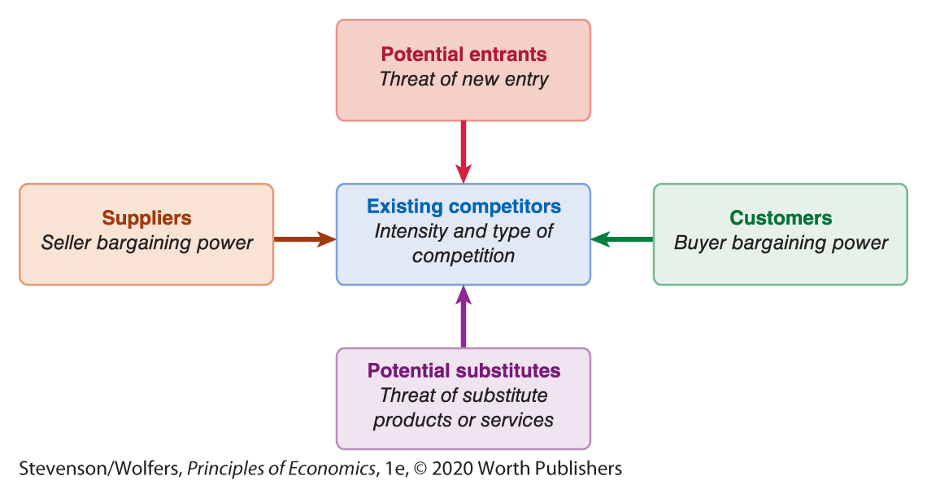
Discussion Question
Choose one company or industry and evaluate it’s five forces pre-Covid-19 and post-Covid-19. Has the industry become more or less attractive?
Notes:
Lecture Notes: This slide provides students to break into small groups and choose an industry/company to evaluate through the lens of Porter’s Five Forces. Ask students to evaluate the industry for each source before the coronavirus pandemic and after. Ask the groups to reach consensus on whether the industry is now more attractive (less intense competition, lower threat of entrants/substitutes, lower buyer/supplier bargaining power) or less attractive (more intense competition, higher threat of entrants/substitutes, higher buyer/supplier bargaining power).

Slide 53
Discussion Question
The movie theater industry, has become less attractive
Existing Competitors
Potential entrants
Potential substitutes
Competing theaters were also forced to shut
Entrants are unlikely, competitors will have to reopen at same time
Increased threat of streaming services, Peacock & HBOMax debuted during Covid-19
Suppliers
Customers
Movie studies, like Universal, are more willing to premiere movies on streaming platforms
Have more options for streaming services (& be more willing to pay while quarantined) & are unable to access theaters,
Notes:
Lecture Notes: This slide provides an example for the discussion question using the movie theater industry like AMC Theaters.
Sources:
The Los Angeles Times ‘AMC Theatres lost $561 million in one quarter, with revenue down nearly 100%, because of COVID-19’ (https://www.latimes.com/entertainment-arts/business/story/2020-08-06/amc-theatres-lost-561-million-in-one-quarter-because-of-covid-19)

Slide 54
Discussion Question
The at-home fitness streaming industry, has become more attractive
Existing Competitors
Potential entrants
Potential substitutes
A limited set of competitors such as Peloton, Mirror, Myx etc.
Entrants are unlikely in a downturn economy
In-person gyms (Orange Theory, Planet Fitness) were forced to close due to Covid-19
Suppliers
Customers
After initial disruption, exports may recover faster than in-person fitness classes
Have less options for fitness classes during quarantine
Notes:
Lecture Notes: This slide provides an example for the discussion question using the at-home fitness streaming industry (like Peloton).
Sources:
Business Insider ‘Peloton reports 66% increase in sales as coronavirus keeps consumers working out at home’ (https://www.businessinsider.com/peloton-sales-surge-coronavirus-keeps-consumers-working-out-at-home-2020-5)

Slide 55
Sophisticated Pricing Strategies
PRINCIPLES OF ECONOMICS
Betsey Stevenson – Justin Wolfers | First Edition

Slide 56


Discussion Question
Why are these examples of pricing strategies used during Covid-19, in a company’s best interest?
What’s free during the coronavirus pandemic? Auto discounts, insurance, TV and more
-TODAY (April 16, 2020)
Shop these brands offering special discounts for workers on the front lines of covid-19
-CNN (May 14, 2020)
Notes:
Lecture Notes: This slide asks students to discuss pricing strategies they saw companies use during the Covid-19 pandemic. Ask students identify how companies were segmenting their customers, through group discounts or hurdles.
Sources:
Today “What’s free during the coronavirus pandemic? Auto discounts, insurance, TV and more (https://www.today.com/money/best-deals-during-coronavirus-auto-discounts-insurance-tv-more-t178512)
CNN “Shop these brands offering special discounts for workers on the front lines of covid-19” (https://www.cnn.com/2020/04/24/cnn-underscored/coronavirus-healthcare-workers-deals-discounts/index.html)
Headspace, accessed on July 1st 2020 (https://www.headspace.com/unemployed)

Slide 57
Game Theory and Strategic Choices
PRINCIPLES OF ECONOMICS
Betsey Stevenson – Justin Wolfers | First Edition

Slide 58
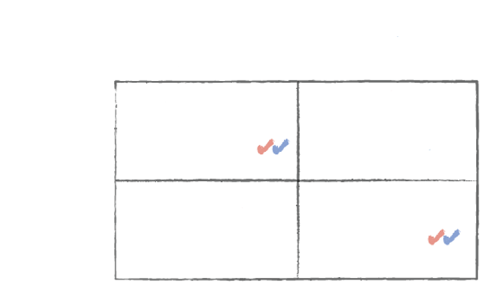
Everyday Economics: The Covid-19 Toilet Paper ‘Shortage’ was a Coordination Game
“If everybody else buys toilet paper before you do, you won’t be able to. So you run out for toilet paper not because you fear society is about to crumble but because you fear others fear this.”
- NPR (March 7, 2020)
Toilet Paper Runs
Others race to the store to stock up
Others don’t race to the store
Toilet Paper run: We race to see who gets toilet paper first
You have too much toilet paper
Others don’t have enough toilet paper
You race to the store to stock up
You don’t have enough toilet paper
Others have too much toilet paper
Stability: We all have enough toilet paper
You don’t race to the store
Notes:
Lecture Tips: This slide can be an additional example of “Good and Bad Equilibriam”. The slideconnects coordination games to the Covid-19 pandemic and shows how fear – or our perception of other’s fear – can push us from one equilibrium to another. Also this is not a new phenomena! In 1974 the New York Time published an article about a similar ‘shortage’ of toilet paper (https://www.nytimes.com/1974/02/03/archives/the-shortage-of-bathroom-tissue-a-classic-study-in-rumor-shortage.html)
Additional Resources:
NPR “Why is There a Worldwide Run on Toilet Tissue Amid The Coronavirus” (https://www.npr.org/2020/03/07/813191533/why-is-there-a-worldwide-run-on-toilet-tissue-amid-the-coronavirus)

Slide 59
Everyday Economics: Indefinitely Repeated Games and Covid-19 Price Gouging
During coronavirus large retail chains responded to shortages of essential items not by raising prices but by limiting the quantity each customer can buy.
Amazon and eBay prohibited price gouging on their sites.
Additionally, during natural disasters, retailers like Walmart sell supplies at list price or lower.
How are these retailers’ anti-price gouging practices sound business strategy?
Source: The New York Times
Notes:
Lecture Tips: UPDATE THESE NOTES This slide can be an additional example of “Good and Bad Equilibria”. The slideconnects coordination games to the Covid-19 pandemic and shows how fear – or our perception of other’s fear – can push us from one equilibrium to another. Also this is not a new phenomena! In 1974 the New York Time published an article about a similar ‘shortage’ of toilet paper (https://www.nytimes.com/1974/02/03/archives/the-shortage-of-bathroom-tissue-a-classic-study-in-rumor-shortage.html)
Additional Resources:
NPR “Why is There a Worldwide Run on Toilet Tissue Amid The Coronavirus” (https://www.npr.org/2020/03/07/813191533/why-is-there-a-worldwide-run-on-toilet-tissue-amid-the-coronavirus)

Slide 60
Everyday Economics: Indefinitely Repeated Games and Covid-19 Price Gouging
Customer loyalty can be like a Grim Trigger strategy in an indefinitely repeated game with retailers
“The large companies are playing a long game, and by behaving ‘fairly’ they are hoping to retain customer loyalty after the emergency”
Big retailers continue to behave ‘fairly’
Big retailers ‘defect’ and raise prices
You buy essential items at fair price today and tomorrow
Big retailers continue to profit from customers today and tomorrow
You buy essential items at a higher price today, and shop elsewhere tomorrow
Big retailers earn higher profit today, zero profit tomorrow
You continue to shop at the big retailer
You buy essential items at a higher price elsewhere today and tomorrow
Big retailers earn lower profits today, raise prices tomorrow
You buy essential items at a higher price elsewhere today and tomorrow
Big retailers earns zero profit today, zero profit tomorrow
You shop elsewhere
Richard Thaler, Nobel Prize winning economist at the University of Chicago (The New York Times May 20, 2020)
Notes:
Lecture Tips: UPDATE THESE NOTESThis slide can be an additional example of “Good and Bad Equilibria”. The slideconnects coordination games to the Covid-19 pandemic and shows how fear – or our perception of other’s fear – can push us from one equilibrium to another. Also this is not a new phenomena! In 1974 the New York Time published an article about a similar ‘shortage’ of toilet paper (https://www.nytimes.com/1974/02/03/archives/the-shortage-of-bathroom-tissue-a-classic-study-in-rumor-shortage.html)
Additional Resources:
NPR “Why is There a Worldwide Run on Toilet Tissue Amid The Coronavirus” (https://www.npr.org/2020/03/07/813191533/why-is-there-a-worldwide-run-on-toilet-tissue-amid-the-coronavirus)

Slide 61
Decisions Involving Uncertainty
PRINCIPLES OF ECONOMICS
Betsey Stevenson – Justin Wolfers | First Edition

Slide 62
Everyday Economics: Is it Possible to Reduce the Risk of Future Global Pandemics?
Diversification: current supply chains that over emphasize lean manufacturing and small inventories are vulnerable. Larger inventories and diversified locations (at home and abroad) are more resilient
Politicians ignore far-out risks: they need to up their game
-The Economist (June 25, 2020)
Gather Information: global systematic disease surveillance can provide monitoring and early warnings to enable rapid international response. Coordinated global research on diagnostics, treatment, and vaccine platforms expand world knowledge on infectious diseases
Notes:
Lecture Notes: This slide aims to get students to think about how strategies to reduce risk/uncertainty can be applied for global pandemics (and other catastrophic events). The Economist article provides great examples for ‘gathering information’ for future existential risks such as the National Oceanographic and Atmospheric Administration’s statellite ‘DSCOVR’ that monitors geomagnetic storms from the sun.
Sources:
The Economist “Politicians ignore far-out risks: they need to up their game” (https://www.economist.com/leaders/2020/06/25/politicians-ignore-far-out-risks-they-need-to-up-their-game) see also “The world should think better about catastrophic and existential risks”
The Economist “Covid-19 is foisting changes on business that could be beneficial” (https://www.economist.com/business/2020/03/05/covid-19-is-foisting-changes-on-business-that-could-be-beneficial)
The New York Times “How to Fight the Next Epidemic” (https://www.nytimes.com/2015/03/18/opinion/bill-gates-the-ebola-crisis-was-terrible-but-next-time-could-be-much-worse.html) and Bill Gates’ related TedTalk (https://www.ted.com/talks/bill_gates_the_next_outbreak_we_re_not_ready/transcript#t-68246)

Slide 63
Decisions Involving Private Information
PRINCIPLES OF ECONOMICS
Betsey Stevenson – Justin Wolfers | First Edition

Slide 64
Everyday Economics: Do 'Immunization Passports' Solve Private Information Problems?
As economies reopen, how will employers know who to hire to minimize the spread of Covid-19? Which workers have antibodies?
In Italy, Going Back to Work May Depend on Having the Right Antibodies
-The New York Times (April 4, 2020)
One possible solution are ‘immunity passports’
Proponents claim passports could protect those most vulnerable while allowing economies to reopen sooner
Opponents caution that such a policy could lead to discrimination, an 'immunization certificate black-market', and demotivate employers from taking other preventative measures
Notes:
Lecture Notes: This slide aims to get students to consider the pros and cons of using immunization passports to improve information regarding the anti-body status of individuals – which is currently an individual's private information.
Sources:
The New York Times “In Italy, Going Back to Work May Depend on Having the Right Antibodies" (https://www.nytimes.com/2020/04/04/world/europe/italy-coronavirus-antibodies.html?referringSource=articleShare)
The New York Times “Should People Without Coronavirus Antibodies Be Second-Class Citizens?” (https://www.nytimes.com/2020/04/28/opinion/coronavirus-antibody-certificate-testing.html)
The New York Times “The Dangerous History of Immunoprivilege" (https://www.nytimes.com/2020/04/12/opinion/coronavirus-immunity-passports.html?auth=login-email&login=email)

Slide 65
Sizing Up the Economy Using GDP
PRINCIPLES OF ECONOMICS
Betsey Stevenson – Justin Wolfers | First Edition

Slide 66
Everyday Economics: GDP’s Limitations are Exacerbated During a Pandemic
GDP does not measure productive Nonmarket activities
The immense value of social distancing and lives saved is not captured
If a pharmaceutical company developed a drug that prevented coronavirus, but side effects caused people to stay home, quarterly GDP would measure total output in hundreds of billions dollars
But the same outcome achieved through social distancing is not measured
“G.D.P Doesn’t Credit Social Distancing, but It Should”
- The New York Times (May 14, 2020)
“Failing to understand the assumptions that shape our economic statistics can lead to a misdiagnosis of our economic ills.”
Justin Wolfers, professor of economics and public policy at the University of Michigan
Notes:
Lecture Tips:
These slides provide an opportunity to connect GDP limitation two (omitting nonmarket activities) to Covid-19. A useful exercise could be to ask students to imagine if a pharmaceutical company developed a drug that could prevent/treat Covid-19 but side effects caused you to stay home. GDP would measure this value through consumption (people spending to buy the new drug) and total income (the wages of the scientists and profits of the pharma company)
Additional Resources:
The New York Times “G.D.P Doesn’t Credit Social Distancing, but It Should” (https://www.nytimes.com/2020/05/14/business/social-distancing-gdp-coronavirus.html?searchResultPosition=1)

Slide 67
Everyday Economics: GDP’s Limitations are Exacerbated During a Pandemic
GDP could evolve to measure valuable Nonmarket activities
If so, GDP could account for valuable ‘public health services’ that are not paid for
A truer measure of GDP could also account for unpaid labor
Unpaid labor includes housework, childcare and tending to the elderly/sick
Measuring unpaid labor could have implications for greater gender equality
“A truer measure of output would recognize that collective output hasn’t fallen; it has merely shifted so that we’re producing less ‘stuff’ and more public health.”
Justin Wolfers
(The New York Times May 14, 2020)
Notes:
Lecture Tips:
These slides provide an opportunity to connect GDP limitation two (omitting nonmarket activities) to Covid-19. This slide shows how these oft cited economic measures have evolved over time per the economic questions of the day. This can be a launching point for a broader discussion on how “we measure what we value, and value what we measure” with connections beyond public health (for example, the unpaid labor/care economy and gender equality)
Additional Resources:
The New York Times “G.D.P Doesn’t Credit Social Distancing, but It Should” (https://www.nytimes.com/2020/05/14/business/social-distancing-gdp-coronavirus.html?searchResultPosition=1)
Marcuss, Rosemary D., and Richard E. Kane. "Us national income and product statistics.“ (https://apps.bea.gov/scb/pdf/2007/02%20February/0207_history_article.pdf)
Unpaid Labor/Care
The New York Times “Women’s Unpaid Labor is Worth $10,900,000,000,000” (https://www.nytimes.com/interactive/2020/03/04/opinion/women-unpaid-labor.html)
Oxfam “Time to Care: unpaid and underpaid care work and the global inequality crisis” (https://oxfamilibrary.openrepository.com/bitstream/handle/10546/620928/bp-time-to-care-inequality-200120-en.pdf)

Slide 68
Interpreting the data: GDP Conventions and Large Percentage Changes can be Misleading
By convention quarterly GDP measures are reported as an annualized rate
If GDP falls approximately 13% in Q2, GDP will be reported at an annualized rate of roughly -43% (calculation: -.43 = [(1 - .13)^4)-1])
Large swings in the economy can cause percentage changes to be misleading
-91%
Air travel is still 91% lower than normal
+123%
-96%
Notes:
Lecture tips: This slide can build from slide 64 “Strategies for Scaling Big Numbers” to highlight how percent changes can be misleading when the economy is changing rapidly and in large magnitudes. This discussion can emphasize the importance of being a smart consumer of data to students – especially given political incentives and dynamics during an election year
Source:
The New York Times “Air Travel Surges by 123%! (Beware of Misleading Data Like That)” (https://www.nytimes.com/2020/05/19/upshot/virus-economic-data-upended.html)

Slide 69
Economic Growth
PRINCIPLES OF ECONOMICS
Betsey Stevenson – Justin Wolfers | First Edition

Slide 70
Discussion Question
How will Covid-19 change the production function?
Will shutdowns and a recession decrease production functions?
Or will Covid-related technological progress (ex. telemedicine or remote working) increase production functions?
GDP per worker
Technological progress
Production function
Reduced production
Capital per worker
Notes:
Lecture Notes: This slide asks students to discuss whether they think Covid-19 will decrease production functions or if covid-related technological progress will increase production functions in the long term.

Slide 71
Unemployment
PRINCIPLES OF ECONOMICS
Betsey Stevenson – Justin Wolfers | First Edition

Slide 72
Everyday Economics: Unemployment Numbers During Covid-19 Can be Difficult to Interpret
During the Great Recession, 9 million jobs were lost by 2010
Job growth did not return to pre-recession levels until 2014
Between February & April 21.4 million people were temporarily laid off due to Covid-19 shutdowns
Most of the Great Recession loss jobs were permanently destroyed, but it’s unclear how much of the current job loss is permanent.
“The job numbers are horrible. But there’s more to this story.”
The Washington Post (May 9, 2020)
“We shouldn’t over-interpret any short-term improvements, either, just as we shouldn’t assume the horrible jobs numbers are permanent”
Betsey Stevenson, professor of economics and public policy at the University of Michigan
Notes:
Lecture Tips: These slides can build upon the alternate measures of unemployment discussion. The first slide aims to show students that during a government mandated shutdown of the economy, it is difficult to know which jobs lost are permanent (because of businesses not able to stay afloat, supply chain destruction, and continued depressed demand) and which jobs will return businesses reopen and consumers are confident in the public health response.
The next slide, shows how looking at specific jobs/industries – such as dentists – can inform our understanding of a country’s post-pandemic recovery. Per Professor Betsey Stevenson’s quote, if all that happened during Covid-19 lockdowns was the economy on pause once the economy was restarted we would expect most if not all dentists to return to work. This is because dental services should not have experiences second order supply chain or business model destruction. However, “the fact that dentistry employment is down 30 percent tells us that there is income loss and there is fear” (Betsey Stevenson). Income loss, fear, and other areas of the economy (closed schools/day care) can still constrain dentistry and hint at wider economic constriction.
Sources:
The Washington Post “The job numbers are horrible. But there’s more to this story” (https://www.washingtonpost.com/opinions/2020/05/09/job-numbers-are-horrible-theres-more-this-story/)
The New York Times “How’s the Economy Doing? Watch the Dentists” (https://www.nytimes.com/2020/06/10/upshot/dentists-coronavirus-economic-indicator.html)

Slide 73
Inflation and Money
PRINCIPLES OF ECONOMICS
Betsey Stevenson – Justin Wolfers | First Edition

Slide 74
Everyday Economics: Post-Covid Inflation May Not Be a Cause for Alarm
Rising inflation is often a cause for alarm in the media, but deflation can also cause problems
Post-Covid inflation may spike due to pent-up demand and supply shortages left over from shutdowns
Rising prices could be exacerbated by stagnant or decreasing wages due to mass unemployment
“Should We Fear Post-Pandemic Inflation?”
The New York Times (May 28, 2020)
“In many ways, an inflation surge in the early 2020s, would be a signal that all the efforts being taken now (to flood the financial system with cash, to prop up small businesses and aid unemployed people) had worked – preventing a deflationary spiral akin to what happened in the Great Depression.
Neil Irwin, senior economics correspondent - New York Times
Notes:
Lecture Tips: These slides build upon the discussion of inflation and deflation. Students may be aware of the media’s alarm over inflation and the looming threat of hyperinflation. However, this slide attempts to show that interpreting inflation is not always straight forward. For example, rising prices (especially year over year) can rise due to ‘pent-up demand’ and supply shortages from shutdowns. But these prices can still be below pre-pandemic levels, and rising inflation could mask the larger deflationary trend of mass unemployment.
Per the Neil Irwin quote (and linked article), some inflation could be a signal that the anti-recession measures taken now worked and prevented a deeper recession.
Sources:
The New York Times “Should We Fear Post-Pandemic Inflation?” (https://www.nytimes.com/2020/05/28/upshot/should-we-fear-inflation.html)

Slide 75
Consumption and Saving
PRINCIPLES OF ECONOMICS
Betsey Stevenson – Justin Wolfers | First Edition

Slide 76
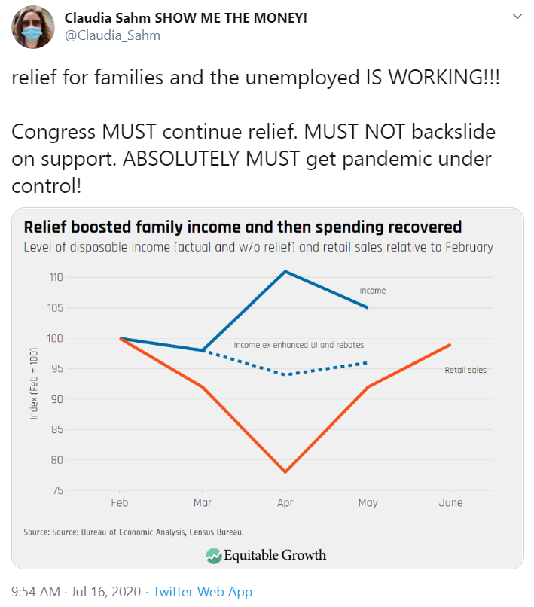
Interpreting the Data: The CARES Act’s Unemployment Benefits Boosted Spending
Macroeconomist Claudia Sahm provides data on family disposable income and retail sales relative to February 2020 (before the CARES Act was passed)
What does the data show happened to income and consumption after the relief bill was passed?
How would the July 31st expiration date of unemployment benefits effect the Consumption function of unemployed families in mid-July?
Notes:
Lecture Tips: This slide shows the effect of additional income (in the form of relief aid) on consumption using retail sales data. Students can use the data to draw the connection between the CARES Act’s unemployment benefit and a shift along the Consumption function due to the increase in income.
To further explore the application, ask student to place themselves in mid-July when the CARES Act unemployment benefit was set to expire at the end of the month and Congress had yet to agree on a plan forward. How would this uncertainty and the expectation that the benefits were to expire change the Consumption function?
Sources:
Claudia Sahm (Director of Macroeconomic Policy, Washington Center for Equitable Growth) Twitter: https://twitter.com/Claudia_Sahm/status/1283761964611768321

Slide 77
Investment
PRINCIPLES OF ECONOMICS
Betsey Stevenson – Justin Wolfers | First Edition

Slide 78
Discussion Question
How could the following factors change the market for loanable funds?
1. High unemployment due to Covid-19 causes families to spend a larger portion of their income to make ends meet
Market for Loanable Funds
Real interest rate
Covid-19 Savings
Savings
Investments
Quantity of loanable funds
Notes:
Lecture Notes: This slide asks students to connect what they have learned about loanable funds to potential changes in savings and investment due to Covid-19.
1. High unemployment, in theory would lead to more families spending a larger portion of their income on consumption, meaning they are saving less. Therefore, the Savings curve (or supply for loanable funds) would shift left, decreasing the quantity and increasing the real interest rate.

Slide 79
Discussion Question
How could the following factors change the market for loanable funds?
2. Business leaders expect corporate profits to decrease for the next couple of years
Market for Loanable Funds
Real interest rate
Savings
Investments
Covid-19 Investments
Quantity of loanable funds
Notes:
Lecture Notes: This slide asks students to connect what they have learned about loanable funds to potential changes in savings and investment due to Covid-19
2. If Business leaders expect company profits to decrease over the next couple years, then they are less likely to make planned investments. Therefore, the investment curve (or the demand for loanable funds) will decrease shifting left, the quantity would decrease and the real interest rate would decrease.

Slide 80
Discussion Question
How could the following factors change the market for loanable funds?
3. Governments increase spending to combat the public health crisis and reduce the economic fallout
Market for Loanable Funds
Real interest rate
Covid-19 Savings
Savings
Investments
Quantity of loanable funds
Notes:
Lecture Notes: This slide asks students to connect what they have learned about loanable funds to potential changes in savings and investment due to Covid-19
3. If Governments increase spending on stimulus packages then Governments are saving less which shifts the savings curve (supply for loanable funds) leftward. Therefore the quantity of loans decreases and the price (the real interest rate) increases.

Slide 81
The Financial Sector
PRINCIPLES OF ECONOMICS
Betsey Stevenson – Justin Wolfers | First Edition

Slide 82
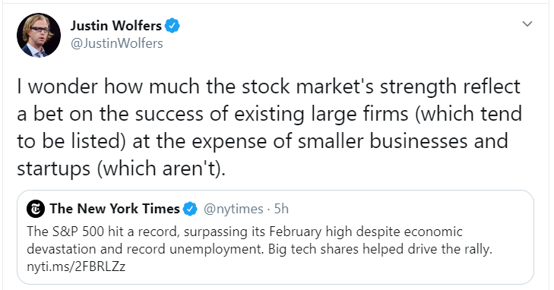
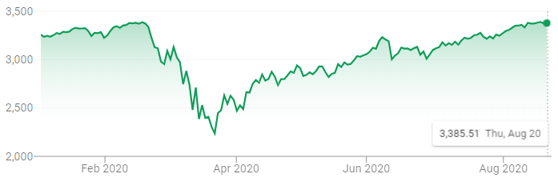
Everyday Economics: The Stock Market Must be Interpreted Carefully
Despite record unemployment, the S&P 500 reached record highs in August
Indicators like the S&P 500 must be interpreted critically, the 5 largest stocks increased 35% while the remaining 495 stocks collectively declined 5%
S&P 500 Index
Source: Google Market Summary
Notes:
Lecture Notes: This slide asks students to be careful consumers of economic data – especially stock prices. Specifically, the S&P 500 can be reaching record highs even while the U.S. is experiencing widespread unemployment. Additionally, the performance of the stock market can be driven by a handful of companies (top 5 largest stocks are Amazon, Apple, Facebook, Google, Microsoft). Students may have heard of ‘Wall Street vs Main Street’
Sources:
A Wealth of Common Sense “Concentrated Performance in the Stock Market” (https://awealthofcommonsense.com/2020/08/concentrated-in-the-stock-market/)

Slide 83
International Finance and the Exchange Rate
PRINCIPLES OF ECONOMICS
Betsey Stevenson – Justin Wolfers | First Edition

Slide 84
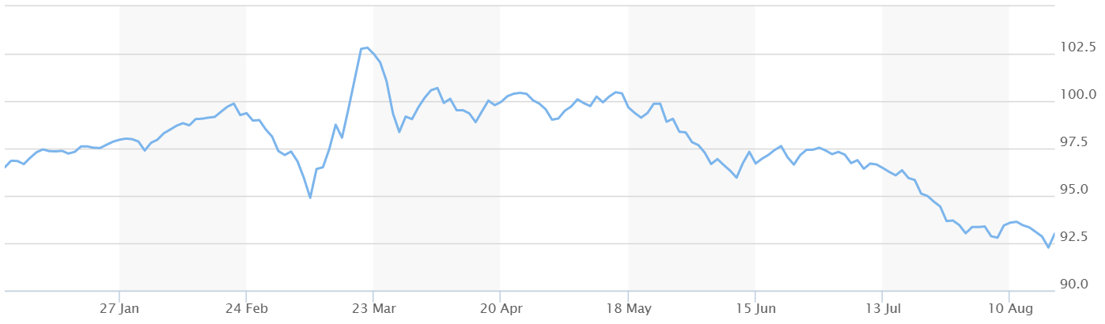
Everyday Economics: A Global Public Health Crises Changes the Value of Currencies
Early in the pandemic the US dollar value increased as foreign investors bought more of the ‘safe haven’ currency
However, as the U.S. struggled to contain the virus the value of the U.S. dollar decreased rapidly due to foreigners’ decreased demand because of the U.S. response to Covid-19
“The US dollar is still king during the coronavirus”
- CNN (April 17, 2020)
“The world loves the US dollar … the pandemic could change that”
- CNN (July 16, 2020)
U.S. Dollar Index
Source: MarketWatch
Notes:
Lecture Tips: This slide shows how the value of the U.S. dollar changed throughout the course of the coronavirus crisis. It may be helpful to ask student how the crisis shifted demand for U.S. dollars and how demand changed after the consequences of the government’s response became clear. You may need to introduce students to the term ‘safe haven currency’ as a global currency that is perceived to be lower risk than other foreign currencies and therefore demand for ‘safe haven’ currencies increase during an economic crisis
Sources:
CNN “The US dollar is still king during the coronavirus” (https://www.cnn.com/2020/04/17/perspectives/strong-dollar-coronavirus/index.html)
CNN “The world loves the US dollar. Trump and the pandemic could change that” (https://www.cnn.com/2020/07/16/investing/us-dollar-coronavirus-trump/index.html)
Chart is from MarketWatch (https://www.marketwatch.com/investing/index/dxy/charts) accessed August 18, 2020

Slide 85
Business Cycles
PRINCIPLES OF ECONOMICS
Betsey Stevenson – Justin Wolfers | First Edition

Slide 86
Everyday Economics: Official Indicators Can’t Keep Pace with Abrupt Economic Changes
Government’s official economic indicators can take months to collect, analyze and report - too slow for the swift economic disruption caused by Covid-19
“Another Way to See the Recession: Power Usage Is Way Down”
- The New York Times (April 8, 2020)
“Although the United States has an array of reliable official economic statistics, none are well suited to tracking a downturn like the current one [Covid-19] when the unemployment rate may change as much in two days as it typically does over an entire year. It is likely that these electricity data – which can be produced with a lag of about a day – will also provide the first clear signal of when the current free fall will end.”
Justin Wolfers The New York Times (April 8, 2020)
Notes:
Lecture Tips: These slides build on the discussion of leading and lagging indicators and the top 10 economic indicators. Extreme economic circumstances – like the abrupt shuttering of entire economies due to Covid-19 lockdowns – may call for innovative alternative measures that can show what is happening in the economy in a timelier fashion.
Can students think of any other potential alternative measures to capture the impact of Covid-19 on the economy?
Sources:
The New York Times “Another Way to See the Recession: Power Usage is Way Down” (https://www.nytimes.com/interactive/2020/04/08/upshot/electricity-usage-predict-coronavirus-recession.html?searchResultPosition=2)

Slide 87
IS-MP Analysis: Interest Rates and Output
PRINCIPLES OF ECONOMICS
Betsey Stevenson – Justin Wolfers | First Edition

Slide 88
Discussion Question
How is Covid-19 affecting the macroeconomy?
Let’s use the IS-MP framework to look at the larger picture of Covid-19
While there’s some debate on the details, lets start with the most straightforward: Covid-19 caused a spending shock in consumption
Real interest rate
MP curve
IS curve
Output gap
(GDP, relative to potential GDP)
Notes:
Lecture Notes: These next few slides walks through an application of Covid-19 in the IS-MP Framework. It is probably most straightforward to start with the spending / demand shock due to government shutdowns / social distancing and high unemployment.

Slide 89
Discussion Question
How is Covid-19 affecting the macroeconomy?
Spending Shock
With government shutdowns and historic unemployment, will consumption increase or decrease?
How will the IS curve respond? What will happen to the Output gap?
Real interest rate
MP curve
IS curve
Covid-19 IS curve
Output gap
(GDP, relative to potential GDP)
Lower output
Notes:
Lecture Notes: This slide shows that the spending shock will shift the IS curve left and therefore lower (or make more negative) the output gap. You could point students to evidence in the data by showing decreases in GDP worldwide throughout the pandemic

Slide 90
Discussion Question
How is Covid-19 affecting the macroeconomy?
2. Monetary Response
We know the Federal Reserve (the U.S. central bank) responded to the spending shock by cutting interest rates
How will the MP curve respond? What will happen to the Output gap?
Real interest rate
MP curve
Covid-19 MP curve
IS curve
Covid-19 IS curve
Higher output
Output gap
(GDP, relative to potential GDP)
Notes:
Lecture Notes: Second, ask students to consider the effect of the Federal Reserve’s response. The Fed lowered interest rates causing the MP curve to shift downward with the aim of increasing (or making more positive) the Output gap. With the looming threat of a recession, the Fed is lowering rates to try to ‘heat up’ the economy

Slide 91
Discussion Question
How is Covid-19 affecting the macroeconomy?
3. Putting It All Together
We know the real interest rate decreased, but the change in Output gap is ambiguous
Which curve do you think shifted more, the IS Curve or the MP Curve? Why?
Real interest rate
MP curve
Covid-19 MP curve
IS curve
Covid-19 IS curve
Unclear
Output gap
(GDP, relative to potential GDP)
Notes:
Lecture Notes: Thirdly, ask students to put these two shifts together. It is clear the real interest rate decreased however the change in Output gap is ambiguous (the shift in IS curve lowered the output gap but the shift in the MP curve was meant to make the output gap more positive). It may be helpful to remind students that when Supply and Demand both shifted sometimes the change in price or quantity was ambiguous – the same is true in this case.
Additionally, you could ask students to hypothesize which shift they think is greater and why. You could also ask students for what kind of data or evidence would they need to test their hypothesis.

Slide 92
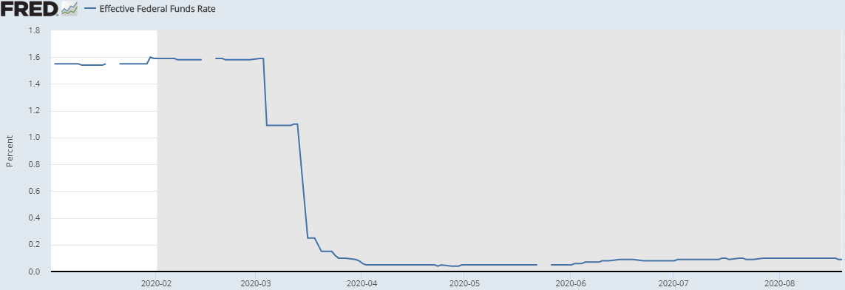
Discussion Question
How is Covid-19 affecting the macroeconomy?
Bonus: It’s Complicated
The Zero Lower Bound: the Fed is limited in how much it can cut interest rates; nominal interest rates cannot be effectively set below zero
Notes:
Lecture Notes: These ‘bonus’ slides add complicating factors to our simplified IS-MP analysis. These slides may be helpful to show students the ‘messiness’ of real-world macroeconomics, but also show that the IS-MP framework is a powerful tool they can use to see the larger picture even when things get complicated!
For example, the Zero Lower Bound can be understood as a limit in how low the Fed can shift the MP curve to respond to Covid-19. The graph shows FRED data on the Effective Federal Funds Rate, it may be helpful to point out to students that 1) the rate is very close to zero (0.09 on Aug 20th) and 2) the gray shading denotes a U.S. recession as determined by the Federal Reserve.
Lastly, given the Zero lower bound an argument can be made that the shift in the IS curve could be greater due to Covid-19 since it is not constrained in the same way.

Slide 93
Discussion Question
How is Covid-19 affecting the macroeconomy?
Bonus: It’s Complicated
Many companies had limited cash and were finding it difficult to borrow; this Financial Shock increased the risk premium shifting the MP curve upward and limiting the effectiveness of the Fed
Real interest rate
Original MP curve
Financial shock
Monetary response
Covid-19 IS curve
Output gap
(GDP, relative to potential GDP)
Notes:
Lecture Notes: These ‘bonus’ slides add complicating factors to our simplified IS-MP analysis. These slides may be helpful to show students the ‘messiness’ of real-world macroeconomics, but also show that the IS-MP framework is a powerful tool they can use to see the larger picture even when things get complicated!
For example, the financial shock raises the MP curve upward in opposition to the Fed’s effort to lower the MP curve. This can be understood as limiting the effectiveness of the Fed’s effort (how low the MP curve can go) to respond to Covid-19. Therefore, the argument can be made that the shift in the IS curve could be greater due to Covid-19 since it is not being counteracted by the financial shock (However in the next bonus slide we show how the shift is being counteracted by fiscal policy…)

Slide 94
Discussion Question
How is Covid-19 affecting the macroeconomy?
Bonus: It’s Complicated
The U.S. government responded to Covid-19 with the largest stimulus package in history (CARES Act)
How do you think this Fiscal Policy changes the IS-MP Curves?
Real interest rate
Covid-19 MP curve
Original IS curve
Spending shock
Fiscal Policy
Output gap
(GDP, relative to potential GDP)
Notes:
Lecture Notes: These ‘bonus’ slides add complicating factors to our simplified IS-MP analysis. These slides may be helpful to show students the ‘messiness’ of real-world macroeconomics, but also show that the IS-MP framework is a powerful tool they can use to see the larger picture even when things get complicated!
For example, the U.S. CARES Act is an example of Fiscal Policy being used to counteract the leftward shift of the IS curve. The largest stimulus package in U.S. history aims to shift the IS curve rightward thereby reducing the effect of the original Covid-19 Spending Shock.

Slide 95
The Phillips Curve and Inflation
PRINCIPLES OF ECONOMICS
Betsey Stevenson – Justin Wolfers | First Edition

Slide 96
Discussion Question
How is Covid-19 affecting unexpected inflation?
Let’s use the Phillips curve to connect Covid-19 and unexpected inflation
While there’s some debate on the details, lets assume Covid-19 caused a negative spending shock in consumption that made the Output Gap more negative
How would this change the Phillips curve and unexpected inflation?
Unexpected inflation
Phillips curve
Decreased unexpected inflation
Lower output
Output gap
(GDP, relative to potential GDP)
Notes:
Lecture Notes: These next few slides walks through an application of Covid-19 to the Phillips Curve. It may be helpful to connect this discussion with the previous supplementary slides connecting Covid-19 to the IS-MP framework. Either way, the discussion can start with reminding students that Covid-19 caused a spending shocking and a ‘cooling down’ economy that lowered the output gap (or made it more negative)
This change in output gap would not shift the Phillips curve, but is a movement along the curve toward decreased unexpected inflation

Slide 97
Discussion Question
How is Covid-19 affecting unexpected inflation?
In addition to the Demand-pull decreased inflation, there is also a Cost-push effect
At the start of the pandemic and during government shutdowns there was also a Supply Shock
How would this change the Phillips curve and unexpected inflation?
What type of supply shock do you think Covid-19 caused?
Unexpected inflation
Covid-19 Phillips curve
Increased unexpected inflation
Phillips curve
Lower output
Output gap
(GDP, relative to potential GDP)
Notes:
Lecture Notes: In addition, the spending shock that led to a ‘demand-pulled’ decrease in unexpected inflation, there was also a supply shock that caused a cost-push increase in unexpected inflation. This supply shock shifted the Phillips curve left and upward. There are a couple reasons why this supply shock occurred and its type.
For example, as companies ceased operations during government mandated shutdowns, productivity would have decreased across the economy. This decrease is likely to persist even while governments ease restrictions as workers adapt to remote work and companies operate at reduced capacity to maintain social distancing.
Additionally, the supply shock could be due to the decrease in the U.S. dollar (Exchange rate type of supply shock). While initially the value of the U.S. dollar spiked in March as foreign investors bought the ‘safe haven’ currency, the value of the U.S. continued to decrease well into August (lower than January 2020 levels) as it became clear that the U.S. government was failing to contain the virus.

Slide 98
Discussion Question
How is Covid-19 affecting unexpected inflation?
Putting both shocks together we see that the effect on unexpected inflation is ambiguous
Are there any reasons why you would expect on shock to have a larger effect?
Unexpected inflation
Covid-19 Phillips curve
Ambiguous effect on unexpected inflation
Phillips curve
Lower output
Output gap
(GDP, relative to potential GDP)
Notes:
Lecture Notes: This slide puts the two shocks together to show the ambiguous effect on unexpected inflation. It may be helpful to remind students that when supply and demand both shifted the effect on price or quantity was sometimes ambiguous, similarly the supply and demand side shock have an unclear effect on inflation.
While few economist see inflation rising in the near future, you could ask students whether they think the leftward shift in the Phillips curve will be smaller or larger than the more negative output gap.

Slide 99
Aggregate Demand and Aggregate Supply
PRINCIPLES OF ECONOMICS
Betsey Stevenson – Justin Wolfers | First Edition

Slide 100
Discussion Question
How is Covid-19 affecting the macroeconomy?
Let’s use the AD-AS framework to look at the larger picture of Covid-19
While there’s some debate on the details, lets start with the most straightforward: Covid-19 changed consumption
Price level (GDP deflator)
Aggregate supply
Aggregate demand
Quantity of output
(Real GDP)
Notes:
Lecture Notes: These next few slides walks through an application of Covid-19 in the AD-AS framework. It is probably most straightforward to start consumption changes due to government shutdowns / social distancing and high unemployment.

Slide 101
Discussion Question
How is Covid-19 affecting the macroeconomy?
Consumption
With government shutdowns and historic unemployment, will consumption increase or decrease?
How will Aggregate Demand respond? What will happen to GDP?
Price level (GDP deflator)
Aggregate supply
Original
Aggregate demand
Covid-19
Aggregate demand
Decrease
Quantity of output
(Real GDP)
Notes:
Lecture Notes: This slide shows that the spending shock will shift the IS curve left and therefore lower (or make more negative) the output gap. You could point students to evidence in the data by showing decreases in GDP worldwide throughout the pandemic

Slide 102
Discussion Question
How is Covid-19 affecting the macroeconomy?
2. Productivity
In addition to changes in consumption, at the start of the pandemic supply chains were disrupted, government shutdowns forced businesses to close, and workers forced to adapt to social distanced or remote work
How did Aggregate Supply respond? What will happen to GDP?
Covid-19 Aggregate supply
Price level (GDP deflator)
Original Aggregate supply
Aggregate demand
Quantity of output
(Real GDP)
Decrease
Notes:
Lecture Notes: Second, ask students to consider effects on Aggregate Supply. With supply chain disruptions, government mandated shutdowns, and workers adapting to the ‘new normal’, productivity decreased overall. This change would shift aggregate supply leftward and decrease GDP

Slide 103
Discussion Question
How is Covid-19 affecting the macroeconomy?
3. Putting It All Together
How do the changes to both Aggregate Demand and Aggregate Supply change GDP and Price Levels?
Covid-19 Aggregate supply
Price level (GDP deflator)
Original Aggregate supply
Ambiguous
Original
Aggregate demand
Covid-19
Aggregate demand
Decrease
Quantity of output
(Real GDP)
Notes:
Lecture Notes: Thirdly, ask students to put these two shifts together. It is clear the GDP decreased however the change in Price Level is ambiguous. It may be helpful to remind students that when Supply and Demand both shifted (in microeconomics) sometimes the change in price or quantity was ambiguous – the same is true for Aggregate Supply and Aggregate Demand.

Slide 104
Discussion Question
How is Covid-19 affecting the macroeconomy?
Bonus: Monetary Policy Response
We know the Federal Reserve (the U.S. central bank) responded to Covid-19 by cutting interest rates
How will Aggregate Demand or Aggregate Supply respond? What will happen to GDP and Price Levels?
Covid-19 Aggregate supply
Price level (GDP deflator)
Original Aggregate supply
Increase
Original
Aggregate demand
Monetary policy response
Covid-19
Aggregate demand
Increase
Quantity of output
(Real GDP)
Notes:
Lecture Notes: These additional slides cover the effect of both the Federal Reserves monetary response and Congress’ fiscal response on AD-AS

Slide 105
Discussion Question
How is Covid-19 affecting the macroeconomy?
Bonus: Fiscal Policy Response
The U.S. Congress responded to Covid-19 with the largest stimulus package in history (CARES Act)
How will Aggregate Demand or Aggregate Supply respond? What will happen to GDP and Price Levels?
Covid-19 Aggregate supply
Price level (GDP deflator)
Original Aggregate supply
Increase
Original
Aggregate demand
Fiscal policy response
Covid-19
Aggregate demand
Increase
Quantity of output
(Real GDP)
Notes:
Lecture Notes: These additional slides cover the effect of both the Federal Reserves monetary response and Congress’ fiscal response on AD-AS

Slide 106
Monetary Policy
PRINCIPLES OF ECONOMICS
Betsey Stevenson – Justin Wolfers | First Edition

Slide 107
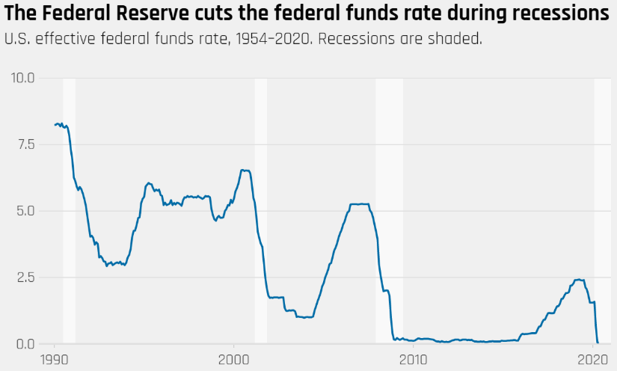
Everyday Economics: Monetary Policy is Limited in How It Can Respond to Covid-19
In response to Covid-19, the Federal Reserve cut interest rates to near zero to make borrowing cheaper, prevent people and businesses from bankruptcy, and encourage spending / investment to boost demand
Unlike past recessions, Covid-19 makes “economic activity more dangerous” and monetary policy cannot address public health safety
Source: Washington Center for Equitable Growth
Notes:
Lecture Tips: This slide aims to connect monetary policy to covid-19 by showing how the coronavirus recession is different from past recessions. While the Covid-19 recession is different in many ways (the speed in economic declined, increased morbidity / mortality) this slide focuses on how the virus has made economic activity more dangerous overall. Therefore, beyond the usual limits of monetary policy (the zero lower bound) and despite the Fed still having policy options when rates are near zero (forward guidance and quantitative easing) nothing in the Federal Reserves monetary policy toolkit can make economic activity less dangerous unless the public health crisis is appropriately addressed.
Sources:
Washington Center for Equitable Growth “The coronavirus recession highlights the importance of automatic stabilizers” (https://equitablegrowth.org/the-coronavirus-recession-highlights-the-importance-of-automatic-stabilizers/)

Slide 108
Everyday Economics: The Federal Reserve is Using All Available Tools to Fight Covid-19
In addition to lowering the federal funds rate to near zero, the Federal Reserve is:
1. Lending directly through the discount window:
The Fed has expanded programs that lend to financial sector institutions to stabilize U.S. financial markets
As part of the CARES Act, the Fed created new programs to lend directly to businesses and state / local governments
The Fed is also lending U.S. dollars to foreign central banks, acting a global lender of last resort to stabilize global financial markets and trade
2. Quantitative Easing and Forward Guidance:
The Fed made an open-ended commitment to purchase Treasury debt, government-guaranteed mortgage-backed securities, and commercial mortgage-backed securities
Notes:
Lecture Tips: This slide shows how the various tools the Federal Reserve is using to stabilize the U.S. economy (and global financial markets) in the wake of the Covid-19 recession
Sources:
Washington Center for Equitable Growth “The coronavirus recession highlights the importance of automatic stabilizers” (https://equitablegrowth.org/the-coronavirus-recession-highlights-the-importance-of-automatic-stabilizers/)
NPR “Why Is The Fed Sending Billions Of Dollars All Over The World?” (https://www.npr.org/sections/money/2020/04/21/839374663/why-is-the-fed-sending-billions-of-dollars-all-over-the-world)

Slide 109
Government Spending, Taxes, and Fiscal Policy
PRINCIPLES OF ECONOMICS
Betsey Stevenson – Justin Wolfers | First Edition

Slide 110
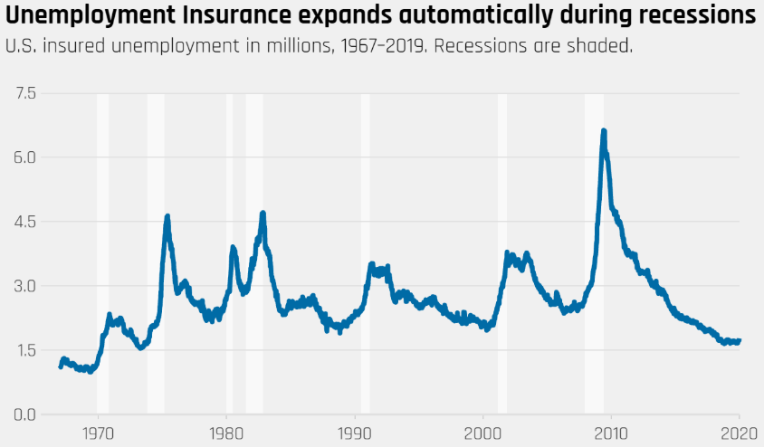
Everyday Economics: Pandemic Recessions Highlight the Need for Automatic Stabilizers
Since, automatic stabilizers like Unemployment Insurance expand or contract as needed during a recession – the greater the uncertainty the greater the need for automatic stabilizers
Beyond the usual uncertainty surrounding a recession, Covid-19 presents additional unknowns; short / long term health impacts, quality of public health response, effectiveness of vaccines / treatments
Source: Washington Center for Equitable Growth
Notes:
Lecture Tips: This slide aims to connect the role automatic stabilizers play in fiscal policy to the coronavirus pandemic. Automatic stabilizers are particularly useful since there is often uncertainty of the duration and severity of recessions. Additionally, unemployment often extends beyond the end of a recession (especially for women, Black, and Latinx workers). Therefore, the greater the uncertainty the greater the need for automatic stabilizers.
A Covid-19 recession would compound the usual recession uncertainty with the uncertainty surrounding the public health crisis. As such, automatic stabilizers stand to play an outsized role in responding to a coronavirus recession
Sources:
Washington Center for Equitable Growth “The coronavirus recession highlights the importance of automatic stabilizers” (https://equitablegrowth.org/the-coronavirus-recession-highlights-the-importance-of-automatic-stabilizers/)

Slide 111
Everyday Economics: An Effective Covid Response Requires A Robust Fiscal Policies
In response to Covid-19, Congress enacted 4 major fiscal policies
Coronavirus Preparedness & Response Supplemental Appropriations Act: provided emergency funds to federal agencies to respond to health crisis and updated Medicare rules for telehealth ($8 billion, March 6)
Families First Coronavirus Response Act: required health insurance to provide free testing, increased state Medicaid funding, provided additional funding for SNAP and unemployment insurance ($192 billion, March 18)
CARES Act: provided direct stimulus payments to most families, greatly (but temporarily) increased unemployment insurance benefits and expanded eligibility, created multiple business loan programs, cut / deferred some business taxes ($1.7 trillion, March 27)
Paycheck Protection Program & Health Care Enhancement Act: additional funds for the PPP (the small business loan program created by CARES Act) and healthcare providers ($484 billion, April 27)
Notes:
Lecture Tips: This slide provides students with a high level summary of the various fiscal policies Congress enacted to respond to the coronavirus pandemic
Sources:
Washington Center for Equitable Growth “The coronavirus recession highlights the importance of automatic stabilizers” (https://equitablegrowth.org/the-coronavirus-recession-highlights-the-importance-of-automatic-stabilizers/)

Slide 112
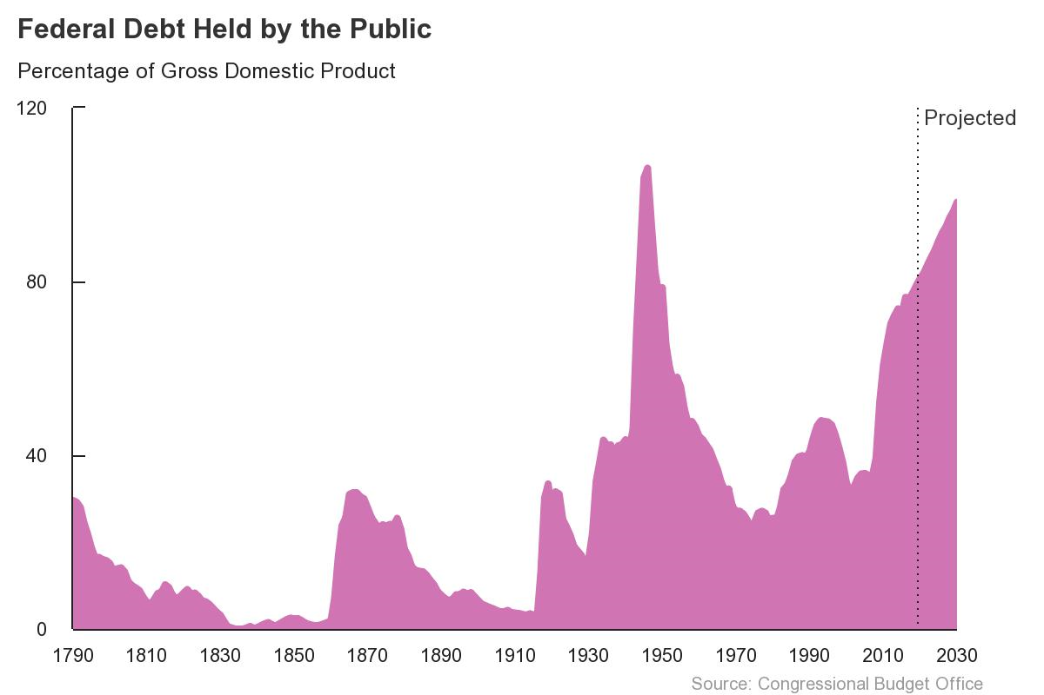
Everyday Economics: Responding to Covid-19 Has Rapidly Increased the Federal Debt
In March 2020, the Congressional Budget Office (CBO) projected the Federal debt to reach 81% of GDP by the end of the fiscal year
By the end of April, the CBO projected the Federal debt to grow to 101% of GDP by the end of 2020 fiscal year
The increase in federal debt is caused by both an increase in spending to address Covid-19 and a decrease in GDP
The only time the federal debt was more than 100% of GDP was during WWII
Source: Congressional Budget Office
Notes:
Lecture Tips: This slide provides additional information on the U.S. fiscal response to Covid-19 by highlighting the effect fiscal policies had on the federal debt as a percentage of GDP. It may be useful to note that the U.S. federal government’s fiscal year runs from October 1st to September 30th. The rapid increase in federal debt reflects both the historic spending Congress enacted to respond to Covid-19 and the decrease in GDP due to the coronavirus.
Sources:
Congressional Budget Office “Federal Debt: A Primer” (https://www.cbo.gov/publication/56165)
Congressional Budget Office “CBO’s Current Projections of Output, Employment, and Interest Rates and a Preliminary Look at Federal Deficits for 2020 and 2021” (https://www.cbo.gov/publication/56335)

