Slide 1
Have natural disasters become deadlier?
Review by
Joanne Linnerooth-Bayer

Slide 2
Questions I
Have natural disasters become more frequent?
Have the death tolls of these disasters increased in more recent years?
Do death tolls vary across different regions?
Do relatively affluent countries suffer fewer deaths?
How important is the role of geophysical and climate related factors in the causation of different types of natural disasters?
Notes:
First set of questions over well traveled territory

Slide 3
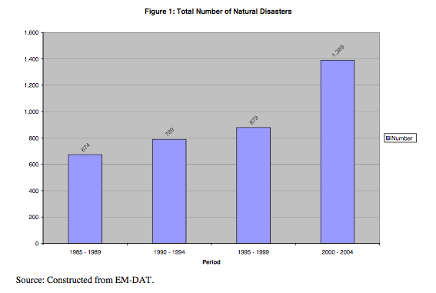

Slide 4
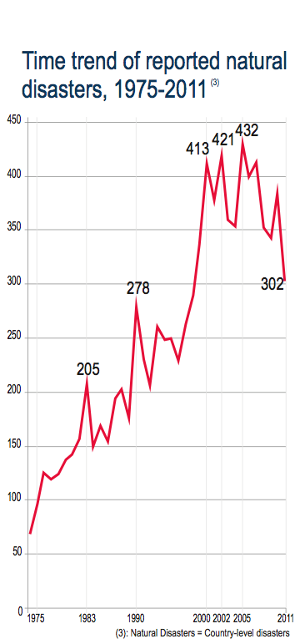
Source: ISDR, USAID, CRED

Slide 5
Questions I
Have natural disasters become more frequent?
Do death tolls vary across different regions?
Do relatively affluent countries suffer fewer deaths?
Have the death tolls of these disasters increased in more recent years?
How important is the role of geophysical and climate related factors in the causation of different types of natural disasters?

Slide 7
Questions I
Have natural disasters become more frequent?
Do death tolls vary across different regions?
Do relatively affluent countries suffer fewer deaths?
Have the death tolls of these disasters increased in more recent years?
How important is the role of geophysical and climate related factors in the causation of different types of natural disasters?

Slide 8
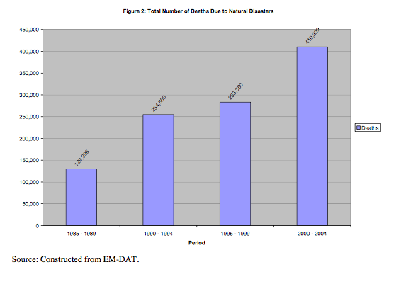

Slide 9
Converging view
Disaster deaths globally somewhat constant, and per event declining
  Hazard intensity?
  Exposure?
  Vulnerability?

Slide 10
Questions I
Have natural disasters become more frequent?
Do death tolls vary across different regions?
Do relatively affluent countries suffer fewer deaths?
Have the death tolls of these disasters increased in more recent years?
How important is the role of geophysical and climate related factors in the causation of different types of natural disasters?

Slide 11
Natural catastrophes worldwide 1980 – 2011
Number of events by peril with trend
NatCatSERVICE
Number
Geophysical events
(Earthquake, tsunami,
volcanic eruption)
Meteorological events
(Storm)
Hydrological events
(Flood, mass movement)
© 2012 Münchener Rückversicherungs-Gesellschaft, Geo Risks Research, NatCatSERVICE – As at January 2012

Slide 12
Losses
IPCC, SREX 2012

Slide 13
Questions II
Do institutions matter? Specifically, are there are fewer deaths in a democracy?
Does ethnic/linguistic/religious fragmentation make it harder to avert deaths?
  Regression to explain intercountry variations in events and deaths
Does higher frequency of disasters in a previous period induce better disaster preparedness?
Is the pay-off to disaster prevention high? Specifically, whether learning from past experience helps save lives?

Slide 14
Methodological issues
Choice of explanatory variables
Assumption of linearity
No simultaneous tests of significance between two subsets (robustness and falsification tests)

Slide 15
Explaining disaster events
Countries prone to natural disasters in previous decades continued to be so
Geophysical factors (e.g. population density, whether in the tropics or temperate zone, and elevation) had an important role in explaining inter-country variation in the occurrence of natural disasters.
Somewhat surprisingly, the effect of level of development was weak or non-existent.

Slide 16
Explaining disaster deaths
Absence of regional effects
vary with the size of a country but this relationship weakens with size.
unrelated to whether a country is landlocked; its elevation or distance from coast
inversely related to population density.
unrelated to ethnic diversity
(Predicted) frequency of disaster has a positive effect on deaths.
Degree of democracy does not have a significant coefficient unless interacted with (predicted) frequency of disasters

Slide 17
Questions II
Do institutions matter? Specifically, are there are fewer deaths in a democracy?
Does ethnic/linguistic/religious fragmentation make it harder to avert deaths?
Does higher frequency of disasters in a previous period induce better disaster preparedness?
Is the pay-off to disaster prevention high? Specifically, whether learning from past experience helps save lives?

Slide 19
Challenges
How can we reduce disaster mortality in developing countries?
  Understand long term trends by peril and by country/region and their causes;
  Assess costs and benefits of loss reduction measures;
  Take account of long-term losses and consequences for development

Slide 20

www.iiasa.ac.at

Slide 21
Exposure appears key
Increasing exposure of people and economic assets has been the major cause of long-term increases in economic losses from weather- and climate-related disasters (high confidence). Long-term trends in economic disaster losses adjusted for wealth and population increases have not been attributed to climate change, but a role for climate change has not been excluded (high agreement, medium evidence). (SREX 2012)

