Slide 1
Comments on Barry Goodwin Paper
Copula-Based Models of Systemic Risk in U.S. Agriculture:
Implications for Crop Insurance and Reinsurance Contracts
Jerry Skees, HB Price Professor of Risk and Policy
Department of Agricultural Economics,
University of Kentucky
President, GlobalAgRisk, Inc.
Insurance Markets and Catastrophe Risk
NBER, Cambridge May 12, 2012

Slide 2
Structure
The Importance of using Copula-Based Models
Some comments and challenges
Answering the key question: Why do we need the Government?
Vicious attack – but not on the speaker
Getting on my hobby horse

Slide 3
Goodwin’s application is timely and makes a nice contribution
Raises important questions
Applies new methods
Results for the problem seem logical
Important implications
However, who will pay ?
Most likely taxpayers
Insurance company .. Less so

Slide 4
The Importance of using Copula-Based Models
Resources for the Future Professionals Carolyn Kousky and Rober Cooke has a number of paper on this topic as related to larger issues of reinsurance for catastrophe risk
My Climate Science friend, Professor Upmanu Lall at Columbia University has been using these methods for some time to understand extreme events
Some limited applications for risk managers that use CAPM to consider portfolio risk
“spatial correlation of crop yields tends to be significantly stronger during extreme events”

Slide 5
Variography and Kriging
M.S. Thesis by James Long at U of KY
Interpolating a continuous surface from point samples
Focus on U.S. corn yields in the Midwest
After a distance is chosen to compare the points, a sample variogram can be calculated to show the increase in variance (and as a result the decrease in correlation) as distance increases. Variograms must be created for each year for which values need to be interpolated. Different years can have different correlation functions due to weather variations

Slide 6
Variance vs Distance

Slide 7
Three bad years
1988 – large drought across the Midwest
1983 – large (but less large drought) across the Midwest
1993 – Event (floods, rain and lack of photosynthesis – clouds)
Each year has different spatial correlation patterns
  1993 will challenge Goodwin’ work
  Crop yield problems were generally near and west of the Mississippi. There were excellent corn yields in much of Illinois, Indiana, Michigan and Ohio. .. Price yield correlation relationship was not the same

Slide 8
Testing for Directionality in the Variance
In county crop yield losses, there seems to be some directionality.
When kriging was done both with and without taking directionality into consideration the results were not statistically different, so directionality was not considered an important issue for filling missing values.
1983 Corn yield losses showing greater similarity between those counties that lie east and west of each other. This illustration compares all possible combination of counties and illustrates their difference. Higher differences are red while more similar values are blue.

Slide 9
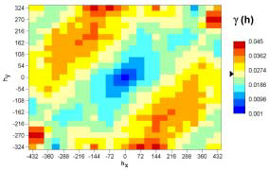
1983 vs 1988

Slide 10
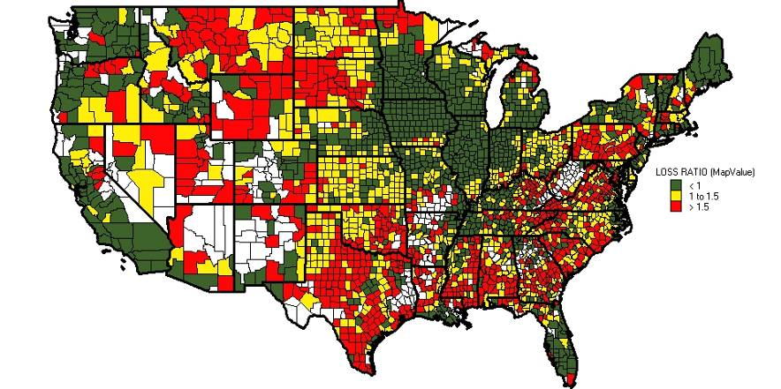
Loss Ratios Vary Across the Country
And so do underlying Yield PDFs

Slide 11
Challenges
Focus was only on 4 Illinois counties
How robust will the Vine Copula
  Given different regions with different underlying PDFs
  Given different spatial patterns for the extreme years
    Degrees of freedom are quite limited in the tail
  I would worry most about another 1993 event where part of core Midwest had poor yield and part had good yields

Slide 12
Does the paper answer the question: Why do we need the Government?
After spending 1989 working on the Congressional Commission for the Improvement and for the Secretary of Agriculture’s task force on the 1990 farm bill, I have been asking that question
This paper does not take the issue head on
1995 – Private work on reinsurance
  We were using copulas to adversely select against the government
  The Standard Reinsurance Agreement allows companies to pick and choose the risk they wish to retain; down to the farm level – the curse of a universally available crop insurance program
Postulate: The private sector would have this sorted and would have rates that reflect these tail risk

Slide 13
Vicious attack
In 1989, we were spending 500 million in subsidies
Today.. We have approach 10 billion
We are insuring crops and products that you can not imagine
Now.. The Congress wants to offer more coverage
Crop insurance subsidies are ‘somehow’ in compliance with WTO
Does the farm safety net create less risk or more?
Taking the risk out of agriculture; only causes farmers to take on more risk
The looming risk come from macro economic policy
Have we create a land price bubble?
When will we have the next farm crisis

Slide 14
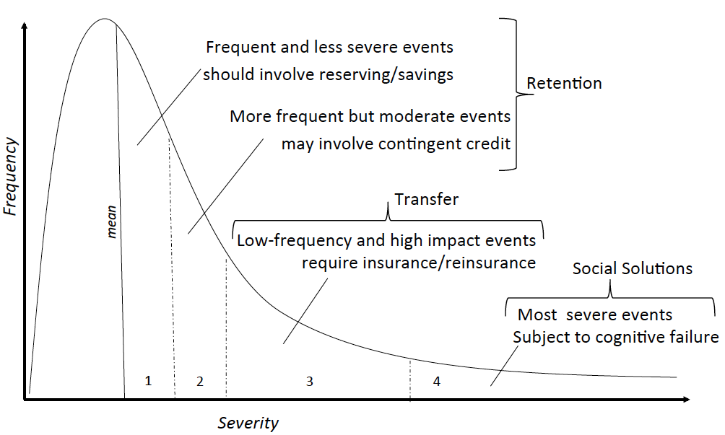
My Hobby Horse: Back to Basics

Slide 15
Spatial correlation of crop yields tends to be significantly stronger during extreme events
Significant implications for our efforts in developing countries
If we redesign these products so that optional savings is in the front layers and catastrophic insurance is in the tail
  We can significant reduce basis risk
Mario Miranda used copula to examine Iowa corn yields with relationship to rainfall and found significantly stronger correlation across space during the really low crop yield years

Slide 16
Thank you
Visit our website to learn more about our international work
www.globalagrisk.com

