Slide 1
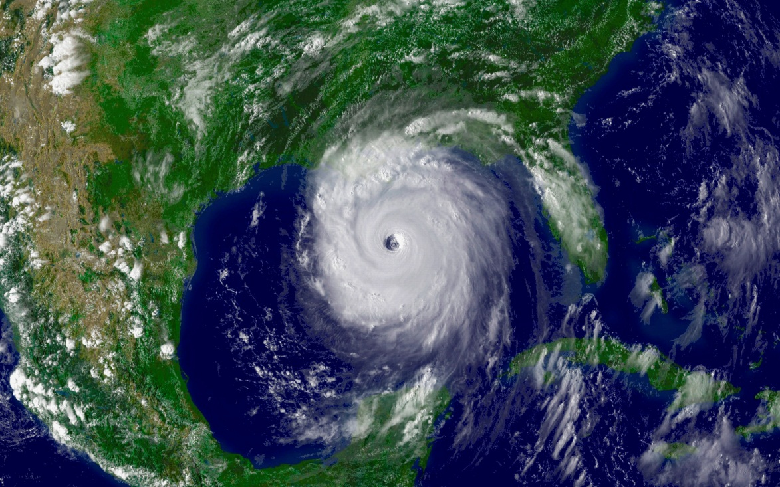
Basker & Miranda:
“Taken by Storm: Business Survival in the Aftermath of Hurricane Katrina”
Discussion by Jeff Brown
University of Illinois
and NBER

Slide 2


The Paper
Hypothesis: Local establishments that are part of larger firms are more likely to survive macro / infrastructure shocks
Evidence: Analysis of establishment level exit data following Katrina is consistent with this hypothesis
  Establishments part of larger firms less likely to exit
  Among smaller establishments, those physically closer to banks (but not dentists!) less likely to exit
  Robust to numerous robustness and falsification tests
Conclusion: Establishments in large firms either have better access to internal or external capital markets and/or insurance

Slide 3

Identifying Assumptions
Precise path of storm – and damage inflicted - was random within counties
  Seems pretty obvious that path was random
  (Unless you believe it was all part of God’s, or POTUS’, plan …)
  But there is spatial clustering of damage
    Most flooding occurred in high density urban areas
    Question: Do firms with many establishments locate in same locations as single-establishment firms?
Demand shocks following storm are fully accounted for by county and industry fixed effects
  Not obvious – one has to worry about whether control group is affected differentially
    Same question as above – do firms with many establishments locate in same areas as single-establishment firms?

Slide 4
Control Group Concerns
Authors are aware of the concerns, and have a nice discussion of these issues in Section 8
Difference-in-difference with establishments in non-damaged areas ignores that these areas may have experienced positive demand shocks (the people had to go somewhere!)
  There is a pattern of relocation of workers/customers to unaffected areas
  Authors are promising future results on this – e.g., time trend of employment per establishment in undamaged areas – not yet in paper
Authors discarded too quickly the idea of exploring alternatives
  “An alternative approach would be to replace the nearby control group with a control group that was not affected by the storms at all, possibly located in other states. The problem … is that … may have experienced an altogether different set of shocks”
  Perhaps try propensity score matching with out of region counties?
  Perhaps try randomly assign out-of-state counties as controls, do it many times, and see how often you fail to reject the null?

Slide 5
Interpreting the Results
Establishments associated with larger firms are more likely to survive over subsequent two years. What does this mean?
Maybe larger firms have easier access to internal credit?
Maybe larger firms having easier access to external credit?
Maybe larger firms having more insurance (e.g., business interruption insurance, property insurance, flood insurance)?
Maybe it is differences in skills – (people with post-disaster experience)?
Maybe larger firms have more robust risk management / disaster preparedness plans and processes?
Maybe larger firms are better able to take advantage of government insurance and disaster relief programs
Paper has convinced me that larger firms less likely to exit
But I am not sure we know why … at end of the day, we don’t really know if the amount of exit that we observed was efficient or not

Slide 6
Convergence
Over longer time period, the difference between large and small firms shrinks.
What does this mean?
Large firms rationally considered the option value of keeping a small operation?
Large firms were doing it for national P.R. value?
Large firms made a mistake in staying open?
  Inefficiencies in the internal capital market?
Small firms more easily able to take advantage of bankruptcy protection?
  Do sole proprietors start up new business?

Slide 7
Proximity to Banks …
Plausible to think bank proximity might matter
  Petersen and Rajan show that geographic proximity to banks matters. Degryse and Ongena have done similar work for European banks.
  Some evidence that “relationship lending” is becoming less important (replaced with small business credit scoring), but typical small business still has a primary business that is physically near, especially for unsecured lines of credit.
But, banking density is not random
  Use of dentists is creative and useful for ruling out factors correlated with population density
  But may be a bit “too removed” from business considerations – bank proximity may be correlated with proximity to supply chain, for example.
    Proximity to interstate exits?

Slide 8
A Few (Minor) Suggestions
Finish all the promised analyses … because they are good ideas!
Can we establish geographic pattern of establishment location by firm size in advance of Katrina?
Is it possible to establish degree of damage, rather than just indicator variable? Specifically, should I worry whether establishments from smaller firms suffered worse flooding/wind, conditional on being damaged?
Do we have information about geographic concentration of establishments within a firm?
  It may not be size of firm per se, but what fraction of a firm’s overall establishments that were affected, that matters

