Slide 1
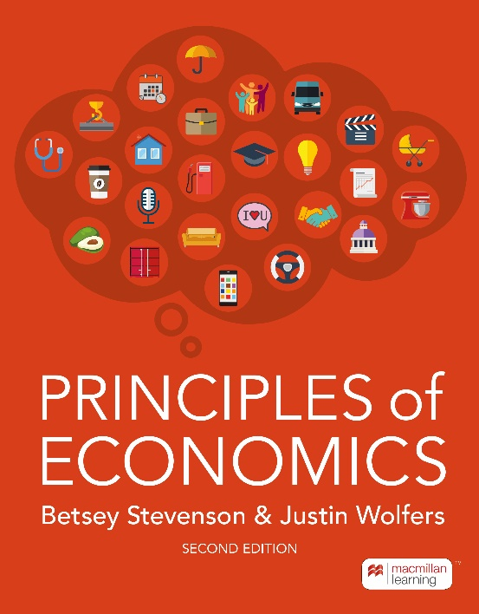
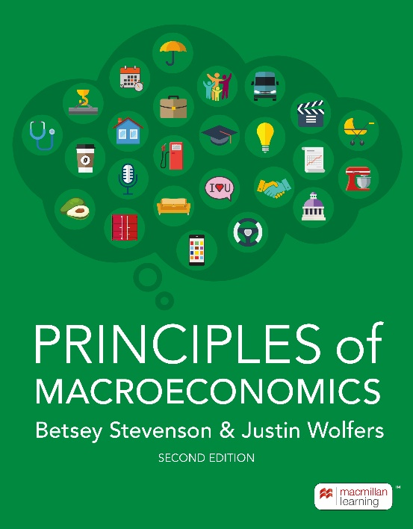
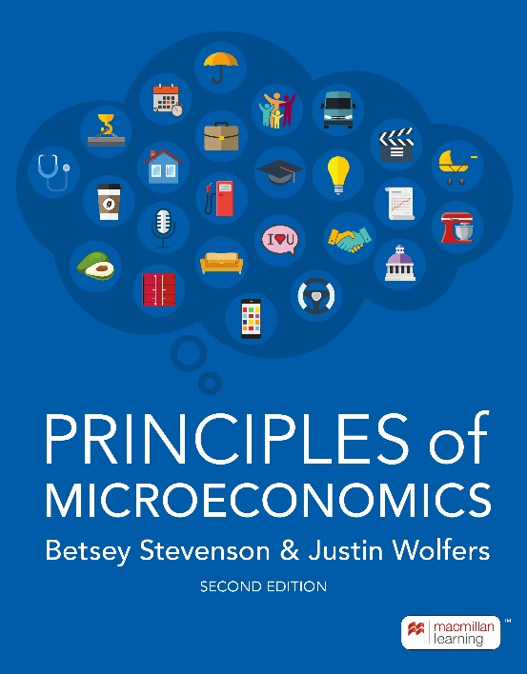
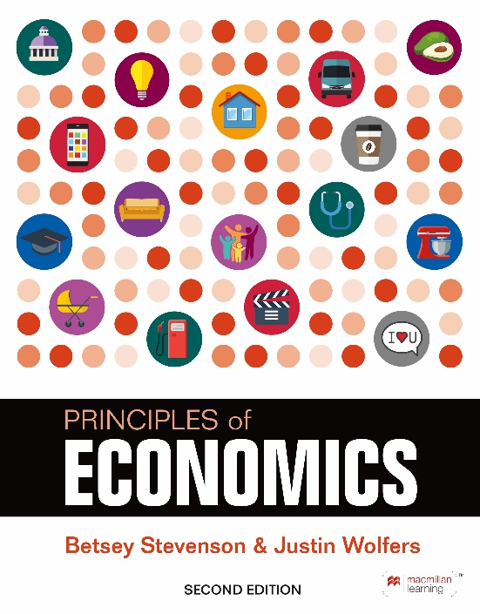
Is it a spike, or a surge?
Lessons from the early 2020’s inflation
Betsey Stevenson and Justin Wolfers
Authors, Stevenson & Wolfers, “Principles of Economics”
March 2023
Notes:
These slides were put together in mid-January 2023. The point is to show recent trends in inflation, and put them into the context of the conceptual framework taught in the Phillips Curve chapter of Stevenson and Wolfers
Athis point none of us know exactly where inflation is going: Hence the title “is it a spike, or a surge?”
Beyond teaching about inflation, a key learning objective here is to show students how economists assess things in real time
A related objective is to illustrate how there can be (good faith!) debate, and how our early conclusions are necessarily tentative.

Slide 2
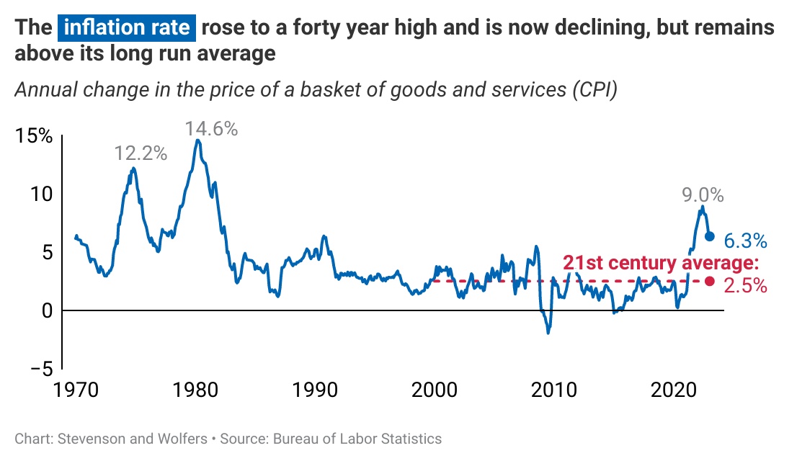
Inflation since 1970
Notes:
The point of this chart is to put the recent spike into historical perspective, and also to show the (at this time, incomplete) fall through early 2023.
Also, note: While the Fed targets 2% inflation, that’s 2% on the PCE deflator, which is typically around ½ a percentage point below CPI inflation. So 2.5% CPI inflation would be roughly compatible with the Fed’s target.

Slide 3
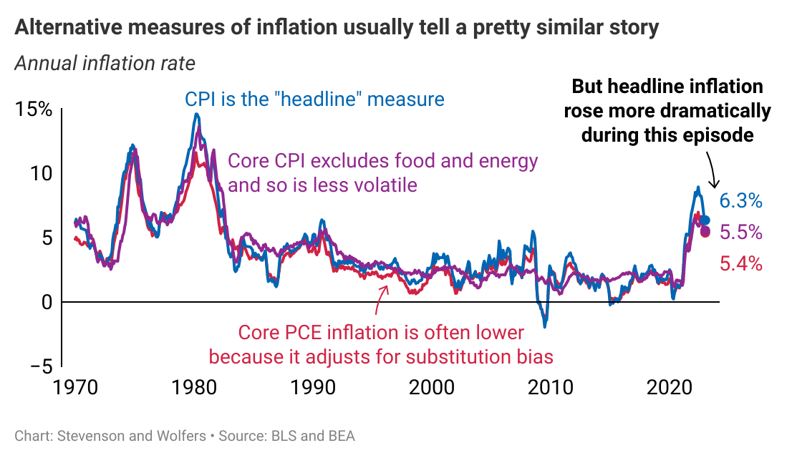
Alternative measures of inflation
Notes:
A useful opportunity to remind students why we have alternative measures of inflation
Headline CPI is a measure of the rising cost of living
But sometimes the prices of food and energy rise and fall (by a lot!) for idiosyncratic reasons.
Food prices are currently affected by the (lack of) production and exports (particularly of wheat) from Ukraine, drought in some parts of the world, to bird flu (currently causing egg prices to rise) or a disease that’s currently driving lettuce prices higher.
And energy prices often rise and fall due to wars or geopolitical tensions (for energy) – and right now the most important shock is that Russia isn’t selling energy to industrialized countries. (More on this later)
As such, focusing on core CPI provides a smoother and more stable measure that arguably better reflects underlying economic conditions
The PCE deflator is the index the Fed focuses on, and while it has a lot in common with the CPI, the key difference is that it adjusts for substitution bias – that is, it accounts for changes in spending patterns -- and so tends to be about a quarter or half point lower than CPI).

Slide 4
A framework: Three causes of inflation
Inflation =
Expected inflation
Demand-pull inflation
Cost-push inflation
+
+
↑inflation expectations → ↑inflation
↑output relative to potential → ↑inflation
↑production costs
→ ↑inflation
Inflation
Inflation expectations
Unexpected inflation
Phillips Curve
Unexpected inflation
New
Old Phillips Curve
Output gap
Output gap

Slide 5
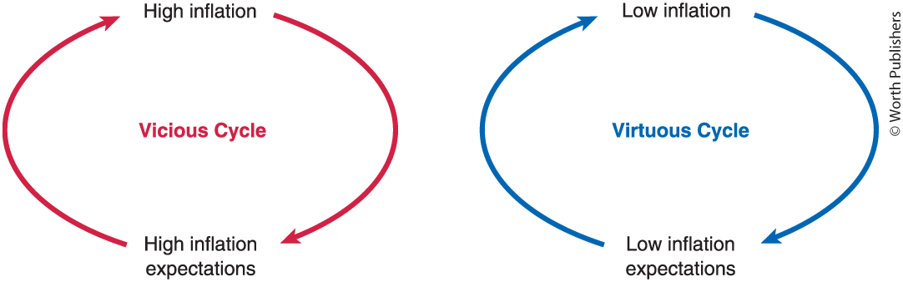
Cause #1: Inflation expectations
Where we were
(1990s through 2020)
Where we don’t want to go (re-run of the inflationary 1970s)

Slide 6
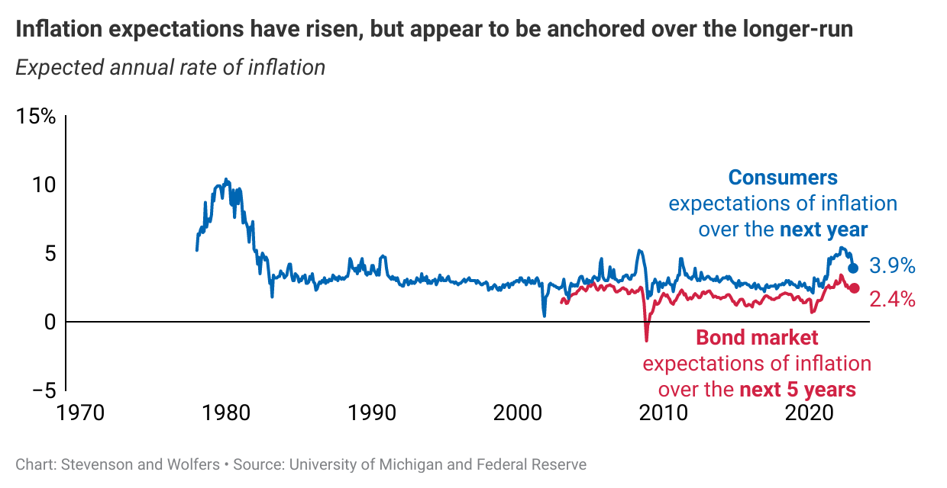
Cause #1: What can data on inflation expectations tell us?
Open questions
Whose expectations are most relevant?
  We have data from consumers, financial markets, and professional economists?
Which time horizon is most relevant?
  Expectations over the next year, next 3-5 years, or the long run (10+ years)
Notes:
This graph suggests that inflation expectations – particularly the short-run expectations of consumers – did rise, and are now falling, but longer run expectations (particularly of more sophisticated bond market players) remain close to the Fed’s target.
This also provides a useful opportunity to discuss different measures of expectations:
Consumers (Michigan survey) v. Bond market (difference between the yields on non-indexed and inflation-indexed bonds) v. Surveys of economists (not shown here)
…whose expectations are most relevant for inflation?
Short run (next year) versus longer run (next few years) versus long run (usually a decade or longer).
…over which horizon are expectations most relevant?

Slide 7
Cause #1: What can theories of inflation expectations tell us?
Adaptive expectations: Recent inflation is our best guide to the future
  Inflation expectations will remain high (for as long as inflation remains high)
Anchored expectations: Expectations are anchored to the Fed’s target
  Inflation expectations will continue to be 2%
Sticky expectations: People only revise their views about inflation sporadically
  Rising for some: Those who are yet to adjust their views in light of recent high inflation
  Falling for others: Those who are yet to adjust their views in light of the (recent) fall in inflation
Rational expectations: Inflation expectations reflect all available data and a deep understanding of macroeconomic relationships
  Best proxied by bond market expectations (which remain relatively low)
…Different models (and different data) yield sharply different perspectives

Slide 8
Cause #2: Demand-pull inflation (“demand shocks”)
Inflation =
Expected inflation
Demand-pull inflation
Cost-push inflation
+
+
↑inflation expectations → ↑inflation
↑output relative to potential → ↑inflation
↑production costs
→ ↑inflation
Inflation
Inflation expectations
Unexpected inflation
Phillips Curve
Unexpected inflation
New
Old Phillips Curve
Output gap
Output gap

Slide 9
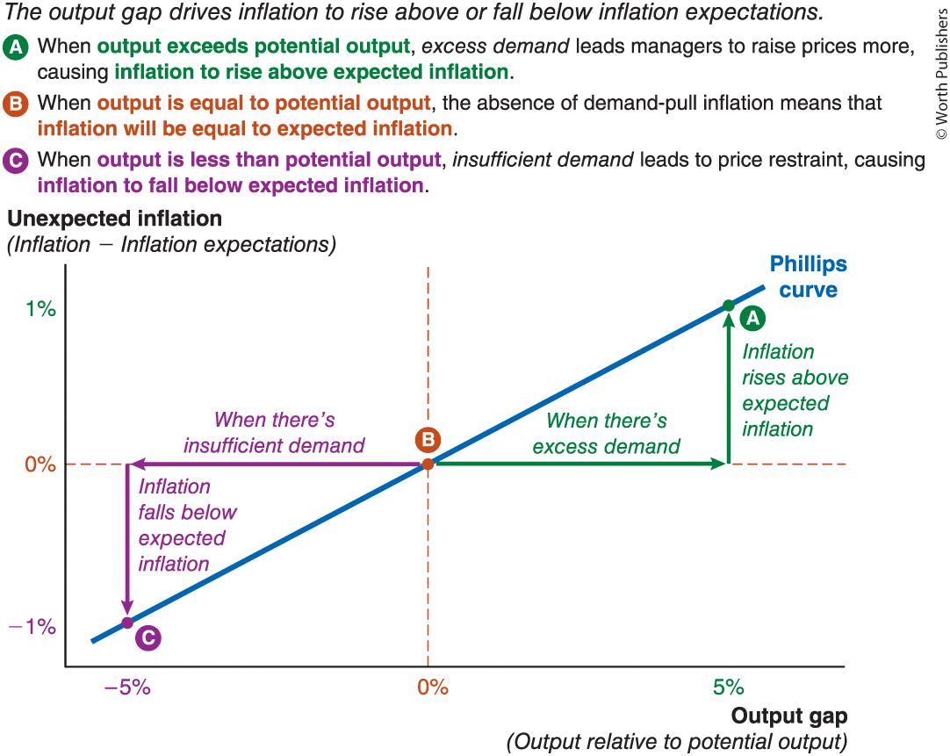
Cause #2: Demand-pull inflation (“demand shocks”)
Key question:
How much excess demand is there?
Different measures of excess demand:
Output gap
Unemployment rate
Employment rate
…each yield different insights

Slide 10
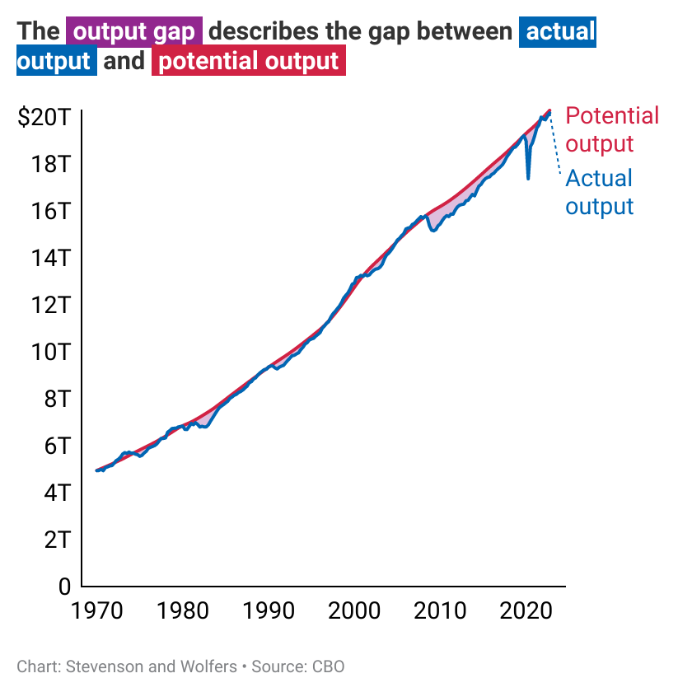
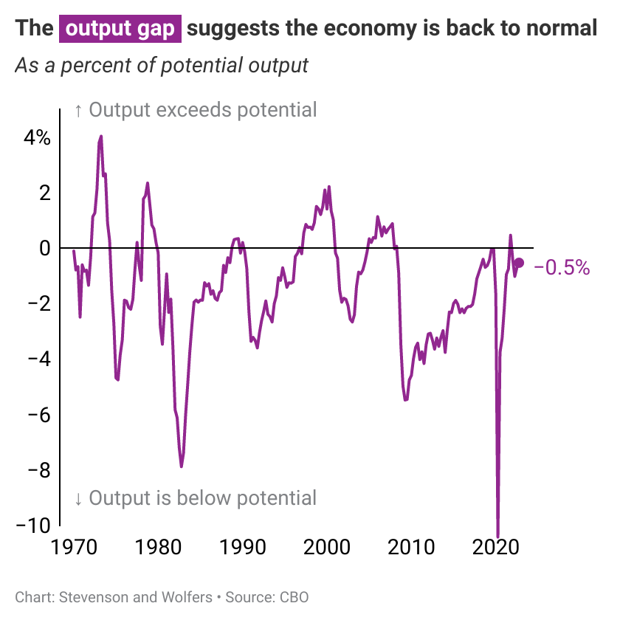
The output gap suggests the economy is close to normal
But how confident can we be that we know what potential output really is?

Slide 11
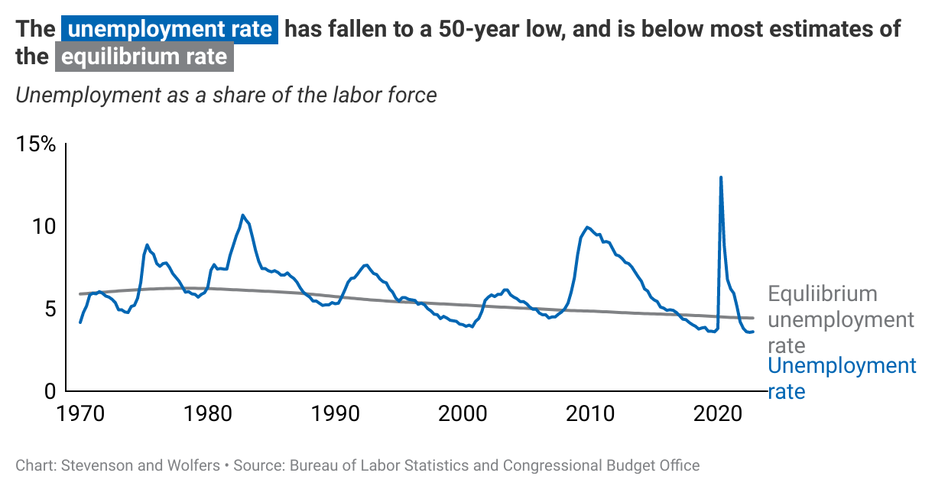
The unemployment rate suggests the economy may be overheating

Slide 12
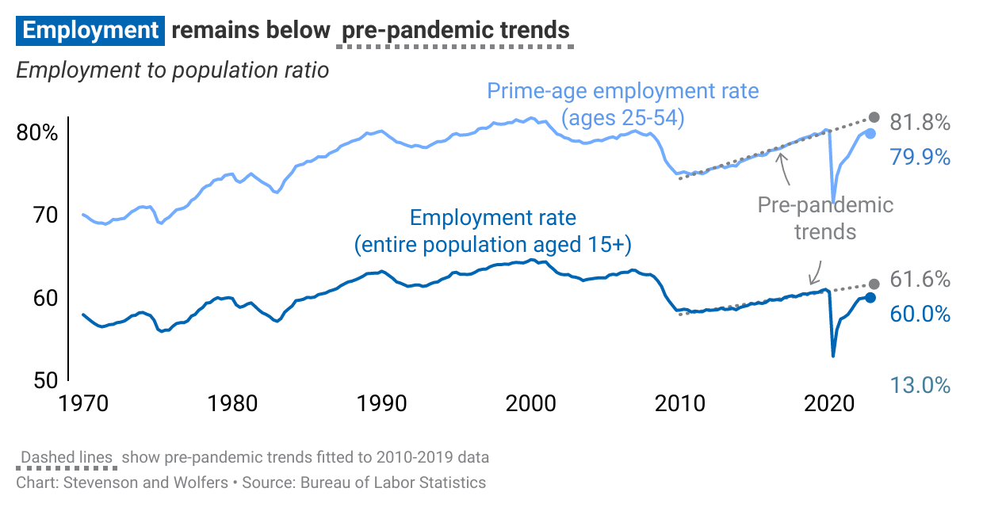
The employment rate suggests the economy has a lot of unused capacity

Slide 13


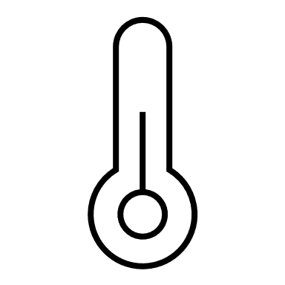
It is unclear how much demand-pull inflation has been a factor
If Goldilocks were evaluating this economy, she is a bit unsure whether it is:
  Too hot
    The unemployment rate is near a 50-year low
  Too cold
    The employment-to-population rate is still quite a bit below pre-pandemic trends
  Just right
    Real GDP is close to estimates of potential output
If this feels a bit unsatisfying, that’s because
  Evaluating the state of the economy is hard
  Data often give conflicting messages
  This is especially true in the wake of a pandemic (not your usual economic shock, is it?)
  …these are themes that will repeat when we turn to other causes of inflation

Slide 14
Did sectoral shocks cause bottlenecks?
The usual story of demand-pull inflation is about the whole economy
  Demand outstrips capacity → bottlenecks → higher prices
But the pandemic was different:
“The big pivot” was a sectoral reallocation from services → goods → services
  Pre-vaccine pandemic: Massive growth in the goods sector, partly offset by weakness in the services sector.
    An example: More Pelotons, fewer gym memberships
    Created bottlenecks in the goods sector
  Post-vaccine re-opening: Consumers returned to buying services (and fewer goods)
    Reducing bottlenecks in the goods sector
    Recently: Is this creating emerging bottlenecks in the service sector?

Slide 15
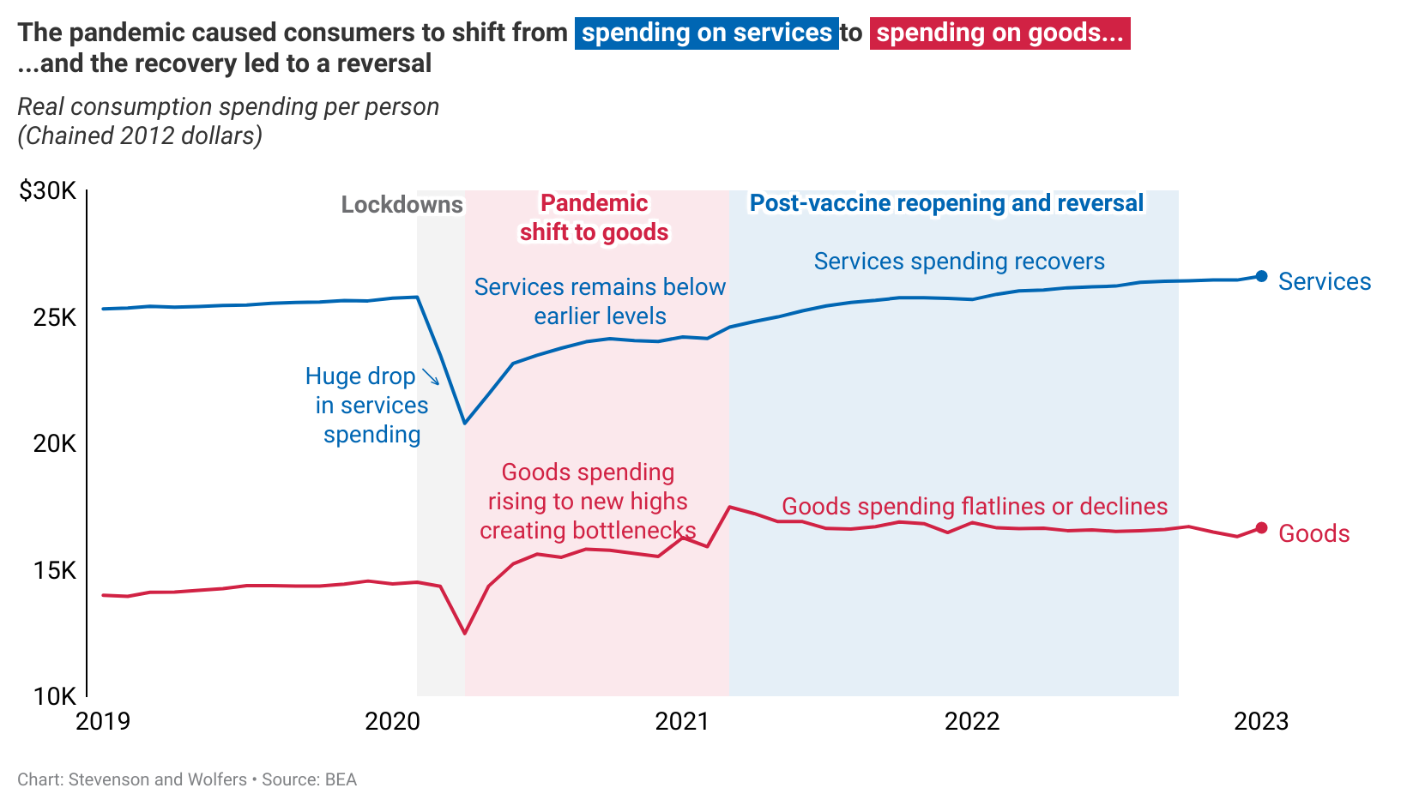
A new kind of bottleneck?
The shift from services, to goods, then services
Notes:
The usual Phillips Curve story is one of a tight macroeconomy leading bottlenecks to emerge.
But the pandemic was different: It led to massive growth in the goods sector, partly offset by weakness in the services sector. (Why? The virus made in-person interactions – that is, services – dangerous)
That massive sectoral shift created bottlenecks – though mainly confined to the goods sector
The next slide will show the effect on goods versus services inflation

Slide 16
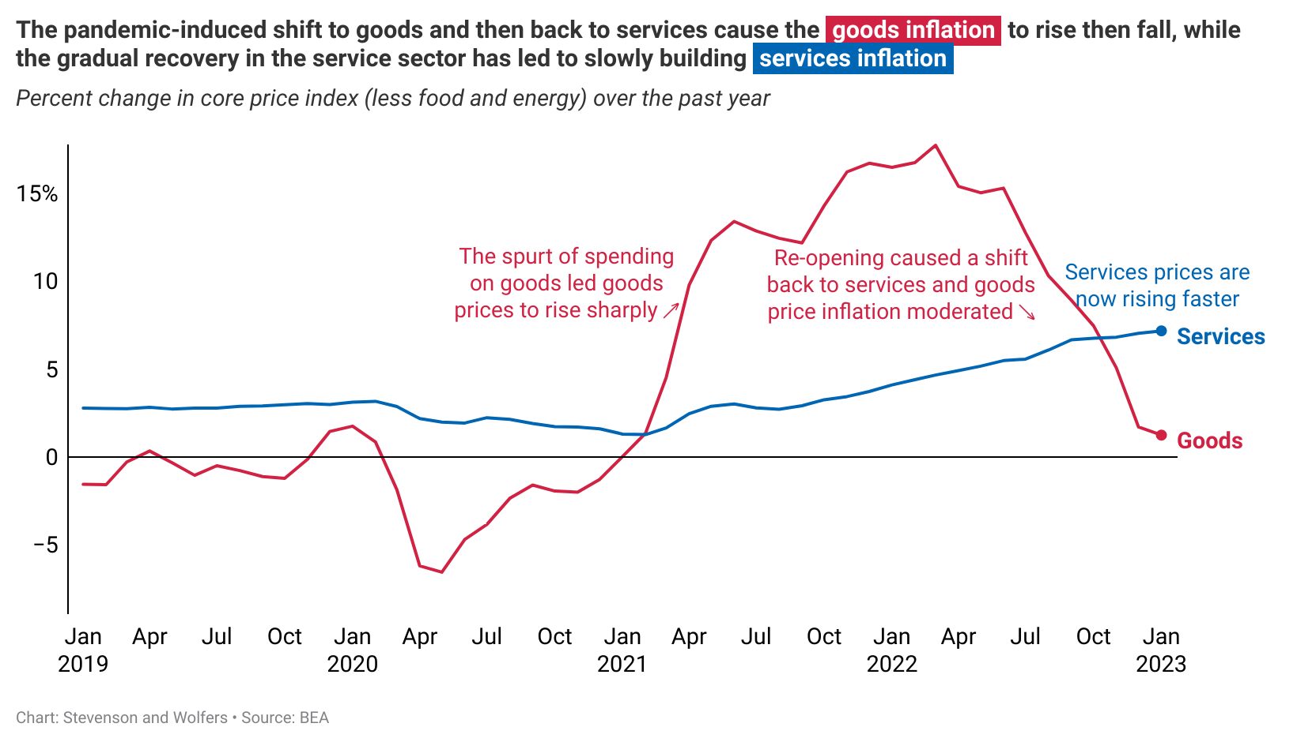
The unbalanced nature of inflation
Notes:
Worth pointing out that concern over inflation has – in recent months – shifted almost exclusively to concern about services prices.
Rent is a big part of services inflation
And labor costs are important in the service sector
…this explains why the labor and housing markets are coming under closer scrutiny.

Slide 17
Cause #3: Cost-push inflation (“supply shocks”)
Inflation =
Expected inflation
Demand-pull inflation
Cost-push inflation
+
+
↑inflation expectations → ↑inflation
↑output relative to potential → ↑inflation
↑production costs
→ ↑inflation
Inflation
Inflation expectations
Unexpected inflation
Phillips Curve
Unexpected inflation
New
Old Phillips Curve
Output gap
Output gap

Slide 18
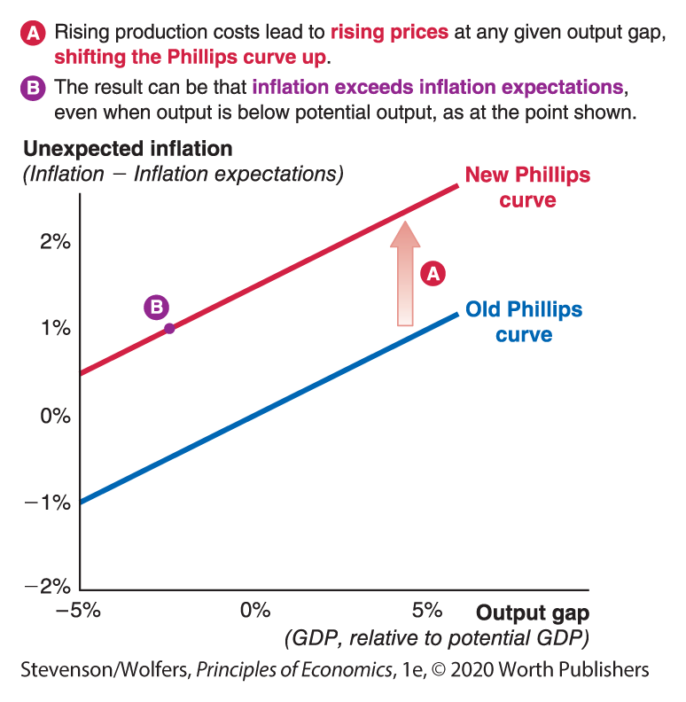
Cause #3: Cost-push inflation (“supply shocks”)
Rising production costs shift the Phillips Curve up, leading to higher inflation
Recent supply shocks
Pandemic-related disruptions
Global supply chain disruption
Rising energy prices due to Russia’s invasion of Ukraine
Concern about rising wage costs and the risk of a wage-price spiral
…let’s explore each, in turn
Rising production costs

Slide 19

Supply shock #1: Lockdowns had minimal direct effect on inflation because reduced supply was matched by reduced demand
A rough-and-ready analysis
  Can think of this analysis product-by-product (micro), or in the demand for “stuff” (macro)
An equivalent description using the language of macroeconomics:
  If supply (potential output) fell by (say) 20%
  …and demand (actual GDP) also fell by the same amount
  The output gap ($=\frac{Actual −Potential }{Potential}$) was unchanged
Price
Pandemic Supply
Pre-pandemic Supply
No change in price
Unexpected inflation
Phillips Curve
Phillips curve:
No change in output gap
⇒ No change in inflation
Pandemic Demand
Pre-pandemic Demand
Output gap
Quantity
Large fall in quantity
Notes:
If you teach using AD-AS, explain the left panel using that language
If not, explain this as an approximation that applies (roughly) product-by-product (or ask students to think about the market for “stuff”)

Slide 20
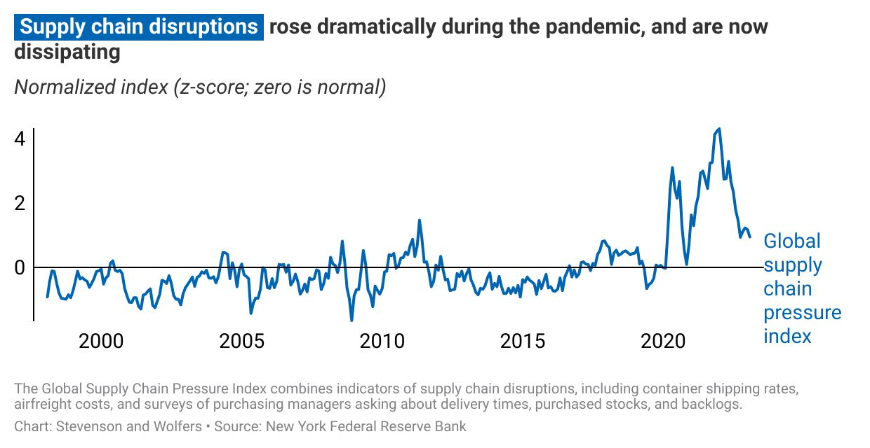
Supply shock #2: Supply chains disruptions raised transport costs

Slide 21
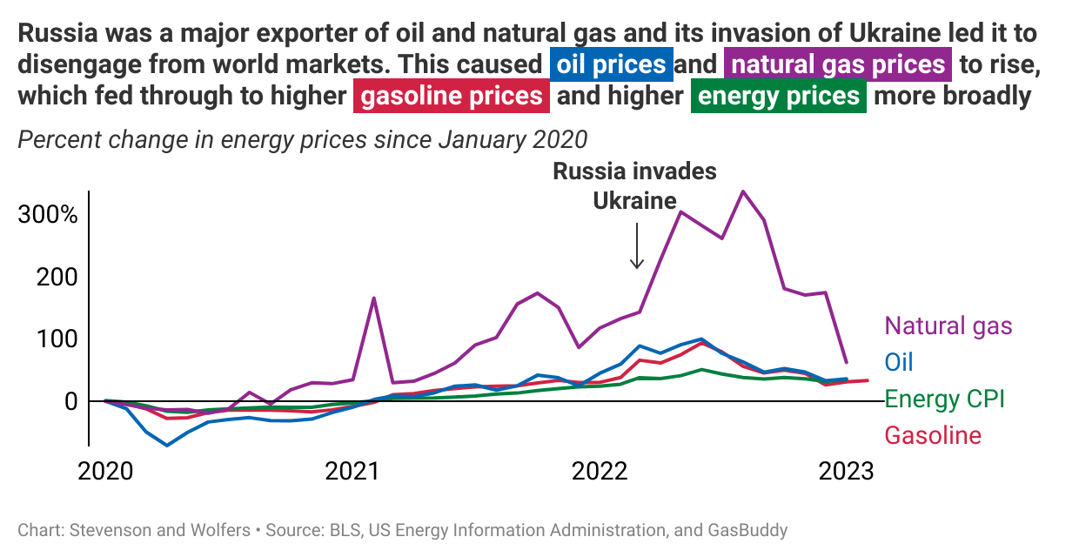
Supply shock #3: Russia’s invasion of Ukraine pushed up energy prices

Slide 22
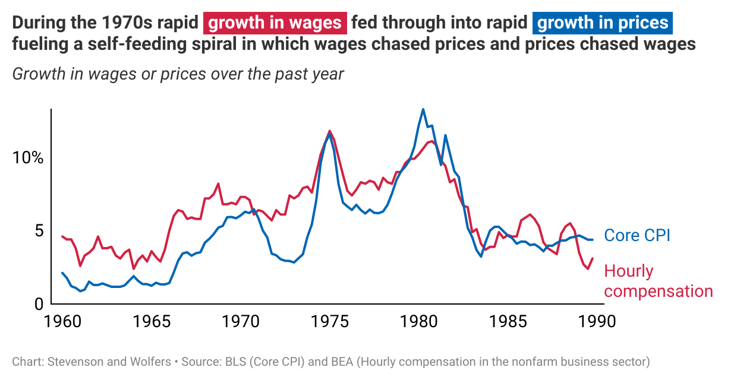
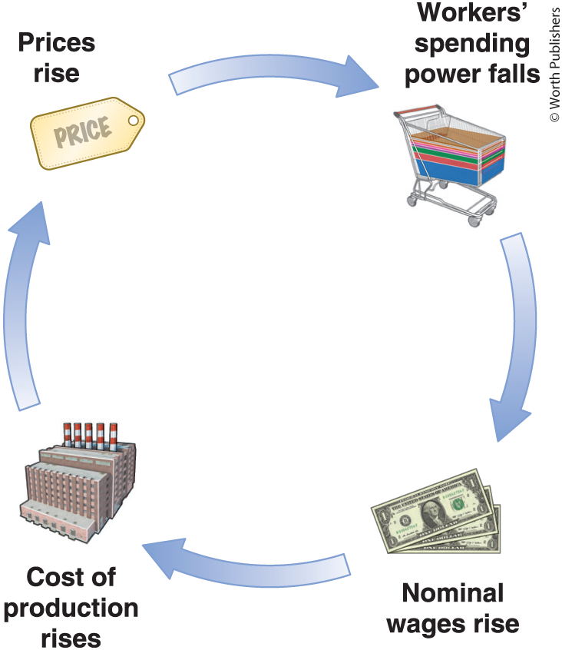
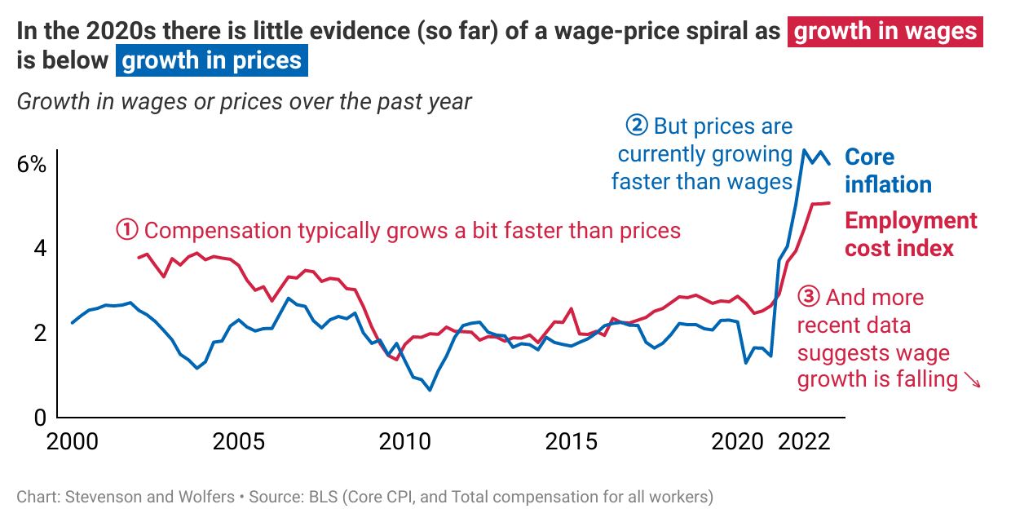
Supply shock #4: Were fears of a wage-price spiral realized?
Then →
(It happened)
Now →
(Looks unlikely)

Slide 23
One more possibility
Inflation =
Expected inflation
Demand-pull inflation
Cost-push inflation
+
+
Measurement error
+
Notes:
The purpose of this section is to tie back to material on how inflation is measured.
The pandemic (and re-opening) are useful teaching points, because the usual biases were reversed.
…I would recommend treating this as an optional extra

Slide 24
Difficulties measuring inflation
 | “Normal” times | Pandemic
Substitution bias (The CPI is based on a fixed basket of goods and services, but people change what they buy) | People buy more of the stuff that’s getting cheaper | People bought more essentials (food) whose prices were rising and fewer inessentials (flights) whose prices were falling
Discounts | Many discounts offer many opportunities to substitute to cheaper goods | Few discounts, and so less substitution
Outlet bias (The CPI considers a good from outlet A to be different from the same good from outlet B) | Purchase goods at (cheap) in-person stores | Purchase from (expensive) delivery services
Variety bias (A greater variety of goods provides you with more ways to achieve a given standard of living) | More varieties are becoming available | Fewer varieties of goods were available
Stockouts (The CPI ignores goods that are out of stock, effectively saying their prices rose at the average rate. But didn’t their prices effectively rise to $∞?) | Rare | What is the price of a dumbbell that you can’t buy? Or of childcare that’s unavailable?
CPI usually overstates the “true” rise in the cost of living

Slide 25
Difficulties measuring inflation
… during a global pandemic
 | “Normal” times | Pandemic
Substitution bias (The CPI is based on a fixed basket of goods and services, but people change what they buy) | People buy more of the stuff that’s getting cheaper | People bought more essentials (food) whose prices were rising and fewer inessentials (flights) whose prices were falling
Discounts | Many discounts offer many opportunities to substitute to cheaper goods | Few discounts, and so less substitution
Outlet bias (The CPI considers a good from outlet A to be different from the same good from outlet B) | Purchase goods at (cheap) in-person stores | Purchase from (expensive) delivery services
Variety bias (A greater variety of goods provides you with more ways to achieve a given standard of living) | More varieties are becoming available | Fewer varieties of goods were available
Stockouts (The CPI ignores goods that are out of stock, effectively saying their prices rose at the average rate. But didn’t their prices effectively rise to $∞?) | Rare | What is the price of a dumbbell that you can’t buy? Or of childcare that’s unavailable?
CPI usually overstates the “true” rise in the cost of living
Pandemic CPI understated the “true” rise in the cost of living

Slide 26

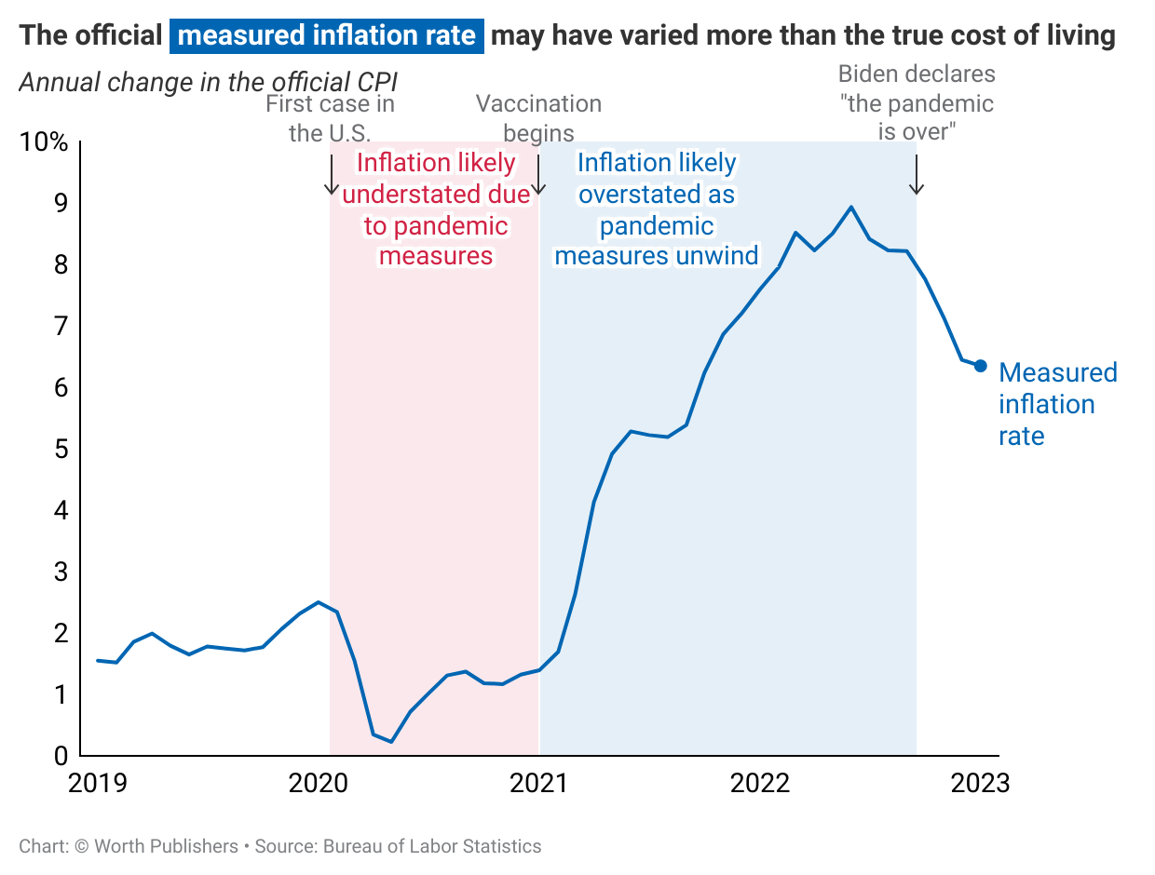
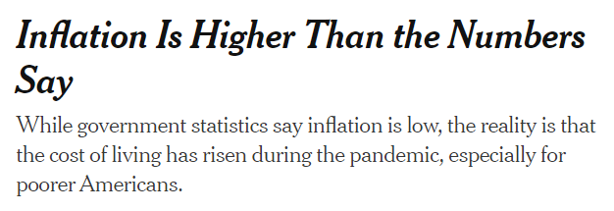

Difficulties measuring inflation through a pandemic
Argument: The pandemic made economic life more expensive in ways not counted by the CPI
Implications:
Official measures understated true inflation through 2020
As pandemic measures unwound, official measures overstated the true rate of inflation through 2021/22
Source: https://www.nytimes.com/2020/09/02/business/inflation-worse-pandemic-coronavirus.html
Notes:
This is a useful opportunity to talk about measurement issues in the CPI
The textbook discusses the usual case, which is that in normal

Slide 27
One more possibility
Inflation =
Expected inflation
Demand-pull inflation
Cost-push inflation
+
+
Measurement error
+
Your goal: Use this framework to interpret the policy debate, and forecast inflation
Notes:
The purpose of this section is to tie back to material on how inflation is measured.
The pandemic (and re-opening) are useful teaching points, because the usual biases were reversed.
…I would recommend treating this as an optional extra

Slide 28
Two (linked) debates about inflation
Transitory v. Persistent
“Team transitory” argued that the pandemic-related disruptions would work their way through the system pretty quickly, and then inflation would return to “normal” (around 2 percent)
“Team persistent” worried that the forces driving inflation higher were more persistent, and that a low unemployment rate, combined with a big fiscal stimulus led the economy to overheat, causing inflation
Supply v. Demand
Supply shocks are often transitory
Pandemic-related disruption are temporary
Supply chains will unsnarl over time
As soon as gas prices stop rising (even if they’re high) they stop contributing to inflation (which is the rate of change of prices)
Policy recommendation: Patience. Inflation will pass, so policy should focus on achieving full employment → expansionary fiscal/monetary policy
Demand shocks cause excess demand and inflation
The economy bounced back to near full-employment
Subsequent fiscal stimulus and low interest rates would likely cause overheating
Excess demand will persist, unless policy adjusts
Policy recommendation: Must eliminate excess demand by slowing the economy to reduce inflation → contractionary fiscal/monetary policy
Notes:
The debate about whether inflation would be transitory or persistent pretty much defined policy debates through 2021-23.
In turn, that debate is linked to whether the key shocks hitting the economy have been supply shocks, or demand shocks.
Ask students on where they come out on this debate
Ask what evidence might help convince folks one way or the other

Slide 29
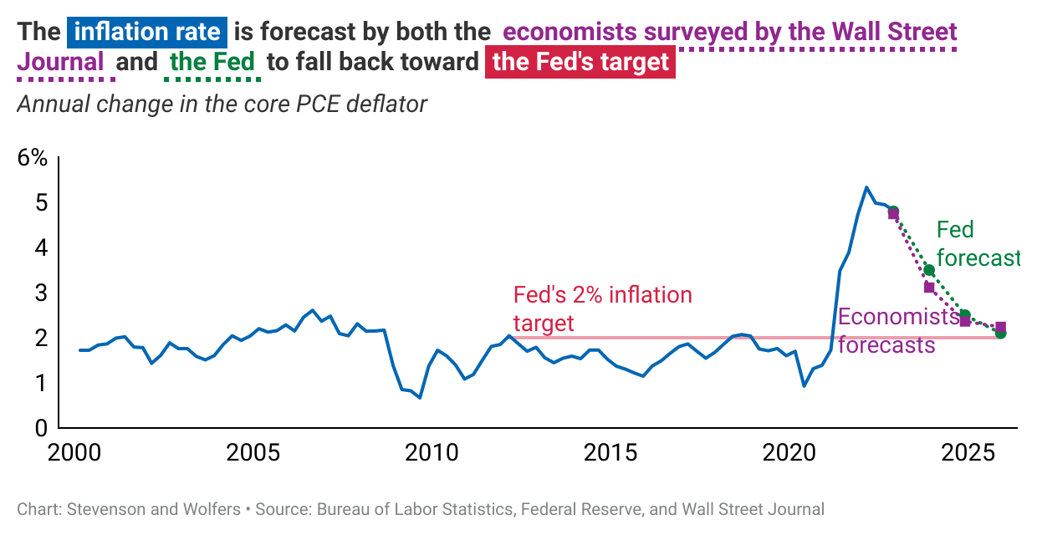
Looking forward: What do the experts say?
Notes:
This chart suggests that the Fed and private-sector forecasts expect the economy to move back toward two percent inflation over the next two years.

Slide 30
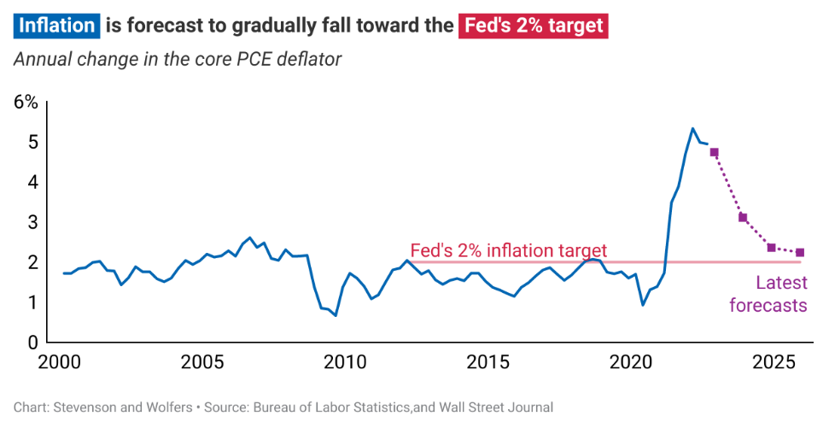
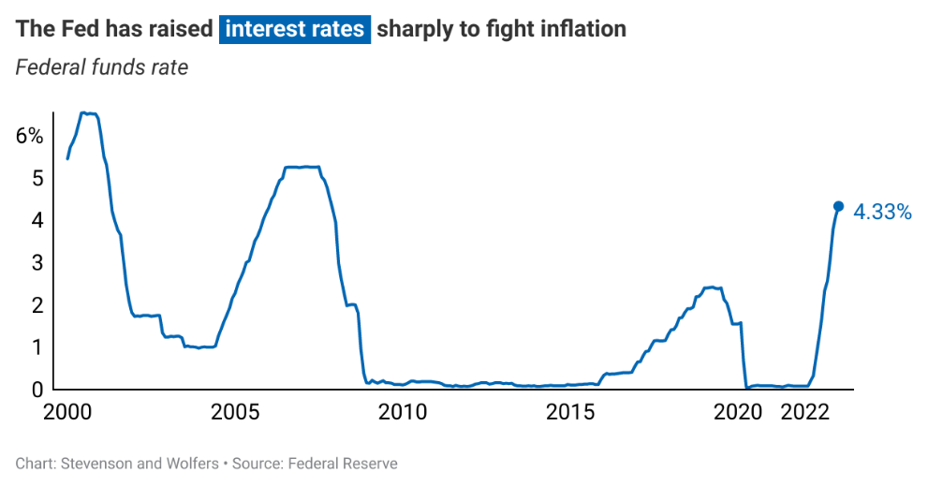
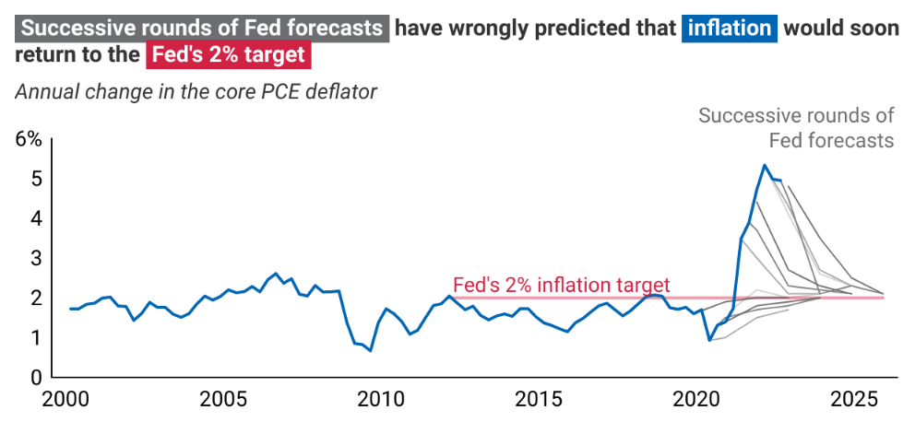
Ongoing policy debates and discussion questions:
Latest forecasts suggest inflation will gradually return to the Fed’s 2% target
Does this suggest that the shock was transitory
  Where “transitory” means a few years, rather than a few months?
Or is this due to the Fed fighting inflation?
  By raising rates and slowing the economy?
Or is this forecast wrong?
  Economists have been consistently wrong in forecasting that inflation will soon return to low levels

