Slide 1
Long-Term Changes in the Wage Structure of Taiwan
Some Observations
Maggie McMillan
IFPRI, NBER & Tufts

Slide 2
Observations
Timely and important research
Missing the employment side of the picture
Careful with education – what is counterfactual?
Use Autor, Katz, Kearney regression (2008) to distinguish between alternative explanations
My (biased) interpretation of data

Slide 3
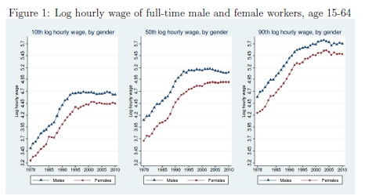
Stagnation Starts in 1990s

Slide 4
What Else is Happening in 1990s

Slide 6
Trends in American Wages and Employment
Point: Manufacturing jobs well paid but are being lost.

Slide 7
Offshoring to PRC by US MNCs
Point: Manufacturing jobs well paid but are being lost.

Slide 8
Remaining Questions
Can your data be used to examine wages by sector and gender?
How different is Taiwan from other industrialized countries?
How has integration with PRC impacted wages in Taiwan?
Can you measure labor demand?

