Slide 1
Discussion
Globalization, structural change and productivity growth
Margaret McMillan and Dani Rodrik
By
Chedtha Intaravitak
June, 15, 2012

Slide 2
Outline
About the paper:
Stylized facts
Key insights
Main contribution
Findings
Discussions
On structural changes
On comparative advantage
On the U curve
On regression
On policy implications

Slide 3

About the paper
Stylized facts:
Developing countries exhibit more variability in sectoral productivities compared to that of developed countries. This is especially true between “traditional” and “modern” sectors.
Productivity of agriculture compared to non-agriculture exhibits a U shape pattern as level of development increases (across countries) and (for individual country) overtime.
Key insight:
Although productivity “within sector” does not increase but if there’s labor migration from low-productivity to high-productivity sectors (structural change), there might be an overall productivity gain.
Main contribution:
Decomposition of productivity growth into “within-sectoral” and “inter-sectoral (structural changes)” components.

Slide 4
About the paper
Findings:
In Asia, structural changes reinforce “within-sectoral” productivity growth, whereas, in Africa and Latin America, they went in the opposite direction.
Country level analysis:
In some Latin American countries, negative relationship between relative productivity and employment share. Labor moves out of high-productivity manufacturing into low-productivity services (e.g. community, social, personal and government services).
Results for African countries are mixed. Labor moves back into low-productivity agriculture. Manufacturing expanded slightly and even contracted in some countries.
In Asia, labor moved out of low-productivity agriculture into high-productivity manufacturing.
Regression analysis:
Initial structure of economy (proxy by agriculture labor share) → +
Comparative advantage in natural resource (proxy by raw material export share) → -
Exchange rate (+)/ employment rigidity index (-)

Slide 5
Discussion
On structural changes
“In some economies, structural changes are more complex and dynamic. Some countries in Asia, especially those who have gotten out of Middle Income Trap (MIT) such as Korea and Taiwan, are experiencing “de-industrialization”. Labor not only has moved out of agriculture but also out of manufacturing into services (see table 1a). Arguably, service sectors have lower productivity compared to manufacturing sectors (see table 1b). Still, these countries seemed to fare well in terms of productivity growth (see Table 1 in the paper).”
“How about using agriculture labor share “overtime” and “manufacturing labor share” overtime?”

Slide 6
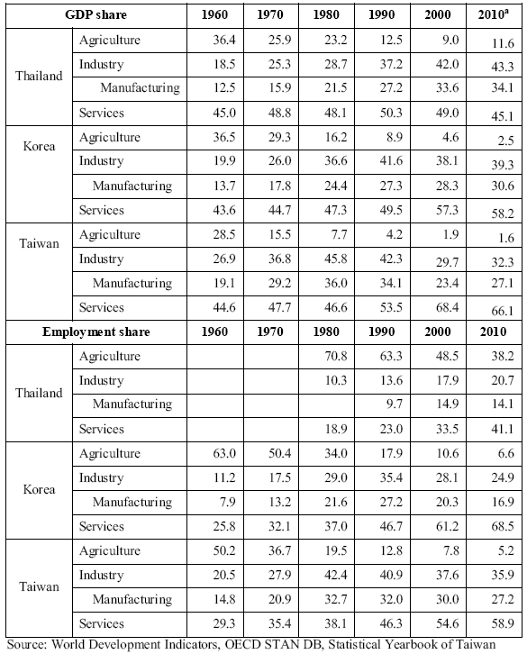
Discussion
Table 1a: Changes in employment share during 1960-2010 in Thailand, Korea and Taiwan
From Kim J. (2012), “Structural Transformation of the Newly Industrialized Economies and its Implications for Thailand.”

Slide 7
Discussion
Table 1b: Changes in GDP share during 1960-2010 in Thailand, Korea and Taiwan
From Kim J. (2012), “Structural Transformation of the Newly Industrialized Economies and its Implications for Thailand.”

Slide 8
Discussion
Table 1 (from paper): Summary statistics

Slide 9
Discussion
On comparative advantage (1)
“How do we account for the “dynamic changes” in patterns of comparative advantage and “special characteristics” of these new-exporting sectors? This issue is particularly relevant for those new high-income countries such as Taiwan, Korea, Singapore, etc., in which their comparative advantage appears to move up the value chain?”
“Perhaps, only using natural resource share in export is not enough to capture this phenomenon.”

Slide 10
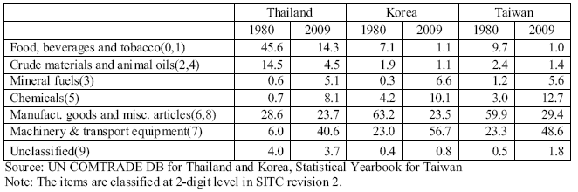
Discussion
Table 2: Export share between 1980-2009 in Thailand, Korea and Taiwan
From Kim J. (2012), “Structural Transformation of the Newly Industrialized Economies and its Implications for Thailand.”

Slide 11
Discussion
On comparative advantage (2)
“In general, including “indicators of comparative advantage” (such as Revealed Comparative Advantage; RCA), of these “modern exporting sectors” should have positive sign in the regression.”
“But not necessarily, some of these higher value added sectors (or slices of sectors if there is international fragmentation of production process) may not be able to absorb surplus labor. These activities have high value added but require highly-specialized skills and are rather capital intensive, for example, designs of vehicles (or automotive parts), medical R&D, textiles designs, etc. The situation is similar to “mining” sector in the paper, where mining has high productivity but cannot absorb much labor. This issue is also related to “labor rigidity”, as only “specialized-skilled” labor can participate in these production slices.”

Slide 12
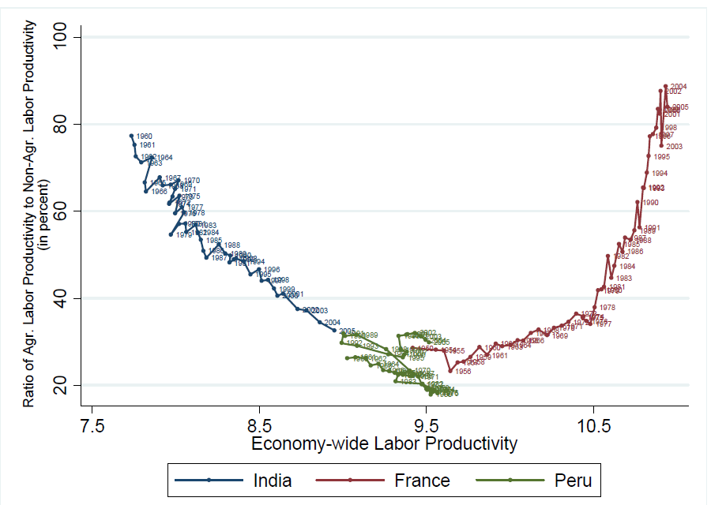
Discussion
On the U curve
“What does the U curve look like for countries that could get out of MIT? If labor moved into services, manufacturing productivity should increase, so the curve should continue to go down? (no decreasing marginal product of labor in manufacturing).”

Slide 13
Discussion
On regression
“In the regression: how about estimating both “within-sectoral” and “inter-sectoral” productivity growth as simultaneous equations (to account for “spill-over effects”) and add variables capturing technology transfer, R&D in applied science, etc.”

Slide 14
Discussion
On policy implication
Policy dilemma:
“Should we follow comparative advantage and “share” gains from trade or aim for high productivity? Justin Lin’s idea of following changing comparative advantage: China is moving towards higher value added activities leaving millions of labor-intensive manufacturing jobs for less-developed countries. These countries (with surplus labor) should follow suit. In the past, China used to promote (and failed in its attempt) heavy industries at the time its economy did not have comparative advantage in these areas. Is this lesson relevant to our discussion?”

Slide 15
Thank you!

