Slide 1
Discussion
Long-Term Changes in the Wage Structure of Taiwan
Stacey H. Chen
By
Chedtha Intaravitak
June, 15, 2012

Slide 2
Outline
About the paper:
  Key contribution
  Interesting observations
Discussion on some issues
  Wage polarization and education wage premium
  Age-earnings profile by cohorts
  Other minor points about the paper write-up

Slide 3

About the paper
Key contribution:
Documenting changes in Taiwan wage structure from 1978 to 2010 highlighting key issues that need further explorations.
Interesting observations:
Closing gender wage gap due to median and bottom 10th percentile male wage stopped growing 10 years (mid 1990s) before those for female did (in mid 2000s).
Wage inequality is severe especially for the “top-end” (90/50 percentiles) and among females. Wage polarization Taiwan style: differs from that for the U.S., U.K. and Thailand.
Education wage premium (high-school wage premium) does not accord well with supply-side story.
Age-earnings profile peaked rather soon (especially for median and bottom 10th percentile) and inter-cohorts gaps vanishes.

Slide 4
Discussion
Polarization and education wage premium
Wage polarization in Taiwan

Slide 5
Polarization and education wage premium
Wage polarization in the U.S.
From Autor, Katz and Kearney (2008), “Trends in the U.S. Wage Inequality: Revising the Revisionists,”

Slide 6
Polarization and education wage premium
Wage polarization in Thailand
Change in log real hourly wage by percentiles, 1987-2006
From Lathapipat, D. (2009), “Changes in the Thai Wage Structure before and after the 1997 Economic Crisis,”

Slide 7
Polarization and education wage premium
Wage polarization in Thailand
From Lathapipat, D. (2009), “Changes in the Thai Wage Structure before and after the 1997 Economic Crisis,”

Slide 8
Polarization and education wage premium
Wage polarization in Thailand
“Analysis of whether education wage premium (which we use as a proxy for wage polarization) is supply or demand driven brings us to….”
Education wage premium
From Lathapipat, D. (2009), “Changes in the Thai Wage Structure before and after the 1997 Economic Crisis,”

Slide 9
Polarization and education wage premium
Wage polarization in Thailand
“To analyze education wage premium in more detail, he further divided the sample by experience.”
Education wage premium
From Lathapipat, D. (2009), “Changes in the Thai Wage Structure before and after the 1997 Economic Crisis,”

Slide 10
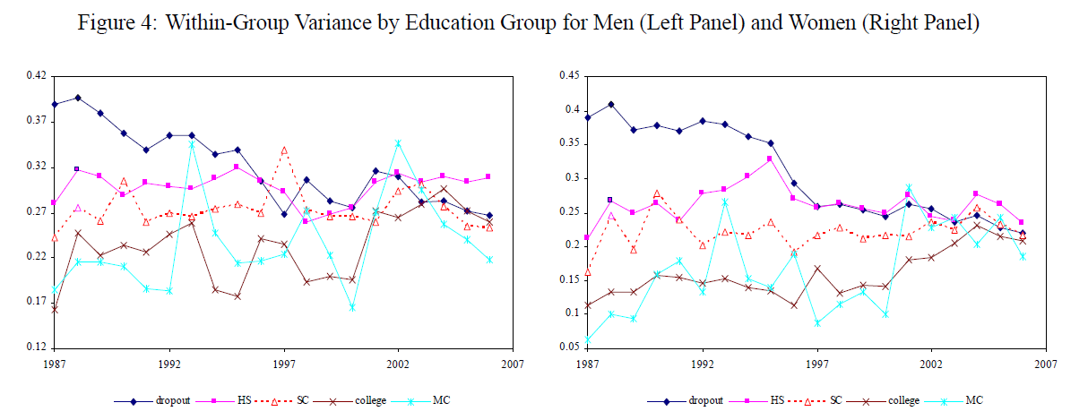
Polarization and education wage premium
Wage polarization in Thailand
“What about within group inequality (residual wage inequality)?”
Education wage premium
From Lathapipat, D. (2009), “Changes in the Thai Wage Structure before and after the 1997 Economic Crisis,”

Slide 11
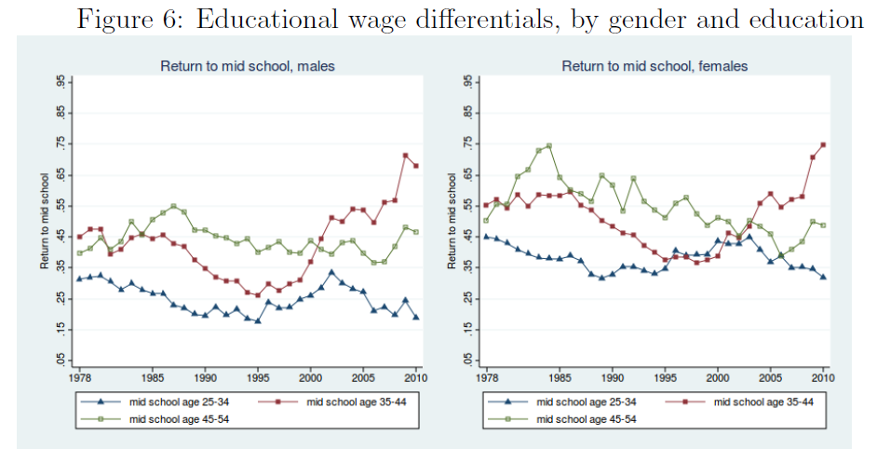
Polarization and education wage premium
“Like to see this analysis in the case of Taiwan
What we have…..

Slide 12
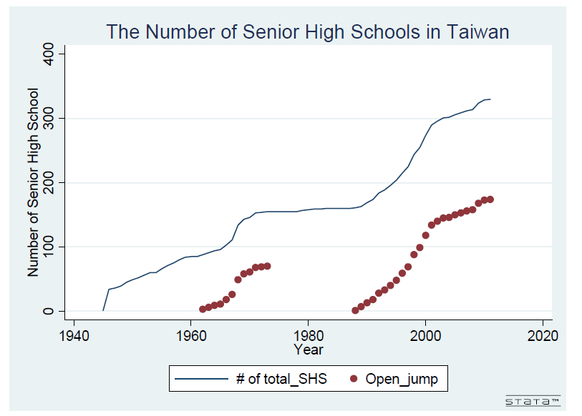
Polarization and education wage premium
and……
So…
1. Break education premium by experience (or age if there is a good theoretical model that is empirically implementable)
2. Get a better proxy of supply than # of schools opened.
3. Models “within-group” inequality.

Slide 13
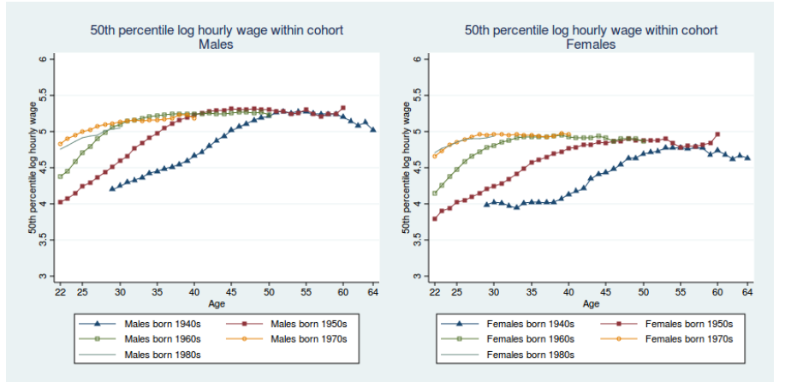
Wage-earning profiles by cohorts
New generations have higher education so started off with higher wage (even at same age as previous generations).
Women wage peaked sooner than men because less time to accumulate human capital due to pregnancy,
family care, etc.
Wage for different generations finally peaked at same level!
Median and bottom 10th percentile wage peak pretty soon? Concave pattern because after-retirement wage lower?

Slide 14
Other minor points
Clarifications: Use Middle school, high school in figures but use secondary school in text.
Missing references/ inconsistent format
Wrong reference to figures
Figure 5: Open-jumps?

Slide 15
Thank you!

