Slide 1
Comments on Retirement Patterns in China by Lei, Wang, and Zhao
Andrew K. Rose
UC Berkeley, CEPR and NBER

Slide 2
Summary
Descriptive analysis of major new Chinese data set
Focus: What drives incidence of retirement?
Key Finding: Big urban/rural differences
Urban retire sooner
Reasons both public (pension) and private (family income)

Slide 3
Early Days
Survey (and paper!) only recently completed
Some things unclear
Many aspects of data unexploited
Example 1: all health-, environment-related issues
Example 2: any use of longitudinal nature of data set (eventually? currently a cross-section?)

Slide 4
Still, Applause for Data Collection
CHARLS: an enormous new data set
Big Task (>10k households, >17k respondents, spread over 150 counties, 28 provinces)
Great Potential Payoffs

Slide 5
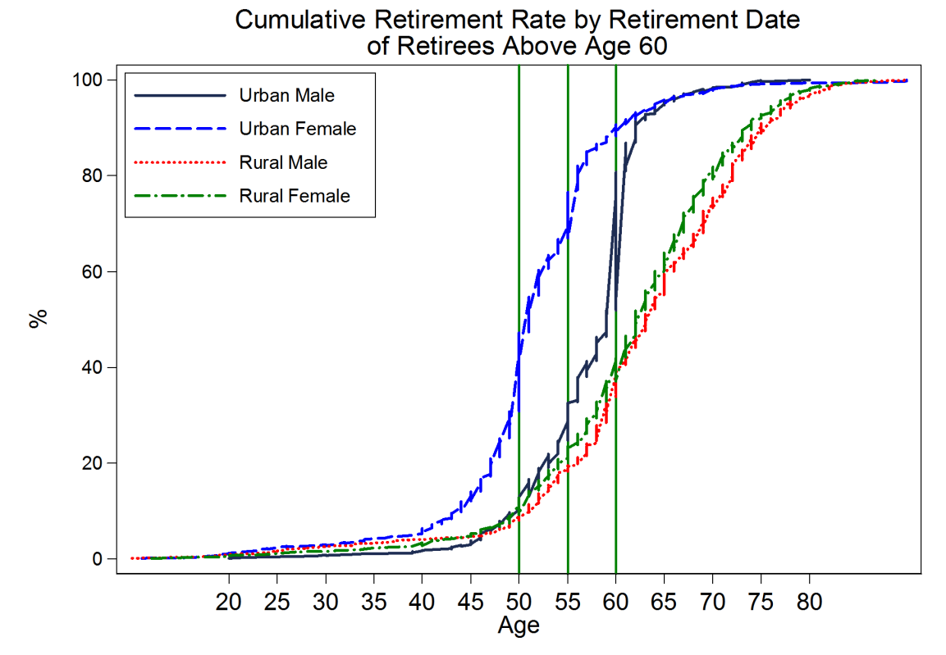
Urban/Rural Differences Striking

Slide 6
Why? Potential Explanations
Mandatory Retirement Policy
Strict in urban areas, especially for SOEs … but urban less likely to retire formally/in practice (p9)
Family Wealth
Hard to test with this data; consumption reflects many things
Support from Children
Small urban/rural differences in help
Size of transfers similar for urban/rural
More rural children (33%) give transfers than urban (18%)
Public Pensions
Higher urban (70%) than rural (41%) coverage
Urban (1350 RMB) much larger than rural (74 RMB)

Slide 7
Comment 1
Reasonable Definition of Retirement?
Not engaging in farm/non-farm work and not searching for job
But labor force members must be able to work
Shouldn’t retirement be distinguished from chronic illness?
Especially for elderly
Doesn’t explain finding
Rural have harder work than urban, worse healthcare

Slide 8
Comment 2
Suspicious of urban Chinese retirement rates
≈51% of Chinese are urban
Can they really be retiring so earlier
Absolute: >60% of urban Chinese 60-64 retired
Relative to OECD: <60% Koreans 65+ retired
60-64 retired: Germany, Canada, Japan have <60%

Slide 9
Comment 3
China faces serious demographic transition
Retirement ages are young compared to other countries, longevity, expense … (males 60, blue-collar women 50, white-collar women 55)
Early retirement also common, medical reasons
Hard to imagine these won’t change
Similarly, hard to imagine rural pensions will change if government wants to urbanize

